Slide 1
Classroom Learning Assessment Techniques
Dr. Rashmi Gore

Slide 2
Introduction
Assessment is compulsory for learning. It motivates students to learn and give them idea to identify the area for improvement.
Teachers assess students to fill the gap between their present status of performance and desired outcomes (regarding pre- planned cognitive, affective and conative objectives)
It provides feed back to teacher on what, how much and how well their students are learning

Slide 3
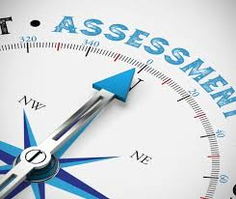
Meaning of Assessment
Assessment is the process of systematic gathering and organizing data of students’ achievement on knowledge, skills, attitudes etc. to refine program and enhance learning
Assessment is used during and after instruction

Slide 4
Contd.
It is the process of knowing learning- outcomes achieved by learners by applying variety of techniques like projects, assignments, tests, viva/ practical, presentations, case studies, performances etc.

Slide 5
Definition of Assessment
Educational Assessment seeks to determine how well students are learning and an integrated part of the quest for improved education. It provides feed back to students, educators, parents, policy makers, and the public about the effectiveness of the educational services –Educational Assessment by National Research Council, (2001,p.1)
Notes:
Assessment involves the use of empirical data on student

Slide 6
Contd.
Assessment involves the use of empirical data on student learning to refine program and improve student learning.------- (Allen, 2004)

Slide 7
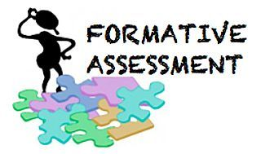
Types of Assessment : on the basis of objectives
Formative Assessment – It is the process which takes place during the instruction of students. Teachers take feed back of students’ learning and modify their teaching strategy accordingly

Slide 8
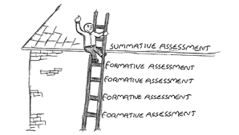
Summative Assessment –
It is the process to find out students achievement at the end of course. Marks or grades are assigned to students according to their performance.
Generally used for crediting, promoting, certifying and selecting .

Slide 9
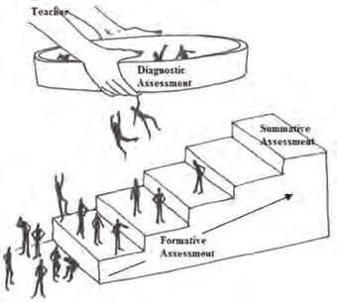
Contd.
Diagnostic Assessment
It is the process to know the student’s weakness and strengths in particular area of knowledge or skill. It is planned for providing remedial instructions to learners.

Slide 10
Some Terms which are close to Assessment
Test
Test is a measurement technique which is used to quantify behaviour.
Tests are done after the instruction has taken place
Tests are widely used by teachers for understanding and prediction of behaviour of the learners.

Slide 11
Contd.
Measurement
The process of obtaining numerical description of an examinee to the extent of degree he possesses
Variety of instruments may be used like tests, rating scales, assignments, projects etc. in this regard

Slide 12
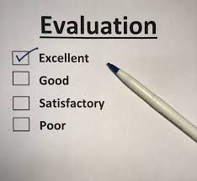
Contd.
Evaluation
Making judgment on value or worth of someone or something to improve its effectiveness (Judgment on performance as success or failure)

Slide 13
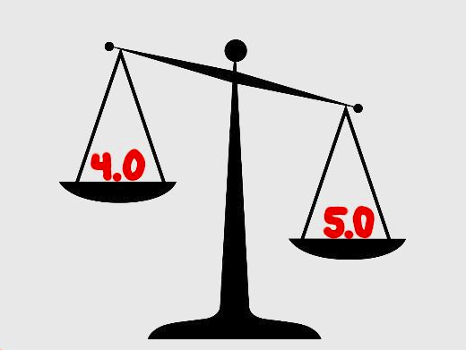
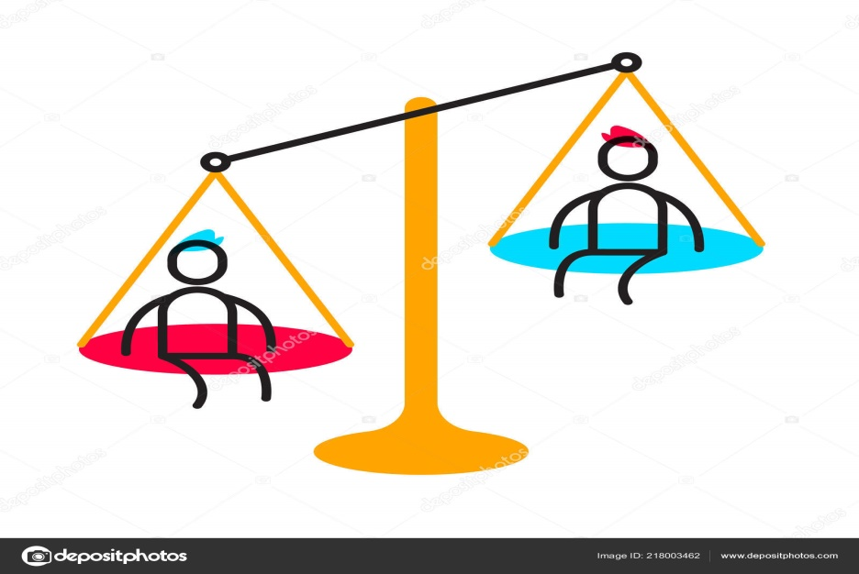
Classification of Assessment Techniques
Qualitative Assessment
It is also called directional assessment. It provides direction as an outcome without quantifying.
Quantitative Assessment
It focuses on countable values and evaluate a person’s knowledge, skill or any performance

Slide 14
Classification of Assessment Techniques
Qualitative
Quantitative
Cumulative Records
Anecdotal Records
Observation
Checklist
Rating Scale
Self reporting
Tests – 1.Oral/Interview or Viva-voce 2.Practical 3.Written- a. Essay Type b. Objective Type Test

Slide 15
Qualitative Assessment Techniques
Cumulative records
Permanent record of a student which is kept up-to-date by institution.
It covers educational information like attendance, academic progress, participation in extra curricular activities, interests, personality, IQ & EQ, character, likings, adjustment, health and other personal data from past to present.

Slide 16
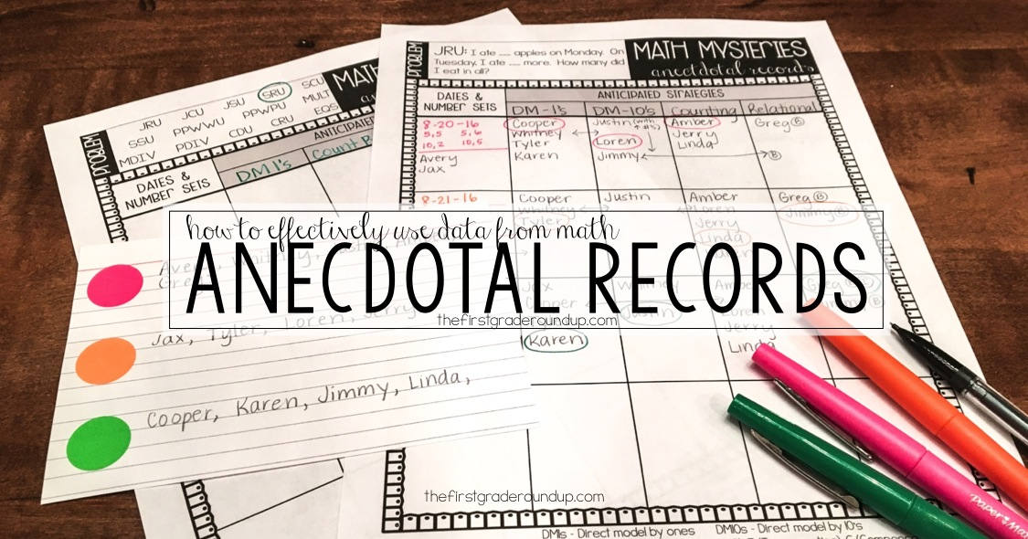
Anecdotal Records
These records are short, objective and descriptive summary of an event of students, written after the event has taken place
It helps teachers to understand student’s personality patterns and provide them guidance & counseling accordingly

Slide 17
Format of Anecdotal record Form

Slide 18
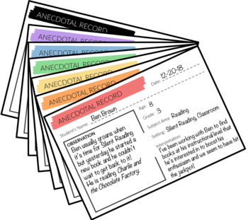
Some suggestions for preparing Anecdotal Records
It should be specifically narrating one event
Simple and accurate
Typical or unusual behaviour should be recorded
Record only directly observed behaviour
Write the record immediately after the event for accuracy
All records should be complete, complied and properly filed

Slide 19
Observation
It is an act of perceiving, noticing, viewing or monitoring someone or something and collecting information
As a tool of evaluation, observation is used to assess the cognitive, affective and psychomotor behaviour of students by perceiving their activities and responses
It is useful for assessing behaviours of young and shy learners, mentally retarded and children of other special needs.

Slide 20
Types of Observation
Planned Observation
Unplanned Observation
Direct Observation
Indirect Observation
Participant Observation
Non-Participant Observation
Controlled Observation
Uncontrolled Observation

Slide 21
Observation should be---
Selective or specific
Objective
Purposive and not casual
Scientific and systematic
Recorded
by trained person
verifiable

Slide 22
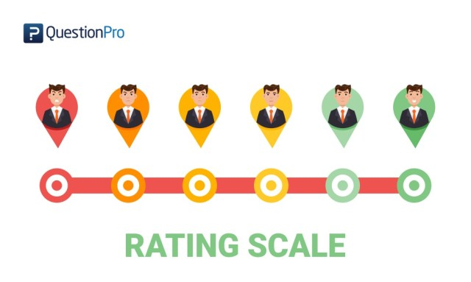
Rating Scale
Rating Scale is a device of evaluation where the opinion of judgment regarding any situation, character, behaviour is expressed on a scale.
A teacher indicates the degree of frequency on the behaviours or skills displayed by the student.

Slide 23
Contd.
Rating Scale may be defined as a set of categories designed to elicit information about a qualitative or quantitative attribute.

Slide 24
Types of Rating Scale
Check List
A check list is used to know the presence or absence of a trait in the learner.
There are some statements indicating presence/absence of a particular trait. A teacher observes
the behaviour of student and give decision on check list.

Slide 25
Numerical Scale
In this scale each statement is assigned a numerical score like 1,2,3,4,5,6,7 or even more. Teacher rates student to the extent as the trait is seen in his behaviour

Slide 26
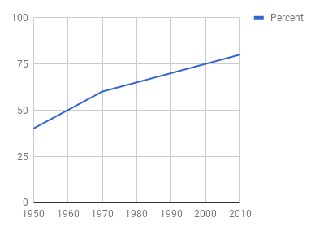
Graphic Scale
In this scale the presence or absence of trait is demonstrated on a horizontal line which displays the trait from lowest to highest.

Slide 27
Self Reporting technique
Self report technique of evaluation is used to ask students about their thoughts, feelings, attitudes, beliefs, behaviours etc.
Students can express themselves through paper-pencil mode or via electronic media. Open-ended questionnaire or interview tools may be used

Slide 28
Quantitative Assessment : Tests a. Oral/viva/Interviews
In oral assessment whether it is viva or interview teacher poses questions to the students in spoken form and students has to answer them showing sufficient knowledge of the subject
Oral test are conducted to evaluate students ability to present his knowledge in a well organized and cogent manner
Oral test are generally subjective in nature

Slide 29
b. Practical or Performance Tests
Practical or performance tests are concerned with testing student’s skills in a particular settings like laboratory, field, schools or any other set up.
Practical tests are conducted to take the feed back that how well can students implement theoretical knowledge in real situations.
Practical can be administered individually as well as in a group

Slide 30
c. Written Test
Written tests are the set of questions where students respond on that particular items through written verbal expressions. It may also be administered on a computer.
Written tests are the most popular and commonly used by teachers to get feed back on learning

Slide 31
Classification of written test : : On the basis of administration
Group Test – which can be administered to a large group of people at one time.
Individual Test- which is administered to one person at a time

Slide 32
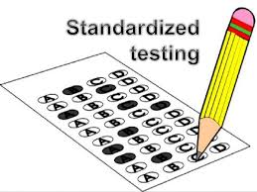
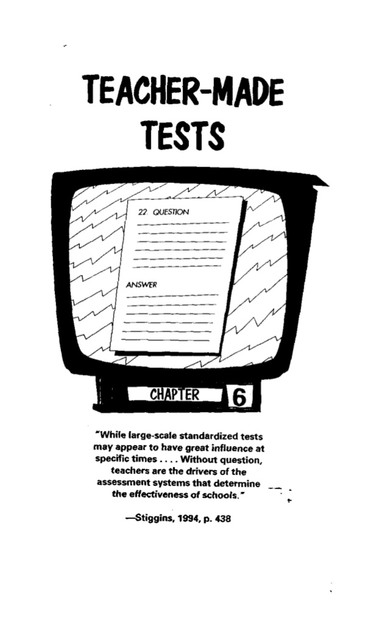
On the basis of test items
Standardized Test-which are constructed on a standard with its objectivity, reliability, validity, usability and interpretability
Non-Standardized Test or Teacher made Test- which are generally made by teacher to know their students achievement

Slide 33
On the basis of test items
Speed Test- When the students are required to respond to the items with speed and accuracy
Power Test- These tests are to measure students’ ability on responding more difficult items

Slide 34
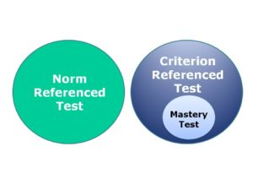
On the basis of objectives
Criterion referenced test – when students’ performances are measured on a particular pre-decided criteria to know their mastery of knowledge or skill on that particular subject
Norm referenced test-
When students performance is compared to other students in percentile terms

Slide 35
On the basis of Evaluation
Subjective Test or Essay Type -where students are free to respond on questions and examiners judge their ability of expression, creativity and originality with knowledge of subject. examiners may vary in their scores
Objective Test –where students are limited to respond within given choices. No biasedness of examiners for scoring even computer can check these tests.

Slide 36
Characteristics of subjective test
Easy to construct and administer
Learner’s organization and presentation of thoughts in logical manner can be evaluated
Suitable for all subjects
Evaluation, criticism, interpretation type objectives can be measured only by subjective test
It motivates students to induce good habits like organizing, comparing, narrating, summarizing, etc.
No chance of guessing

Slide 37
Limitations of subjective test
No coverage of full course
Students are motivated for selective reading
Scoring may be affected by good hand writing, neatness, length of answer, grammar etc.
Scoring is less reliable & less valid
Moods of examiners, personal biasedness, favoritism, weightages to different aspects of the answer may also affect the scoring value

Slide 38
Characteristics of objective tests
Objectivity
Comprehensive representation
Reliability
Validity
Easy to scoring
Practicability
(easy to administer on huge mass)

Slide 39
Limitations of objective test
No space for expression for students
Difficult to evaluate high level mental abilities like synthesis, evaluation, creation, imaginations etc.
Chances for students to anticipate answers
Difficult to construct
Costly
Standardization of test is a complex process

Slide 40
Classification of objective test
Supply Type (Recall Type)
FIB
Answer in one word
or Simple recall
Selective Type (Recognition Type)
MCQ
Matching type
True/False or correct/incorrect
Classification or odd one out

Slide 41
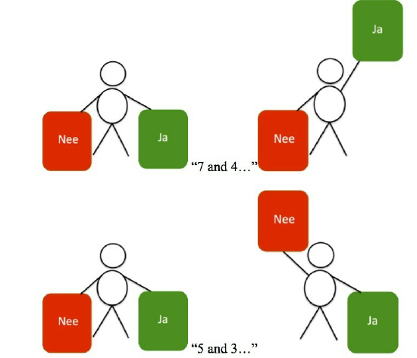
Some interesting & innovative cat (classroom assessment techniques )
Strategic questioning –asking high-order questions to students require more in-depth thinking. (why, & how)
3 -Way summaries- students have been asked to present summery of what they learnt in particular topic in 10-15 words, 30-50words,75-100words long
Think-pair-share- after posing a question to students they are placed in pairs to discuss the responses. Than they share it to class.

Slide 42
Contd.
3-2-1Countdown
At the end of learning students are asked to respond 3 statements-
3 things of it you didn’t know before
2 things that surprised
1 thing you want to start doing
Rubrics- in rubric teacher grade students work by specific component with a point value in a grid in predefined manner. It helps students to check their work before submitting, understand assignment & scoring system, and receive meaningful feedback.

Slide 43
References
Allen,2004.Assessing Academic Program in Higher Education. westminster.edu
http://www.bdu.ac.in/cde/docs/ebooks/B-Ed/I/ASSESSMENT%20FOR%20LEARNING.pdf

Slide 44
Thank You

