Slide 1
RC AND RL circuits Unit-2(ECE-S202) (Atul Kr. Agnihotri )
Problems in RC AND RL Circuits

Slide 2
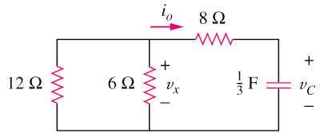
Problems of RL and RC CKT
Example 1
Refer to the circuit below, determine v_{C}, v_{x}, and i_{o} for t ≥ 0.
Assume that v_{C}(0) = 30 V.
Answer: v_{C} = 30e^{–0.25t} V ; v_{x} = 10e^{–0.25t} ; i_{o} = –2.5e^{–0.25t} A

Slide 3
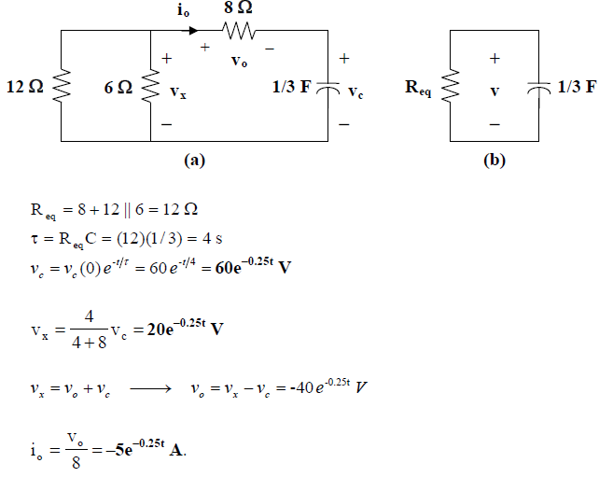

Slide 4
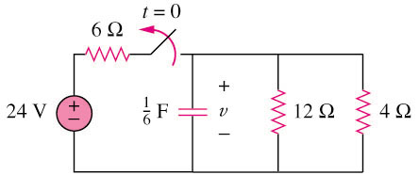
Example 2
The switch in circuit below is opened at t = 0, find v(t) for t ≥ 0.
Please refer to lecture or textbook for more detail elaboration.
Answer: V(t) = 8e^{–2t} V

Slide 5
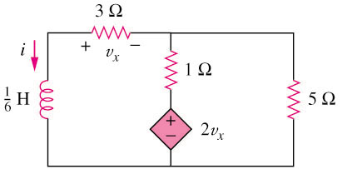
Example 3
Find i and v_{x} in the circuit.
Assume that i(0) = 5 A.
Answer: i(t) = 5e^{–53t} A

Slide 6
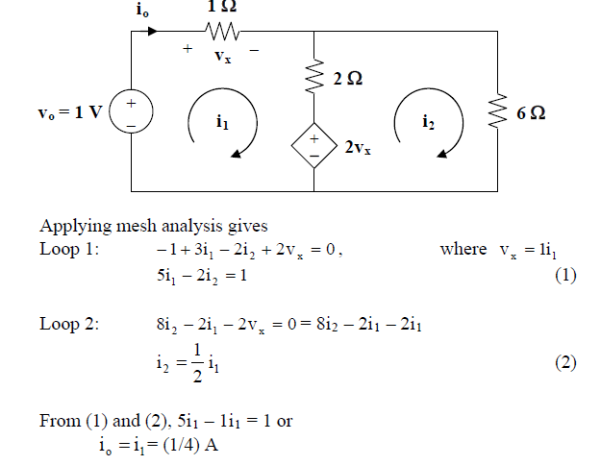

Slide 7
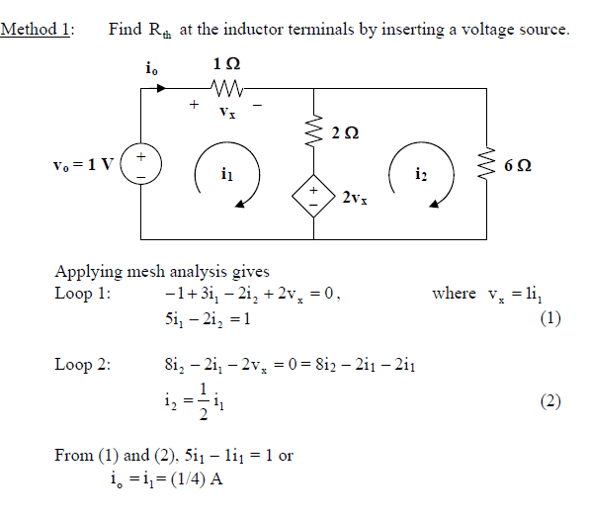

Slide 8
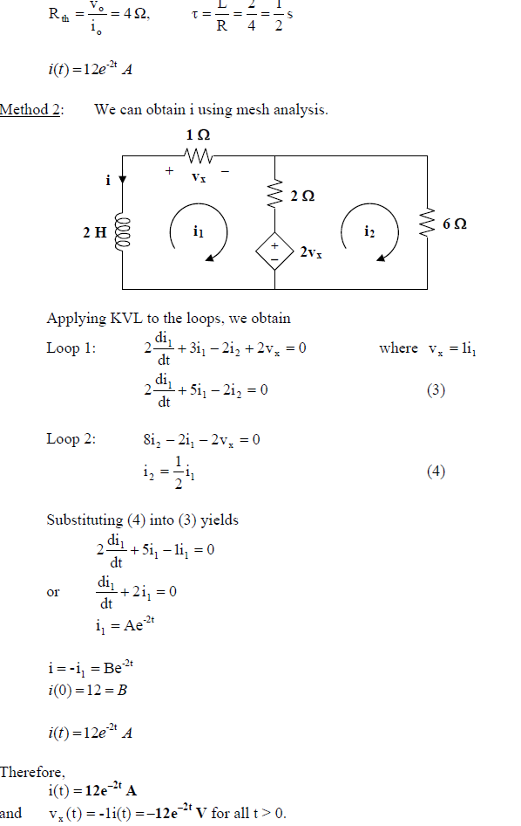

Slide 9
