Slide 1
SYSTEM REALIZATION
We now develop a systematic method for realization (or implementation) of an arbitrary Nth-order transfer function. The most general transfer function with M = N is given by
Since realization is basically a synthesis problem, there is no unique way of realizing a system. A given transfer function can be realized in many different ways. A transfer function H(s) can be realized by using integrators or differentiators along with adders and multipliers.
There are four methods to realization of system as ,
Direct Form I Realization of CT Systems
Direct Form-II Realization of CT Systems
Cascade Form Realisation of CT Systems
Parallel Form Realisation

Slide 2
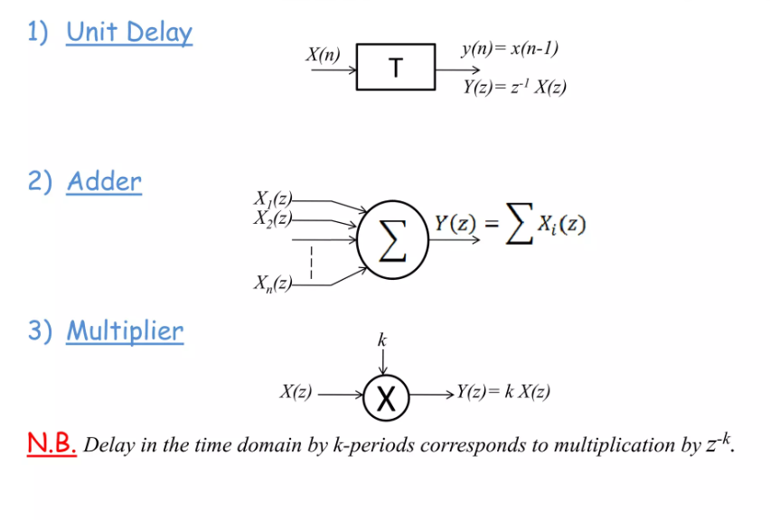
Elements used to construct a block diagram of CT/DT systems

Slide 3
Direct Form I Realization of CT Systems

Slide 4
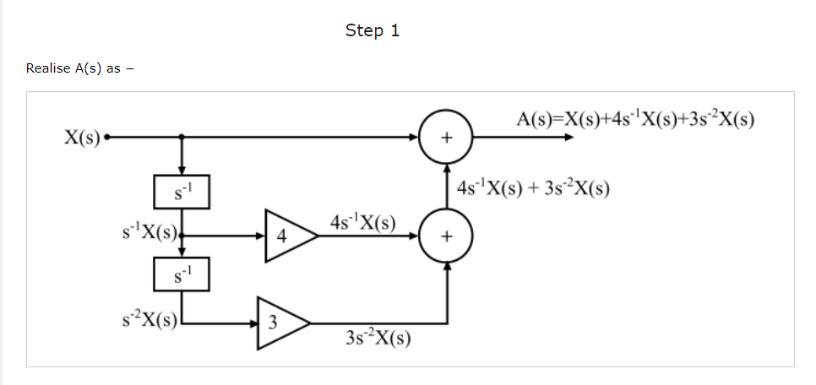
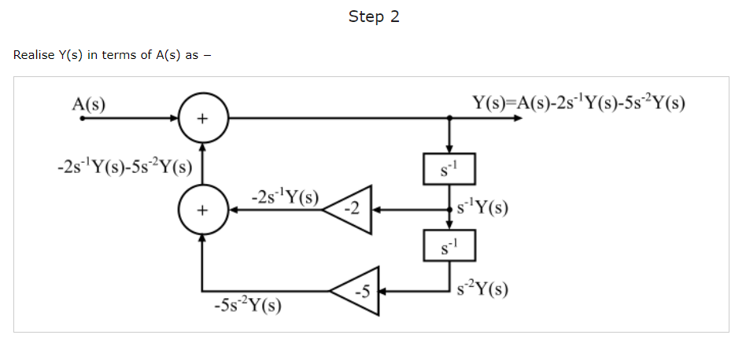
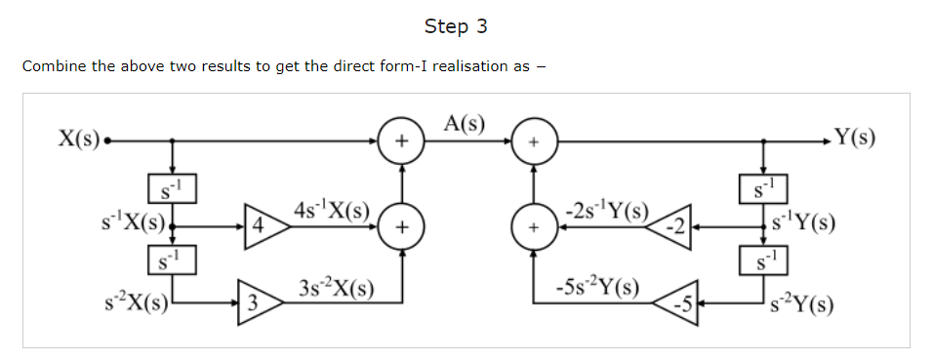

Slide 5
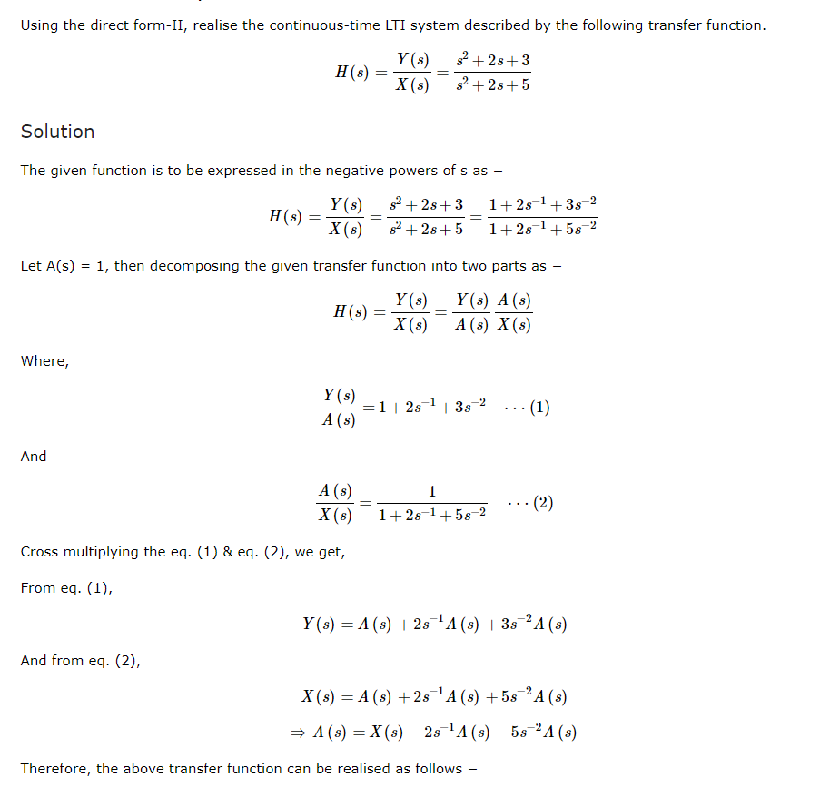
Direct Form-II Realization of CT Systems

Slide 6
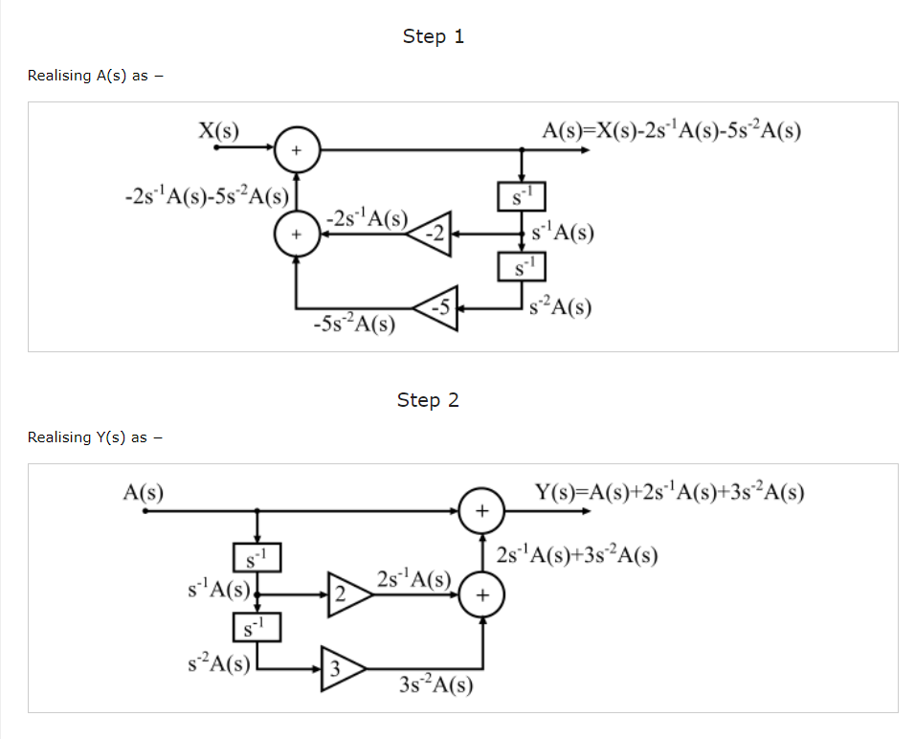

Slide 7
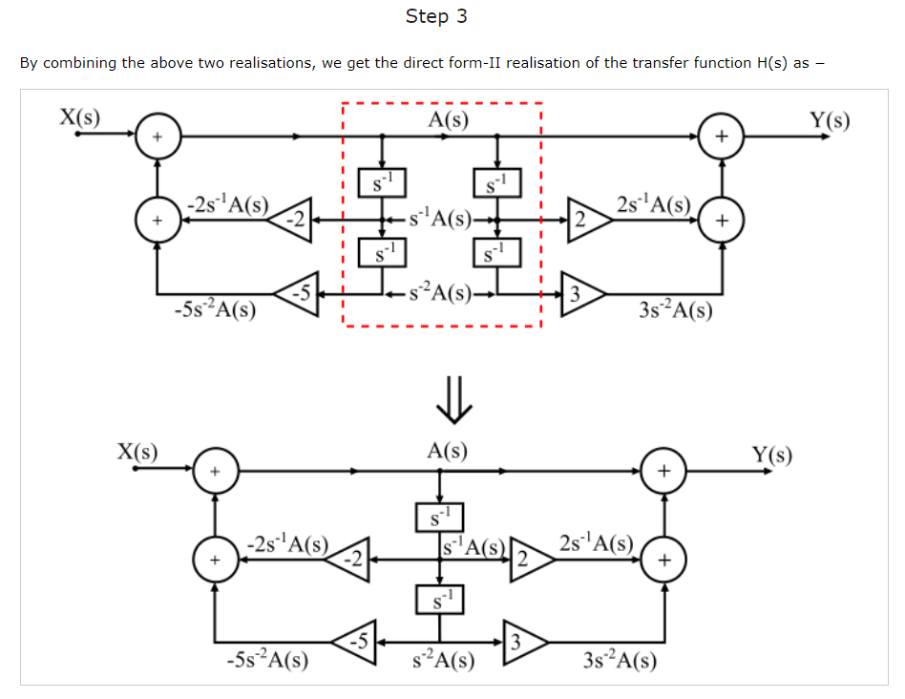

Slide 9
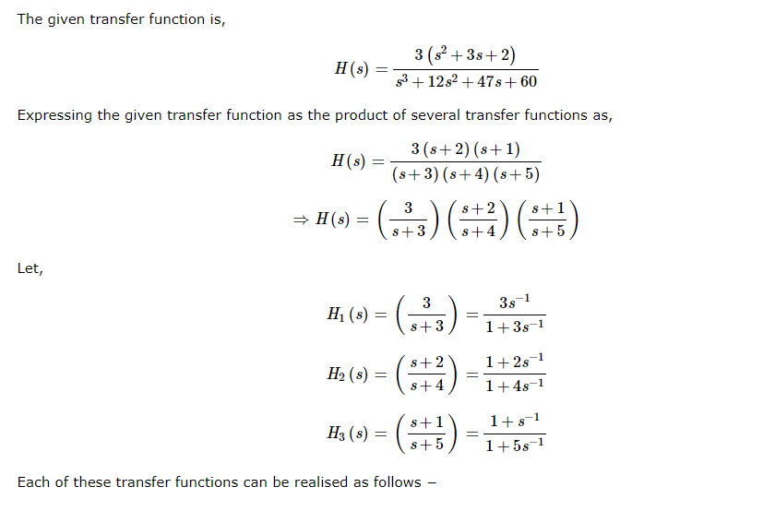

Slide 10
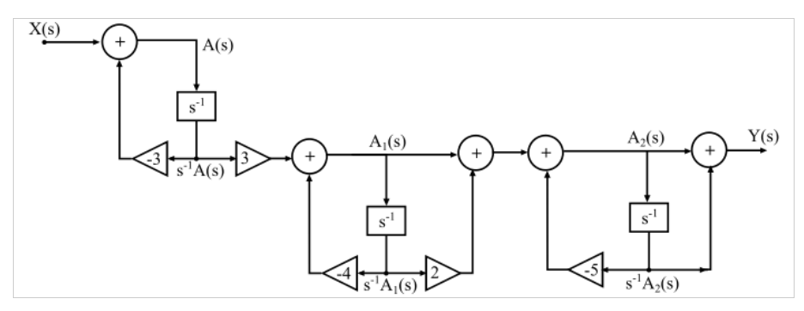

Slide 12
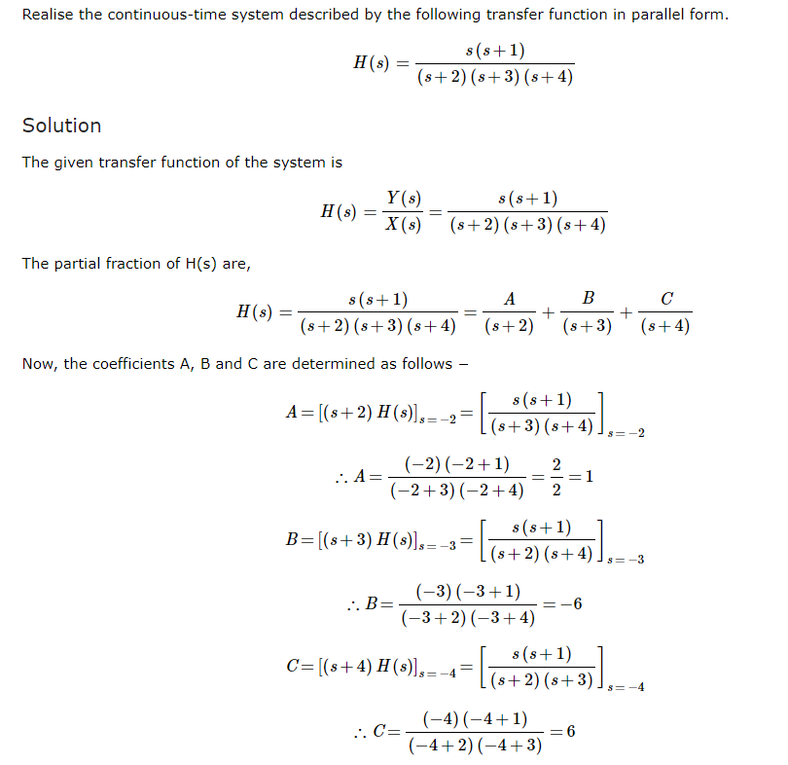

Slide 13
