Slide 1
Signals Unit-1(ECE-S202) (Atul Kr. Agnihotri )
The Unit Step
A step function is one that maintains a constant value before a certain time and then changes to another constant afterwards.
The prototypical form is zero before t=0 and one afterwards.

Slide 2
The Unit Step
Mathematically, the unit step is expressed as:
The switching time may be shifted to t=t₀ by:
Note that this results in a delay in the switch.
The unit step function is written as u(t)

Slide 3
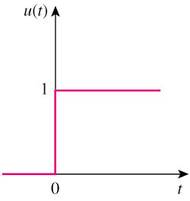
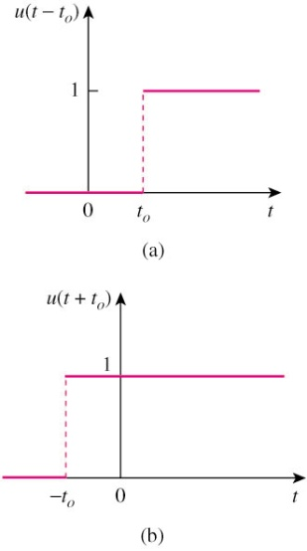
The unit step function u(t) is 0 for negative values of t and 1 for positive values of t.

Slide 4
The Unit Impulse Function
The derivative of the unit step function is the unit impulse function.
This is expressed as:
Voltages of this form can occur during switching operations.

Slide 5
The Unit Ramp Function
Integration of the unit step function results in the unit ramp function:
Much like the other functions, the onset of the ramp may be adjusted.

Slide 6
Step Response of RC Circuit
When a DC source is suddenly applied to a RC circuit, the source can be modeled as a step function.
The circuit response is known as the step response.
Let’s consider the circuit shown here.
We can find the voltage on the capacitor as a function of time.

Slide 7
Step Response of RC Circuit
We assume an initial voltage of V₀ on the capacitor.
Applying KCL:
For t>0 this becomes:
Integrating both sides and introducing initial conditions finally yields:

Slide 8
Forced Response
The complete response can be written as:
Where the nature response is:
And the forced response is:
Note that the eventual response of the circuit is to reach V_{s} after the natural response decays to zero.

Slide 9
Step Response of RL Circuit
Now we can look at the step response of a RL circuit.
We will use the transient and steady state response approach.
We know that the transient response will be an exponential:

Slide 10
Step Response of RL Circuit
After a sufficiently long time, the current will reach he steady state:
This yields an overall response of:
To determine the value of A we need to keep in mind that the current cannot change instantaneously.

Slide 11
Step Response of RL Circuit
Thus we can use the t=0 time to establish A
The complete response of the circuit is thus:
Without an initial current, the circuit response is shown here.

