Slide 1
Physiology of Spinal Cord
Compiled By
Prof. Sudhir Kumar Awasthi
Dept. Of Life Sciences
CSJMU

Slide 2
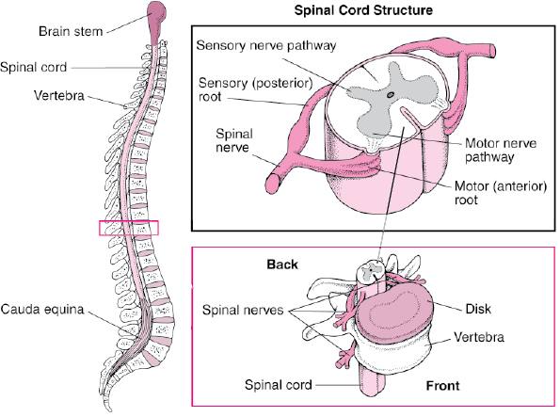
Overview of Spinal Cord
Information highway between brain and body
Extends through vertebral canal from foramen magnum to L1
Each pair of spinal nerves receives sensory information and issues motor signals to muscles and glands
Spinal cord is a component of the Central Nervous System while the spinal nerves are part of the Peripheral Nervous System

Slide 3
Functions of the Spinal Cord
Conduction
bundles of fibers passing information up and down spinal cord
Locomotion
repetitive, coordinated actions of several muscle groups
central pattern generators are pools of neurons providing control of flexors and extensors (walking)
Reflexes
involuntary, stereotyped responses to stimuli (remove hand from hot stove)
involves brain, spinal cord and peripheral nerves

Slide 4
Anatomy of the Spinal Cord
Cylinder of nerve tissue within the vertebral canal (thick as a finger)
vertebral column grows faster so in an adult the spinal cord only extends to L1
31 pairs of spinal nerves arise from cervical, thoracic, lumbar and sacral regions of the cord
each cord segment gives rise to a pair of spinal nerves
Cervical and lumbar enlargements
Medullary cone (conus medullaris) = tapered tip of cord
Cauda equinae is L2 to S5 nerve roots resemble horse’s tail

Slide 5
Meninges of the Spinal Cord
3 Fibrous layers enclosing spinal cord
Dura mater
tough collagenous membrane surrounded by epidural space filled with fat and blood vessels
epidural anesthesia utilized during childbirth
Arachnoid mater
layer of simple squamous epithelium lining dura mater and loose mesh of fibers filled with CSF (creates subarachnoid space)
Pia mater
delicate membrane adherent to spinal cord
filium terminale and denticulate ligaments anchor the cord

Slide 6
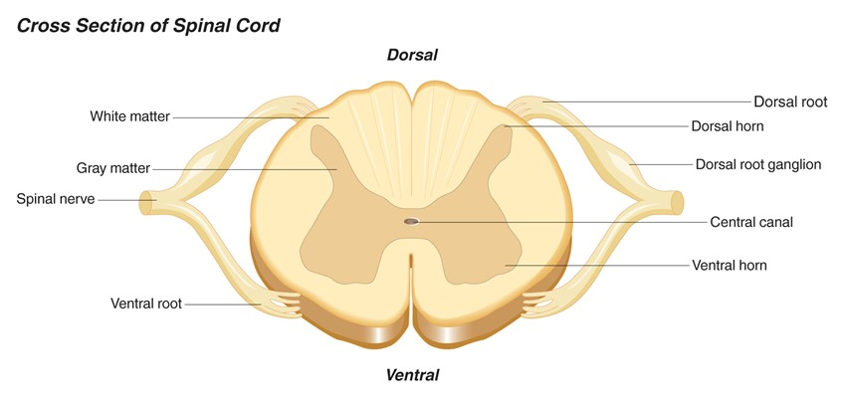
Cross-Sectional Anatomy of the Spinal Cord
Central area of gray matter shaped like a butterfly and surrounded by white matter in 3 columns
Gray matter = neuron cell bodies with little myelin
White matter = myelinated axons

Slide 7
Gray Matter in the Spinal Cord
Pair of dorsal or posterior horns
dorsal root of spinal nerve is totally sensory fibers
Pair of ventral or anterior horns
ventral root of spinal nerve is totally motor fibers
Connected by gray commissure punctured by a central canal continuous above with 4th ventricle

Slide 8
White Matter in the Spinal Cord
White column = bundles of myelinated axons that carry signals up and down to and from brainstem
3 pairs of columns or funiculi
– dorsal, lateral, and anterior columns
Each column is filled with named tracts or fasciculi (fibers with a similar origin, destination and function)

Slide 9
Spinal Tracts
Ascending and descending tract head up or down while decussation means that the fibers cross sides
Contralateral means origin and destination are on opposite sides while ipsilateral means on same side

Slide 10
Spinoreticular Tract
Pain signals from tissue injury
Decussate in spinal cord and ascend with spinothalamic fibers
End in reticular formation (medulla and pons)
3rd and 4th order neurons continue to thalamus and cerebral cortex

Slide 11
Spinocerebellar Pathway
Proprioceptive signals from limbs and trunk travel up to the cerebellum
Second order nerves ascend in ipsilateral lateral column

Slide 12
The Spinal Nerves
31 pairs of spinal nerves (1st cervical above C1)
mixed nerves exiting at intervertebral foramen
Proximal branches
dorsal root is sensory input to spinal cord
ventral root is motor output of spinal cord
cauda equina is roots from L2 to C0 of the cord
Distal branches
dorsal ramus supplies dorsal body muscle and skin
ventral ramus to ventral skin and muscles and limbs
meningeal branch to meninges, vertebrae and ligaments
Spinal nerves: 8 cervical, 12 thoracic, 5 lumbar, 5 sacral and 1 coccygeal.
Each has dorsal and ventral ramus.

Slide 13
Nerve Plexuses
Ventral rami branch and anastomose repeatedly to form 5 nerve plexuses
cervical in the neck, C1 to C5
supplies neck and phrenic nerve to the diaphragm
brachial in the armpit, C5 to T1
supplies upper limb and some of shoulder and neck
lumbar in the low back, L1 to L4
supplies abdominal wall, anterior thigh and genitalia
sacral in the pelvis, L4, L5 and S1 to S4
supplies remainder of lower trunk and lower limb
coccygeal, S4, S5 and C0

Slide 14
Nature of Somatic Reflexes
Quick, involuntary, stereotyped reactions of glands or muscle to sensory stimulation
automatic responses to sensory input that occur without our intent or often even our awareness
Functions by means of a somatic reflex arc
stimulation of somatic receptors
afferent fibers carry signal to dorsal horn of spinal cord
one or more interneurons integrate the information
efferent fibers carry impulses to skeletal muscles
skeletal muscles respond

Slide 15
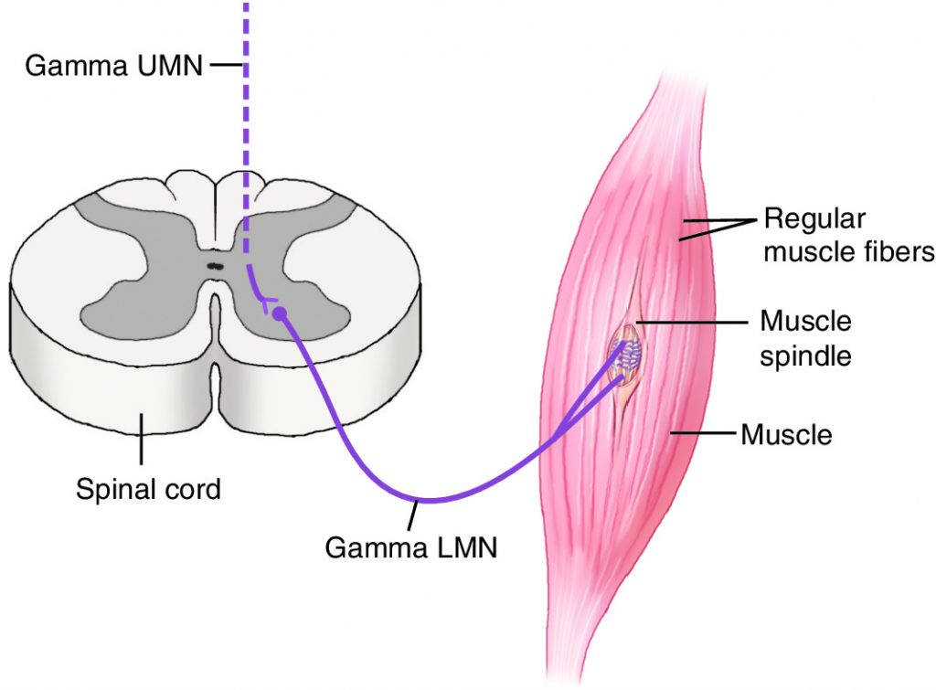
The Muscle Spindle
Sense organ (proprioceptor) that monitors length of muscle and how fast muscles change in length
Composed of intrafusal muscle fibers, afferent fibers
and gamma motorneurons

Slide 16
The Stretch (Myotatic) Reflex
When a muscle is stretched, it contracts and maintains increased tonus (stretch reflex)
helps maintain equilibrium and posture
head starts to tip forward as you fall asleep
muscles contract to raise the head
stabilize joints by balancing tension in extensors and flexors smoothing muscle actions
Very sudden muscle stretch causes tendon reflex
knee-jerk (patellar) reflex is monosynaptic reflex
testing somatic reflexes helps diagnose many diseases
Reciprocal inhibition prevents muscles from working against each other

Slide 17
Spinal Cord Trauma
10-12,000 people/ year are paralyzed
55% occur in traffic accidents
This damage poses risk of respiratory failure
Early symptoms are called spinal shock
Tissue damage at time of injury is followed by post-traumatic infarction

Slide 18
REFERENCES
Neuroanatomy & Neurophysiology: a review by J.S. Citow, R.L MacDonald (2004)
The Human Nervous system:An anatomical viewpoint by Murray Barr(2000)
Textbook of Clinical Neuroanatomy by Vishram Singh (2007)

