Slide 1
Semiconductor Fundamental and Devices (ELC 302),
Two Transistor model of SCR

Slide 2
What is the two transistor model of SCR? Or What is the two transistor analogy of SCR?
Two transistor analogy of SCR is a method of representing SCR in the form of two transistor model.
This represents SCR is the combination of PNP and NPN transistor.
SCR or thyristor is a three terminal semiconductor device which having P-N-P-N structure.

Slide 3
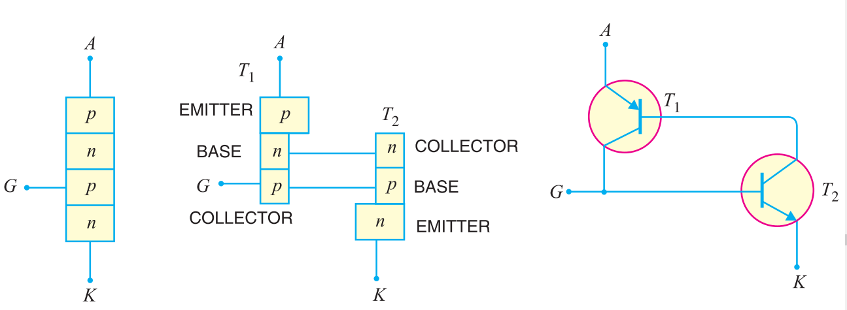
Circuit diagram

Slide 4
Two transistor analogy of SCR
Two transistor analogy of SCR is a method of representing SCR in the form of two transistor model.
This represents SCR is the combination of PNP and NPN transistor.
Now can see the base of the transistor T1 is work as the collector of the transistor T2 and collector of the transistor T1 work as the base of the transistor T2.

Slide 5
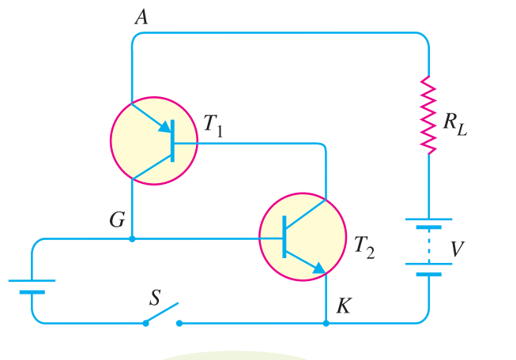
Two transistor model

Slide 6
SCR working with two transistor model
Working of the SCR can be easily explained by two transistor model of SCR. As per figure can see with supply voltage V and load resistance R is applied to SCR. Here first Assume the supply voltage V is less than break over voltage as is usually the case. When the gate is open (i.e. switch S open), there is base current Ib=0. For the base of the T2 is connected with the collector of The T1. Therefore, no current flows in the collector of T2 and hence that of T1. So for this condition, SCR is in OFF condition.

Slide 7
Whenever switch S is closed, a small gate current will flow through the base of T2 which means its collector current will increase. The collector of the transistor T2 is connected with transistor T1. So, the collector current of T2 is the base current of T1. Therefore, the collector current of T1 increases. But collector current of T1 is the base current of T2. This action is accumulative since an increase of current in one transistor causes an increase of current in the other transistor. As a result of this action, both transistors are driven to saturation, and heavy current flows through the load RL. Under such conditions, the SCR closes.

Slide 8
Facts about two transistor analogy of SCR
SCR can be represented in two transistors
(pnp and npn transistor).
With the two transistor model of SCR working principle can easily understand.

