Slide 1
Two Port Network
By- Er. ATUL KUMAR AGNIHOTRI

Slide 2
Overview
In this chapter, the concept of a two-port network.
The relationship between input and output current and voltages will be cataloged and described.
Combinations of networks in series, parallel, and cascaded will be discussed.

Slide 3
One port or two terminal circuit
Two port or four terminal circuit
It is an electrical network with two separate ports for input and output.
No independent sources.

Slide 4
Parameters
To characterize a two-port network requires that we relate the terminal quantities V₁, V₂, I₁, and I₂.
Out of these only two are independent.
The terms that relate to these voltages and currents are called parameters.
Impedance and admittance parameters are commonly used in the synthesis of filters.
They are also important in the design and analysis of impedance-matching networks and power distribution networks.

Slide 5
Impedance Parameters
A two-port network may be either voltage driven or current driven
The terminal voltages can be related to the terminal currents as:

Slide 6
z₁₁ = Open-circuit input impedance
z₂₁ = Open-circuit transfer impedance from port 1 to port 2
z₁₂ = Open-circuit transfer impedance from port 2 to port 1
z₂₂ = Open-circuit output impedance

Slide 7
When z₁₁ = z₂₂, the two-port network is said to be symmetrical.
When the two-port network is linear and has no dependent sources, the transfer impedances are equal (z₁₂ = z₂₁), and the two-port is said to be reciprocal.

Slide 8
Impedance Network II
The values of the parameters can be evaluated by setting the input or output port open circuits (i.e. set the current to zero).
These are referred to as the open-circuit impedance parameters.

Slide 9
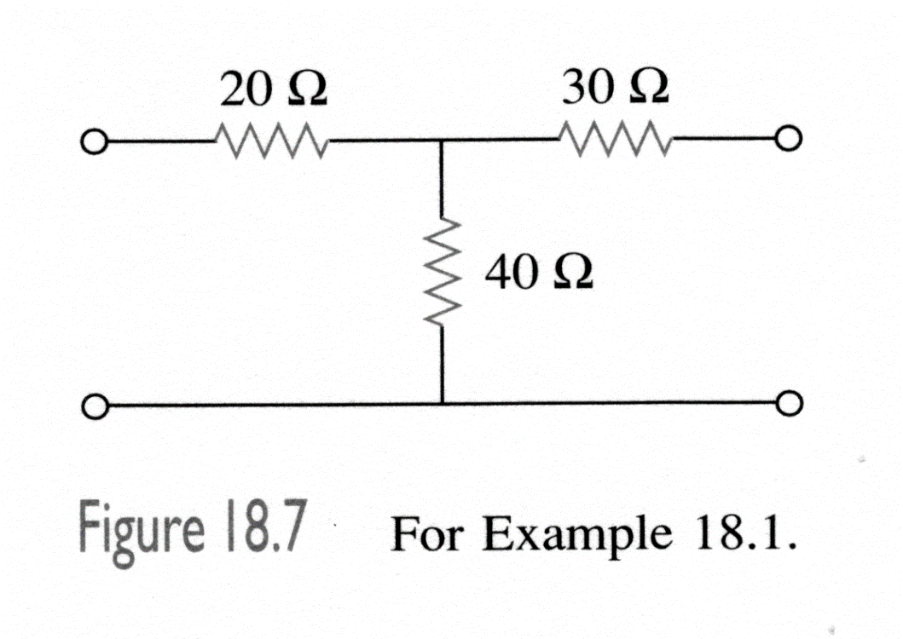
Example 1
Determine the Z-parameters of the following circuit.
I₁
I₂
V₁
V₂
Answer:

Slide 10
Open Circuit Parameters
These parameters are as follows:
z₁₁ Open circuit input impedance
z₁₂ Open circuit transfer impedance from port 1 to port 2
z₂₁ Open circuit transfer impedance from port 2 to port 1
z₂₂ Open circuit output impedance
When z₁₁=z₂₂, the network is said to be symmetrical.

Slide 11
z Parameters
When the network is linear and has no dependent sources, the transfer impedances are equal (z₁₂=z₂₁), the network is said to be reciprocal.
This means that if the input and output are switched, the transfer impedances remain the same.
Any two-port network that is composed entirely of resistors, capacitors, and inductors must be reciprocal.

Slide 12
Admittance Parameters
If impedance parameters do not always exist, then an alternative is needed for these cases.
This need can be met by expressing the terminal currents in terms of terminal currents:
The y terms are known as admittance parameters.

Slide 13
y Parameters.
The y parameters can be determined by short circuiting either the input or output ports (thus setting their voltages to zero).
Because of this, the y parameters are also called the short circuit admittance parameters.

Slide 14
Short Circuit Parameters
These parameters are as follows:
y₁₁ Short circuit input admittance
y₁₂ Short circuit transfer admittance from port 1 to port 2
y₂₁ Short circuit transfer admittance from port 2 to port 1
y₂₂ Short circuit output admittance
The impedance and admittance parameters are collectively called the immitance parameters.

Slide 15
Equivalent Circuit
For a network that is linear and has no dependent sources, the transfer admittances are equal.
A reciprocal network (y₁₂=y₂₁) can be modeled with a Π-equivalent circuit.
Otherwise the more general equivalent network (right) is used.

Slide 16
Hybrid Parameters
Sometimes the z and y parameters do not always exist.
There is thus a need for developing another set of parameters.
If we make V1 and I2 the dependent variables:

Slide 17
Hybrid Parameters II
The h terms are known as the hybrid parameters, or simply h-parameters.
The name comes from the fact that they are a hybrid combination of ratios.
These parameters tend to be much easier to measure than the z or y parameters.
They are particularly useful for characterizing transistors.
Transformers too can be characterized by the h parameters.

Slide 18
Values
The values of the parameters are:
The parameters h₁₁, h₁₂, h₂₁, and h₂₂ represent an impedance, a voltage gain, a current gain, and an admittance respectively.

Slide 19
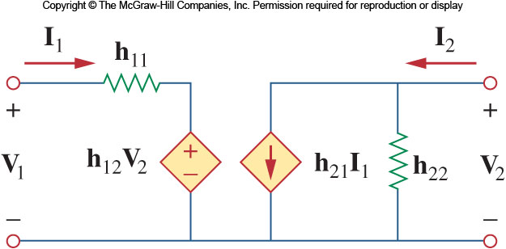
h Parameters
The h-parameters correspond to:
h₁₁ Short circuit input impedance
h₁₂ Open circuit reverse voltage gain
h₂₁ Short circuit forward current gain
h₂₂ Open circuit output admittance
In a reciprocal network, h₁₂=-h₂₁.
The equivalent network is shown below:

Slide 20
g Parameters
A set of related parameters are the g parameters.
They are also known as the inverse hybrid parameters.
They are used to describe the terminal currents and voltages as:

Slide 21
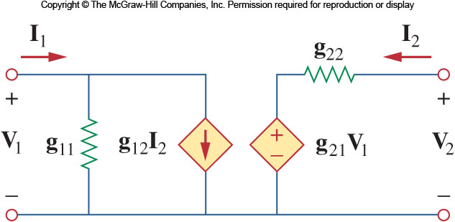
g Parameters II
The values of the g parameters are determined as:
The equivalent model is shown below:

Slide 22
g Parameters
The g parameters correspond to:
g₁₁ Open circuit input admittance
g₁₂ Short circuit reverse current gain
g₂₁ Open circuit forward voltage gain
g₂₂ Short circuit output impedance

Slide 23
Transmission Parameters
Since any combination of two variables may be used as the independent variables, there are many possible sets of parameters that may exist.
Another set relates the variables at the input and output

Slide 24
Transmission Parameters II
Note that in computing the transmission parameters, I₂ has a minus sign because it is considered to be leaving the network.
This is done by convention; when cascading networks it is logical to consider I₂ as coming out.
The transmission parameters are:

Slide 25
Transmission Parameters III
The transmission parameters correspond to:
A: Open circuit voltage ratio
B: Negative short circuit transfer impedance
C: Open circuit transfer admittance
D: Negative short circuit current ratio
A and D are dimensionless while B is in ohms and C is in siemens.
These are also known as the ABCD parameters.

Slide 26
Inverse Transmission Parameters
We can also derive parameters based on the relationship of the input to the output variables.
These inverse transmission parameters are:

Slide 27
t Parameters
The inverse transmission parameters, also called t parameters, correspond to:
a: Open circuit voltage gain
b: Negative short circuit transfer impedance
c: Open circuit transfer admittance
d: Negative short circuit current gain
a and d are dimensionless while b is in ohms and c is in siemens.

