Slide 6
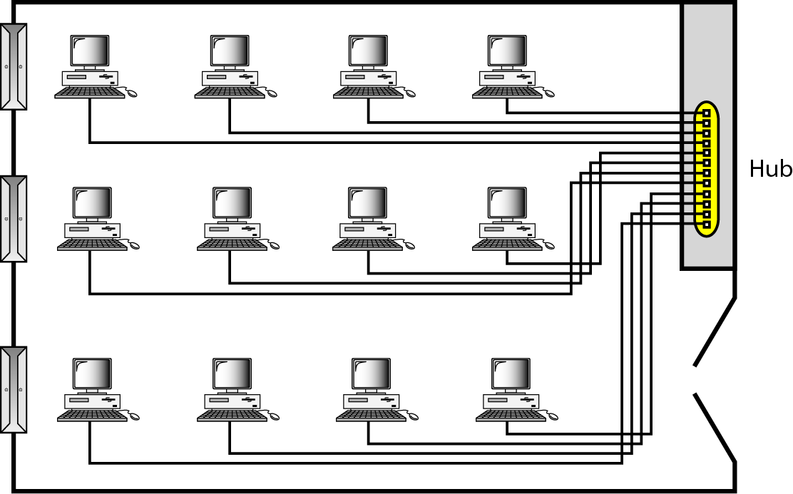
Figure 1.10 An isolated LAN connecting 12 computers to a hub in a closet

Slide 16
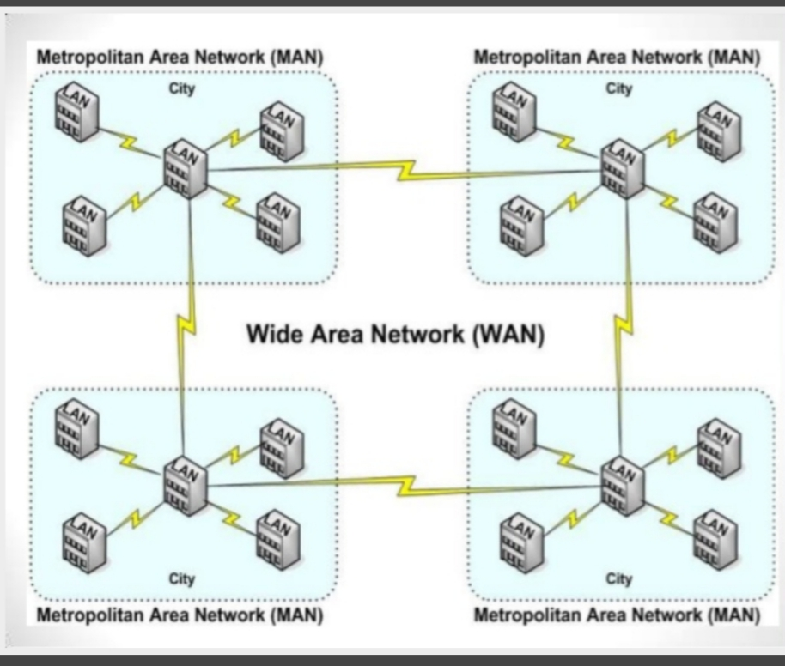

Slide 17
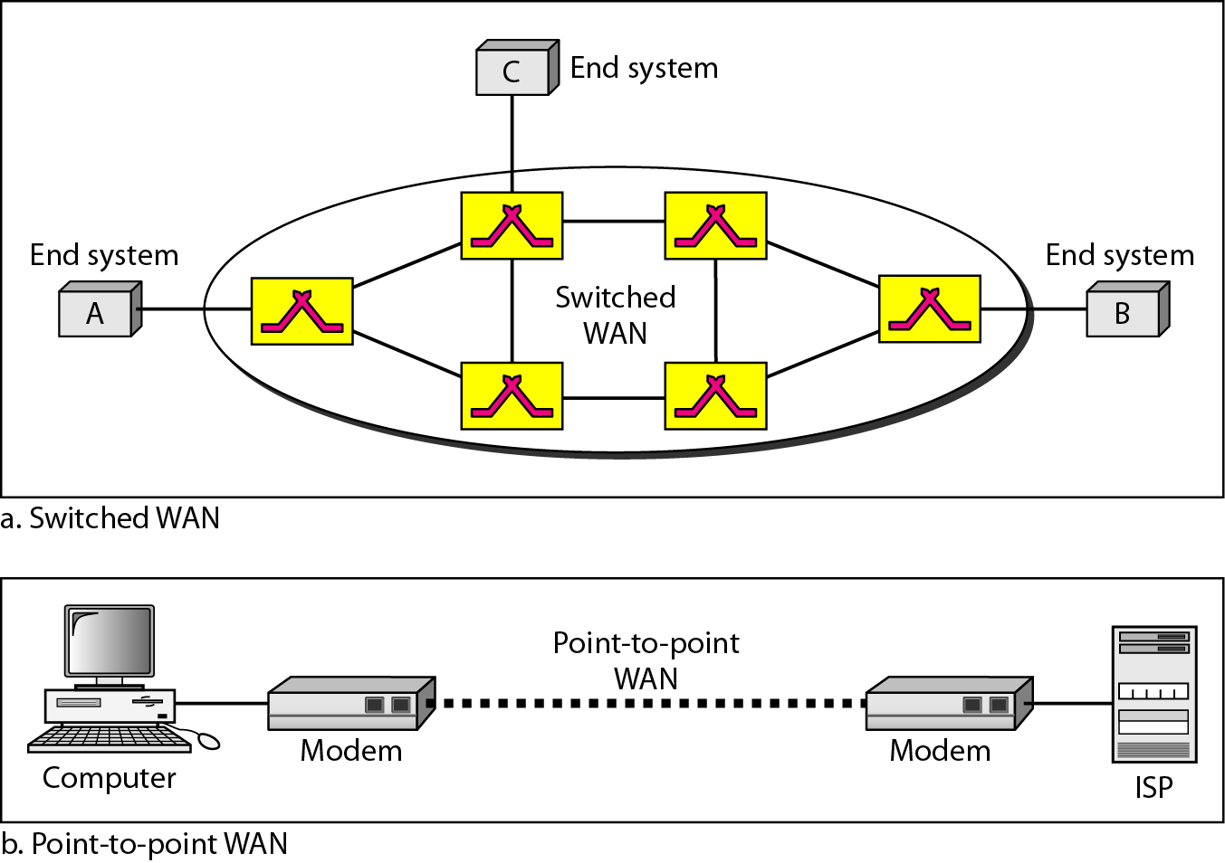
Figure 1.11 WANs: a switched WAN and a point-to-point WAN

Slide 18
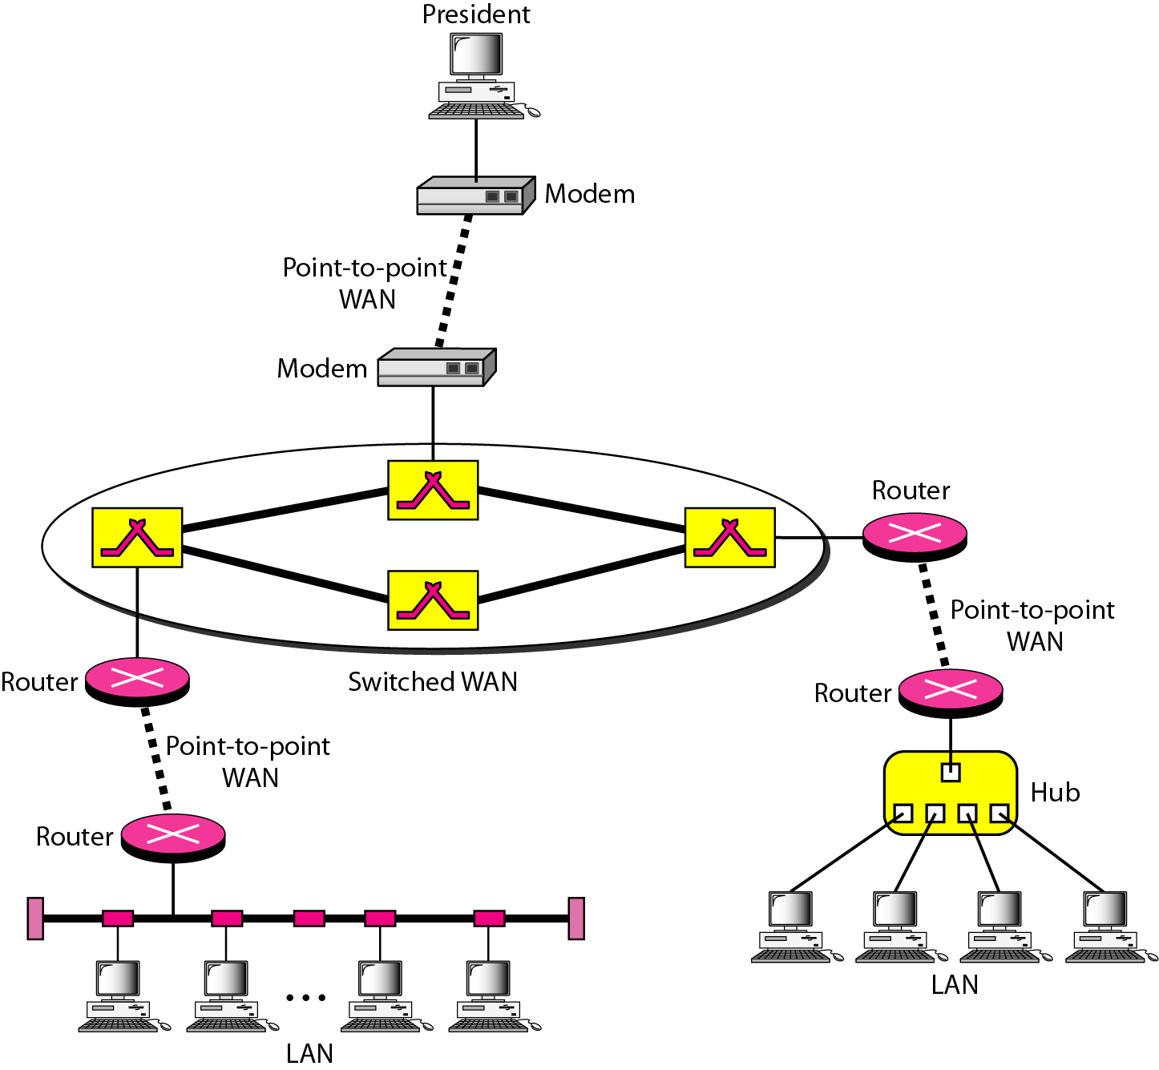
Figure 1.12 A heterogeneous network made of four WANs and two LANs

Slide 22
1-3 THE INTERNET
The Internet has revolutionized many aspects of our daily lives. It has affected the way we do business as well as the way we spend our leisure time. The Internet is a communication system that has brought a wealth of information to our fingertips and organized it for our use.

Slide 23
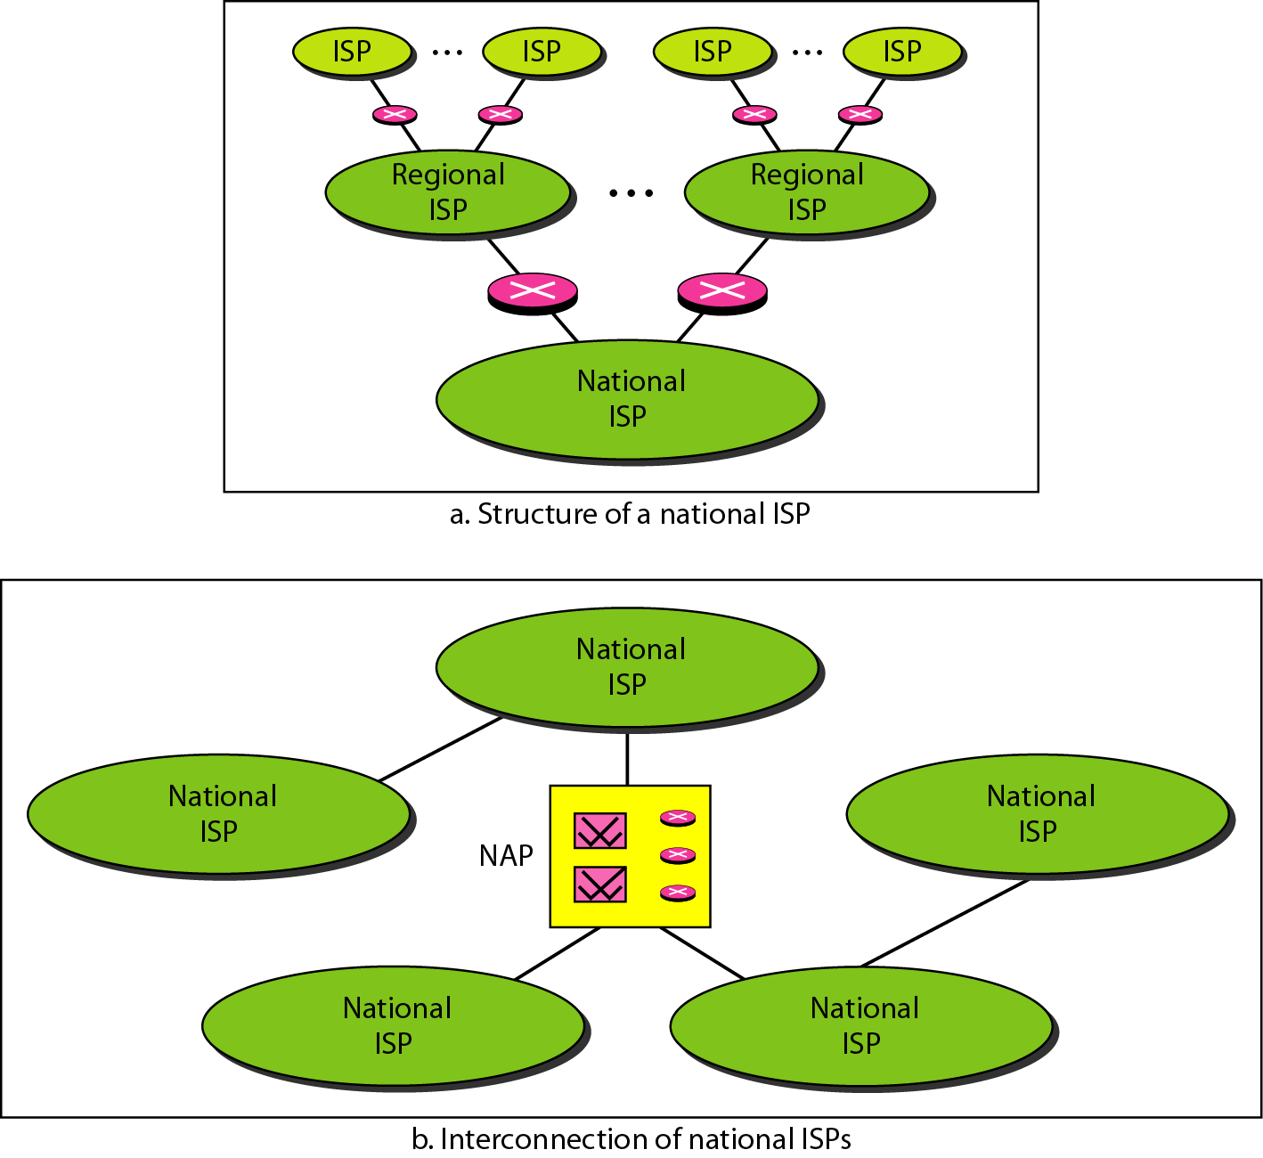
Figure 1.13 Hierarchical organization of the Internet

Slide 24
1-4 PROTOCOLS
A protocol is synonymous with rule. It consists of a set of rules that govern data communications. It determines what is communicated, how it is communicated and when it is communicated. The key elements of a protocol are syntax, semantics and timing
Topics
Syntax
Semantics
Timing

Slide 25
Elements of a Protocol
Syntax
Structure or format of the data
Indicates how to read the bits - field delineation
Semantics
Interprets the meaning of the bits
Knows which fields define what action
Timing
When data should be sent and what
Speed at which data should be sent or speed at which it is being received.

