Slide 1
1-1 DATA COMMUNICATIONS
The term telecommunication means communication at a distance. The word data refers to information presented in whatever form is agreed upon by the parties creating and using the data. Data communications are the exchange of data between two devices via some form of transmission medium such as a wire cable.

Slide 2
Figure 1.1 Components of a data communication system

Slide 3
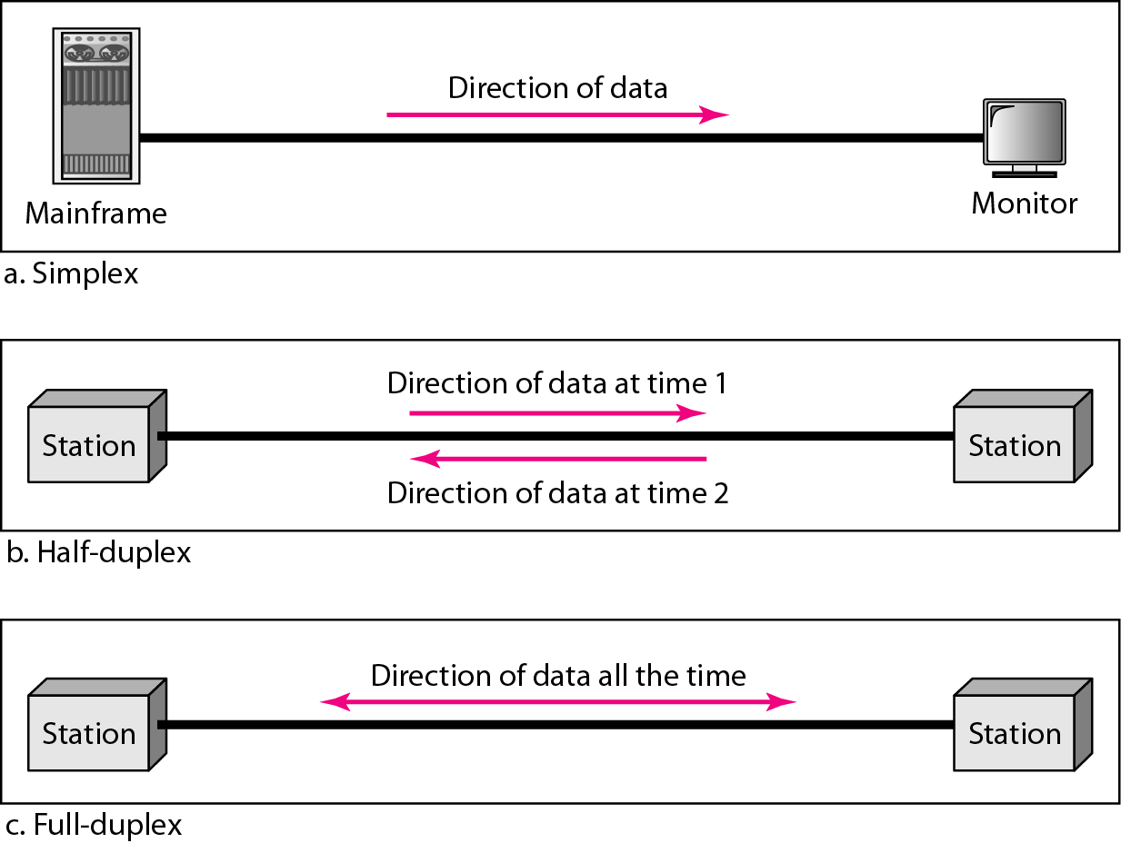
Figure 1.2 Data flow (simplex, half-duplex, and full-duplex)

Slide 4
1-2 NETWORKS
A network is a set of devices (often referred to as nodes) connected by communication links. A node can be a computer, printer, or any other device capable of sending and/or receiving data generated by other nodes on the network. A link can be a cable, air, optical fiber, or any medium which can transport a signal carrying information.
Topics
Network Criteria
Physical Structures
Categories of Networks

Slide 5
Network Criteria
Performance
Depends on Network Elements
Measured in terms of Delay and Throughput
Reliability
Failure rate of network components
Measured in terms of availability/robustness
Security
Data protection against corruption/loss of data due to:
Errors
Malicious users

Slide 6
Physical Structures
Type of Connection
Point to Point - single transmitter and receiver
Multipoint - multiple recipients of single transmission
Physical Topology
Connection of devices
Type of transmission - unicast, mulitcast, broadcast

Slide 7
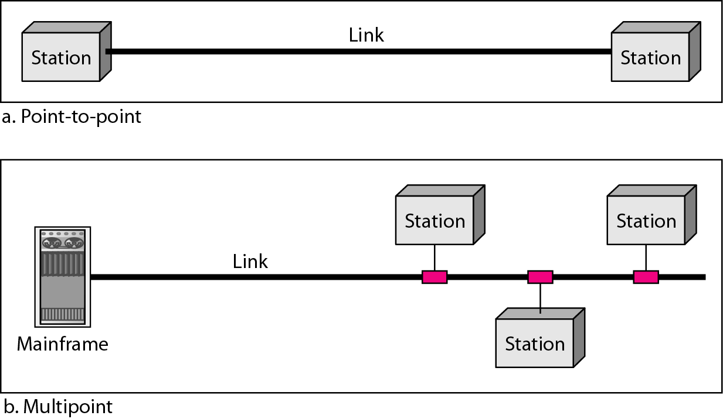
Figure 1.3 Types of connections: point-to-point and multipoint

Slide 8
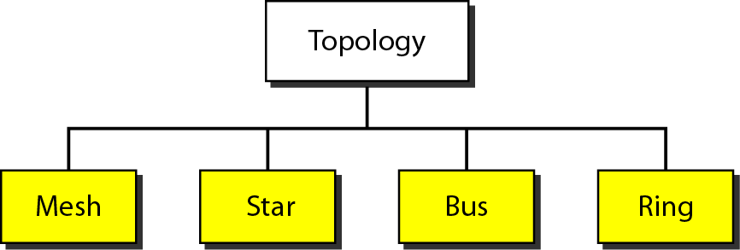
Figure 1.4 Categories of topology

Slide 9
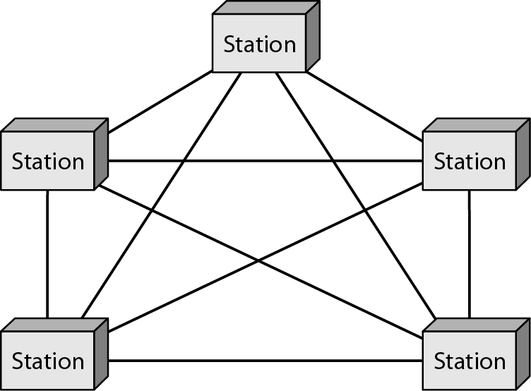
Figure 1.5 A fully connected mesh topology (five devices)

Slide 14
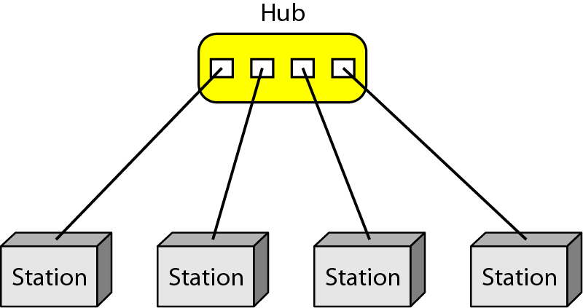
Figure 1.6 A star topology connecting four stations

Slide 19
Figure 1.7 A bus topology connecting three stations

Slide 23
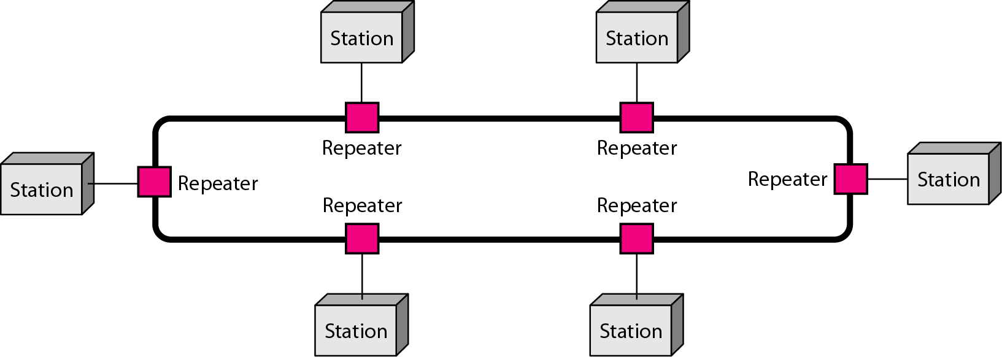
Figure 1.8 A ring topology connecting six stations

