Slide 1
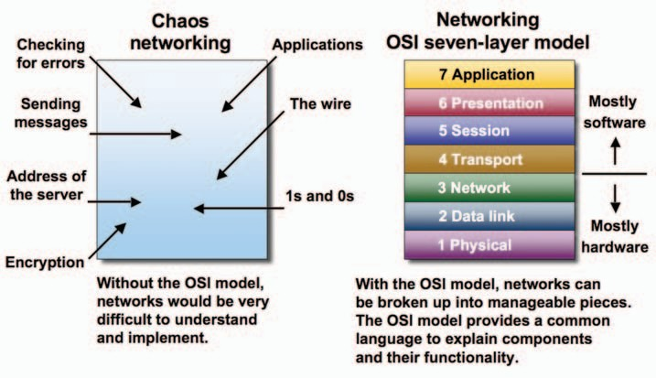
Introduction to OSI Reference Model
The Open Systems Interconnection (OSI) model is a reference tool for understanding data communications between any two networked systems. It divides the communications processes into seven layers. Each layer both performs specific functions to support the layers above it and offers services to the layers below it. The three lowest layers focus on passing traffic through the network to an end system. The top four layers come into play in the end system to complete the process.
An Overview of the OSI Model

Slide 2
A networking model offers a generic means to separate computer networking functions into multiple layers. Each of these layers relies on the layers below it to provide supporting capabilities and performs support to the layers above it. Such a model of layered functionality is also called a “protocol stack” or “protocol suite”.
Protocols, or rules, can do their work in either hardware or software or, as with most protocol stacks, in a combination of the two. The nature of these stacks is that the lower layers do their work in hardware or firmware (software that runs on specific hardware chips) while the higher layers work in software.
The Open System Interconnection model is a seven-layer structure that specifies the requirements for communications between two computers. The ISO (International Organization for Standardization) standard 7498-1 defined this model. This model allows all network elements to operate together, no matter who created the protocols and what computer vendor supports them.
The main benefits of the OSI model include the following:
Helps users understand the big picture of networking
Helps users understand how hardware and software elements function together
Makes troubleshooting easier by separating networks into manageable pieces
Defines terms that networking professionals can use to compare basic functional relationships on different networks
Helps users understand new technologies as they are developed
Aids in interpreting vendor explanations of product functionality

Slide 3
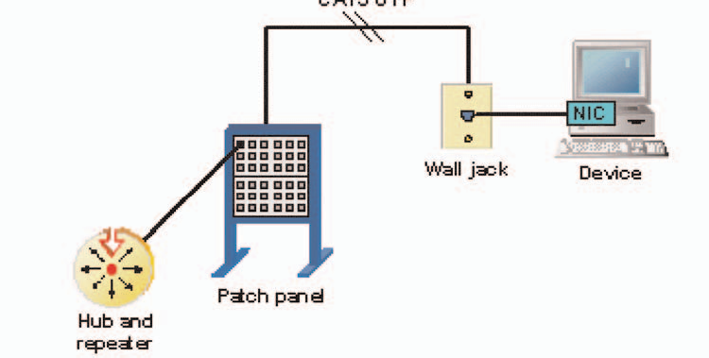
The Physical Layer
The physical layer of the OSI model defines connector and interface specifications, as well as the medium (cable) requirements. Electrical, mechanical, functional, and procedural specifications are provided for sending a bit stream on a computer network.

Slide 4
Components of the physical layer include:
Cabling system components
Adapters that connect media to physical interfaces
Connector design and pin assignments
Hub, repeater, and patch panel specifications
Wireless system components
Parallel SCSI (Small Computer System Interface)
Network Interface Card (NIC)
In a LAN environment, Category 5e UTP (Unshielded Twisted Pair) cable is generally used for the physical layer for individual device connections. Fiber optic cabling is often used for the physical layer in a vertical or riser backbone link. The IEEE, EIA/TIA, ANSI, and other similar standards bodies developed standards for this layer.
Note: The Physical Layer of the OSI model is only part of a LAN (Local Area Network).

Slide 5
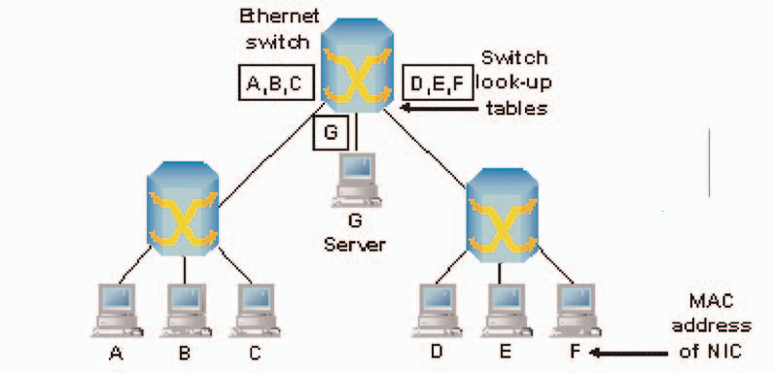
The Data Link Layer
Layer 2 of the OSI model provides the following functions:
Allows a device to access the network to send and receive messages
Offers a physical address so a device’s data can be sent on the network
Works with a device’s networking software when sending and receiving messages
Provides error-detection capability
Common networking components that function at layer 2 include:
Network interface cards
Ethernet and Token Ring switches
Bridges

Slide 6
NICs have a layer 2 or MAC address. A switch uses this address to filter and forward traffic, helping relieve congestion and collisions on a network segment.
Bridges and switches function in a similar fashion; however, bridging is normally a software program on a CPU, while switches use Application-Specific Integrated Circuits (ASICs) to perform the task in dedicated hardware, which is much faster.

