Slide 1
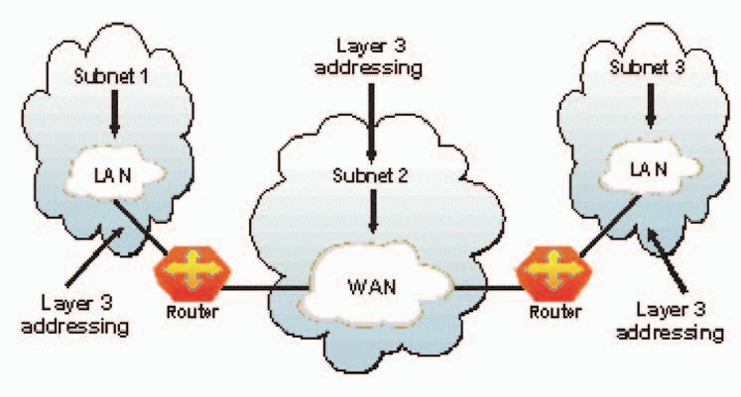
Layer 3 – The Network Layer
the network layer of the OSI model, provides an end-to-end logical addressing system so that a packet of data can be routed across several data link layer networks (Ethernet, Token Ring, Frame Relay, etc.). Note that net- work layer addresses can also be referred to as logical addresses.
Initially, software manufacturers, such as Novell, developed proprietary network layer addressing. However, the networking industry has evolved to the point that it requires a common network layer addressing system. The Internet Protocol (IP) addresses make networks easier to both set up and connect with one another. The Internet uses IP addressing to provide connectivity to millions of networks around the world.

Slide 2
To make it easier to manage the network and control the flow of packets, many organizations separate their network layer addressing into smaller parts known as subnets. Routers use the network or subnet portion of the IP addressing to route traffic between different networks. Each router must be configured specifically for the networks or subnets that will be connected to its interfaces.
Routers communicate with one another using routing protocols, such as Routing Information Protocol (RIP) and Open version of Shortest Path First (OSPF), to learn of other networks that are present and to calculate the best way to reach each network based on a variety of criteria (such as the path with the fewest routers).
Routers and other networked systems make these routing decisions at the network layer.
When passing packets between different networks, it may become necessary to adjust their outbound size to one that is compatible with the data link layer protocol that is being used. The network layer accomplishes this via a process known as fragmentation. A router’s network layer is usually responsible for doing the fragmentation. All reassembly of fragmented packets happens at the network layer of the final destination system.

Slide 3
Two of the additional functions of the network layer are diagnostics and the reporting of logical variations in normal network operation. While the network layer diagnostics may be initiated by any networked system, the system discovering the variation reports it to the original sender of the packet that is found to be outside normal network operation.
The variation reporting exception is content validation calculations. If the calculation done by the receiving system does not match the value sent by the originating system, the receiver discards the related packet with no report to the sender. Retransmission is left to a higher layer’s protocol.
Some basic security functionality can also be set up by filtering traffic using network layer addressing on routers or other similar devices.
Layer 4 – The Transport Layer

Slide 4
the transport layer of the OSI model, offers end-to-end communication between end devices through a network. Depending on the application, the transport layer either offers reliable, connection-oriented or connectionless, best-effort communications.
Some of the functions offered by the transport layer include:
Application identification
Client-side entity identification
Confirmation that the entire message arrived intact
Segmentation of data for network transport
Control of data flow to prevent memory over runs
Establishment and maintenance of both ends of virtual circuits
Transmission-error detection
Realignment of segmented data in the correct order on the receiving side
Multiplexing or sharing of multiple sessions over a single physical link
The most common transport layer protocols are the connection-oriented TCP Transmission Control Protocol (TCP) and the connectionless UDP User Datagram Protocol (UDP).

Slide 5
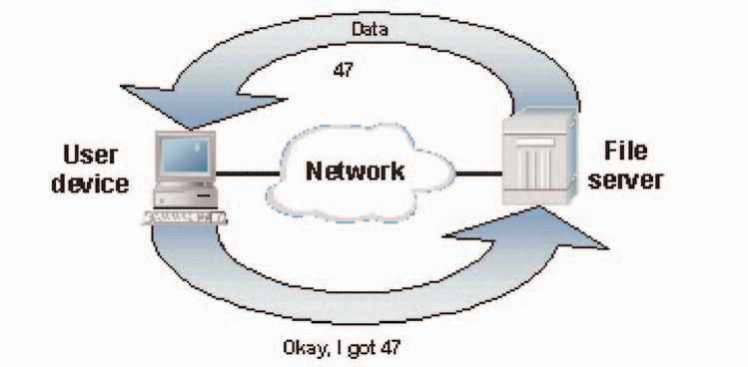
Layer 5 – The Session Layer
the session layer, provides various services, including tracking the number of bytes that each end of the session has acknowledged receiving from the other end of the session. This session layer allows applications functioning on devices to establish, manage, and terminate a dialog through a network. Session layer functionality includes:
Virtual connection between application entities
Synchronization of data flow
Creation of dialog units
Connection parameter negotiations
Partitioning of services into functional groups
Acknowledgements of data received during a session
Retransmission of data if it is not received by a device

Slide 6
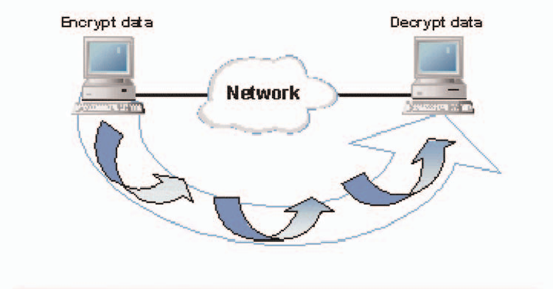
Layer 6 – The Presentation Layer
Layer 6 – The Presentation Layer
the presentation layer, is responsible for how an application formats the data to be sent out onto the network. The presentation layer basically allows an application to read (or understand) the message.
Examples of presentation layer functionality include:
Encryption and decryption of a message for security
Compression and expansion of a message so that it travels efficiently
Graphics formatting
Content translation
System-specific translation

Slide 7
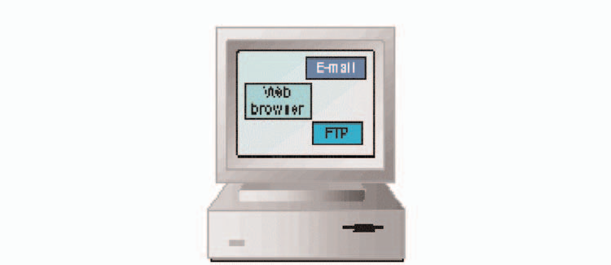
Layer 7 – The Application Layer
the application layer, provides an interface for the end user operating a device connected to a net- work. This layer is what the user sees, in terms of loading an application (such as Web browser or e-mail); that is, this application layer is the data the user views while using these applications.
Examples of application layer functionality include:
Support for file transfers
Ability to print on a network
Electronic mail
Electronic messaging
Browsing the World Wide Web

