Slide 1
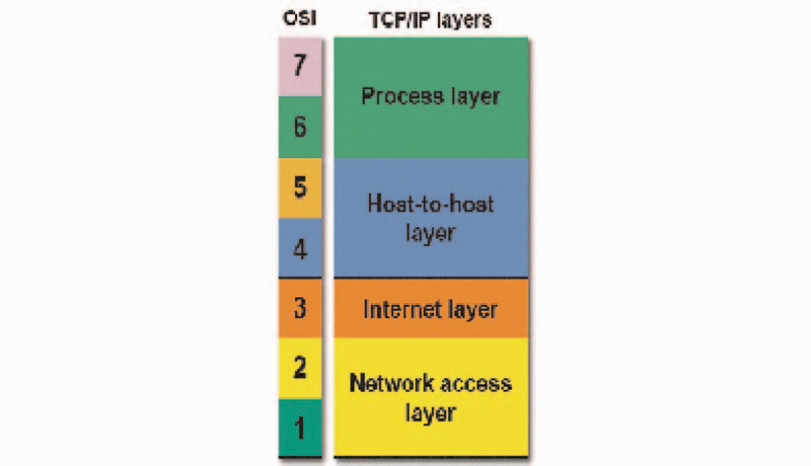
TCP/IP Model Overview
The OSI model describes computer networking in seven layers. While there have been implementations of networking protocol that use those seven layers, most networks today use TCP/IP. But, networking professionals continue to describe networking functions in relation to the OSI layer that performs those tasks.

Slide 2
The TCP/IP model uses four layers to perform the functions of the seven-layer in OSI model.
The network access layer is functionally equal to a combination of OSI physical and data link layers (1 and 2). The Internet layer performs the same functions as the OSI network layer (3).
Things get a bit more complicated at the host-to-host layer of the TCP/IP model. If the host-to-host protocol is TCP, the matching functionality is found in the OSI transport and session layers (4 and 5). Using UDP equates to the functions of only the transport layer of the OSI model.
The TCP/IP process layer, when used with TCP, provides the functions of the OSI model’s presentation and application layers (6 and 7). When the TCP/IP transport layer protocol is UDP, the process layer’s functions are equivalent to OSI session, presentation, and application layers (5, 6, and 7).

Slide 3
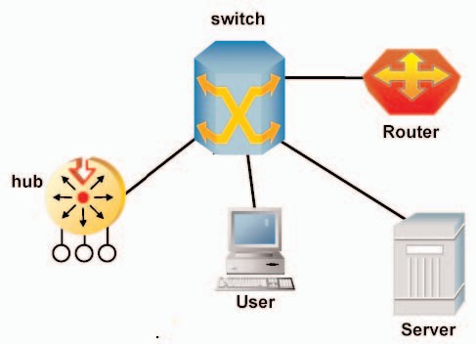
Equipment at the Layers
Some of the layers use equipment to support the identified functions. Hub related activity is “Layer One”. The naming of some devices designates the functional layer such as “Layer Two Switch” or “Layer Three Switch”. Router functions focus on “Layer Three”. User workstations and servers are often identified with “Layer Seven”.

Slide 4
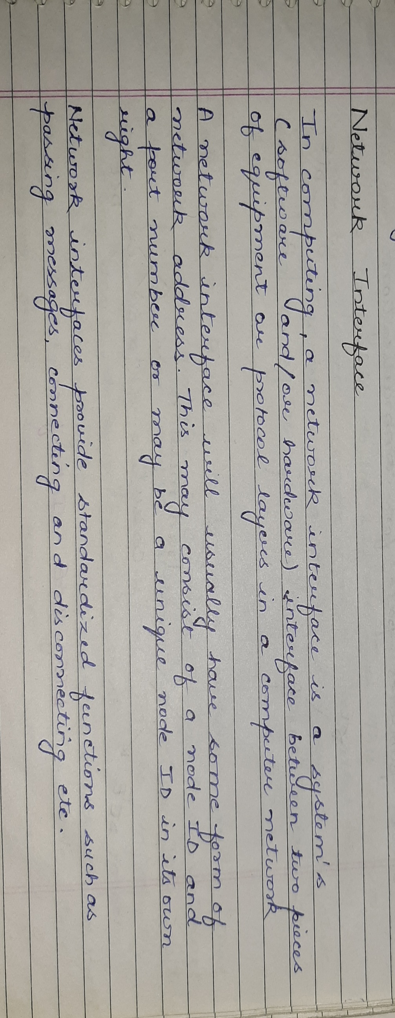

Slide 5
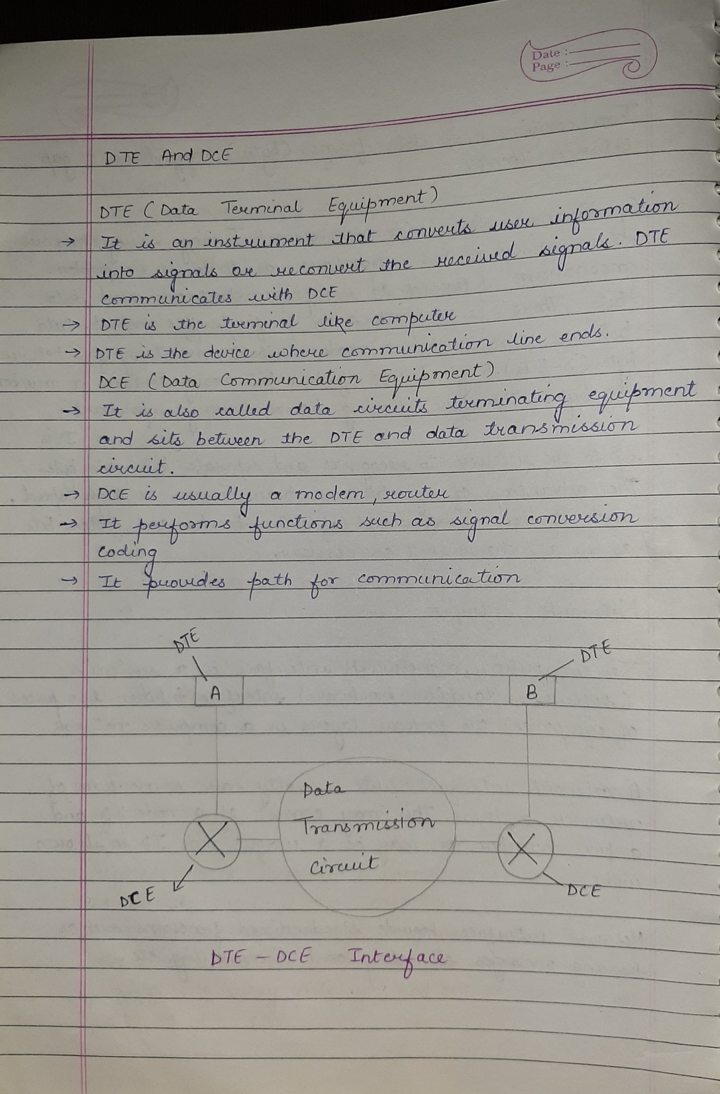

Slide 6
