Slide 1
Transmission Media
Unit2

Slide 2
Transmission Media
The transmission media is nothing but the physical media over which communication takes place in computer networks.
Magnetic Media
One of the most convenient way to transfer data from one computer to another, even before the birth of networking, was to save it on some storage media and transfer physical from one station to another. Though it may seem old-fashion way in today’s world of high speed internet, but when the size of data is huge, the magnetic media comes into play.
For example, a bank has to handle and transfer huge data of its customer, which stores a backup of it at some geographically far-away place for security reasons and to keep it from uncertain calamities. If the bank needs to store its huge backup data, then its transfer through internet is not feasible. The WAN links may not support such high speed. Even if they do; the cost is too high to afford.
In these cases, data backup is stored onto magnetic tapes or magnetic discs, and then shifted physically at remote places.

Slide 3
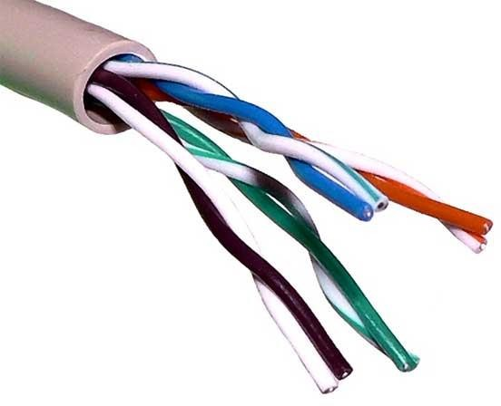
Twisted Pair Cable
A twisted pair cable is made of two plastic insulated copper wires twisted together to form a single media. Out of these two wires, only one carries actual signal and another is used for ground reference. The twists between wires are helpful in reducing noise (electro-magnetic interference) and crosstalk.
There are two types of twisted pair cables:
Shielded Twisted Pair (STP) Cable
Unshielded Twisted Pair (UTP) Cable
STP cables comes with twisted wire pair covered in metal foil. This makes it more indifferent to noise and crosstalk.
UTP has seven categories, each suitable for specific use. In computer networks, Cat- 5, Cat-5e, and Cat-6 cables are mostly used. UTP cables are connected by RJ45 connectors.

Slide 4
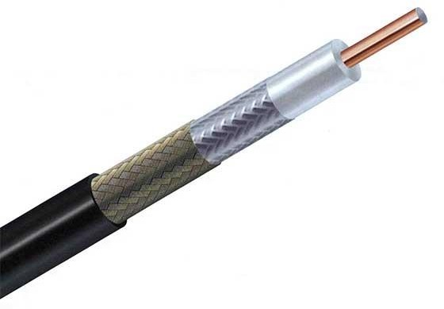
Coaxial Cable
Coaxial cable has two wires of copper. The core wire lies in the center and it is made of solid conductor. The core is enclosed in an insulating sheath. The second wire is wrapped around over the sheath and that too in turn encased by insulator sheath. This all is covered by plastic cover.
Because of its structure, the coax cable is capable of carrying high frequency signals than that of twisted pair cable. The wrapped structure provides it a good shield against noise and cross talk. Coaxial cables provide high bandwidth rates of up to 450 mbps.
There are three categories of coax cables namely, RG-59 (Cable TV), RG-58 (Thin Ethernet), and RG-11 (Thick Ethernet). RG stands for Radio Government.
Cables are connected using BNC connector and BNC-T. BNC terminator is used to terminate the wire at the far ends.

Slide 5
Power Lines
Power Line communication (PLC) is Layer-1 (Physical Layer) technology which uses power cables to transmit data signals. In PLC, modulated data is sent over the cables. The receiver on the other end de-modulates and interprets the data.
Because power lines are widely deployed, PLC can make all powered devices controlled and monitored. PLC works in half-duplex.
There are two types of PLCs:
Narrow band PLC
Broad band PLC
Narrow band PLC provides lower data rates up to 100s of kbps, as they work at lower frequencies (3-5000 kHz). They can be spread over several kilometers.
Broadband PLC provides higher data rates up to 100s of Mbps and works at higher frequencies (1.8 – 250 MHz). They cannot be as much extended as Narrowband PLC.

Slide 6
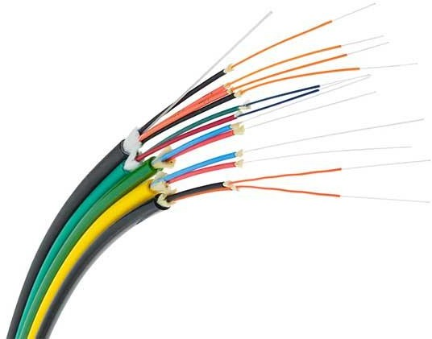
Fiber Optics
Fiber Optic works on the properties of light. When light ray hits at critical angle, it tends to refracts at 90 degree. This property has been used in fiber optic. The core of fiber optic cable is made of high quality glass or plastic. From one end of it light is emitted, it travels through it and at the other end light detector detects light stream and converts it to electric data.
Fiber Optic provides the highest mode of speed. It comes in two modes, one is single mode fiber and second is multimode fiber. Single mode fiber can carry a single ray of light whereas multimode is capable of carrying multiple beams of light.
Fiber Optic also comes in unidirectional and bidirectional capabilities. To connect and access fiber optic special type of connectors are used. These can be Subscriber Channel (SC), Straight Tip (ST), or MT-RJ.

