Slide 1
COMPUTER NETWORK
UNIT-2

Slide 2
Transmission Media
The media over which the information between two computer systems is sent, called transmission media. Transmission media comes in two forms.
Guided Media
All communication wires/cables are guided media, such as UTP, coaxial cables, and fiber Optics. In this media, the sender and receiver are directly connected and the information is send (guided) through it.
Unguided Media
Wireless or open air space is said to be unguided media, because there is no connectivity between the sender and receiver. Information is spread over the air, and anyone including the actual recipient may collect the information.
Channel Capacity
The speed of transmission of information is said to be the channel capacity. We count it as data rate in digital world. It depends on numerous factors such as:
Bandwidth: The physical limitation of underlying media.
Error-rate: Incorrect reception of information because of noise.
Encoding: The number of levels used for signaling

Slide 3
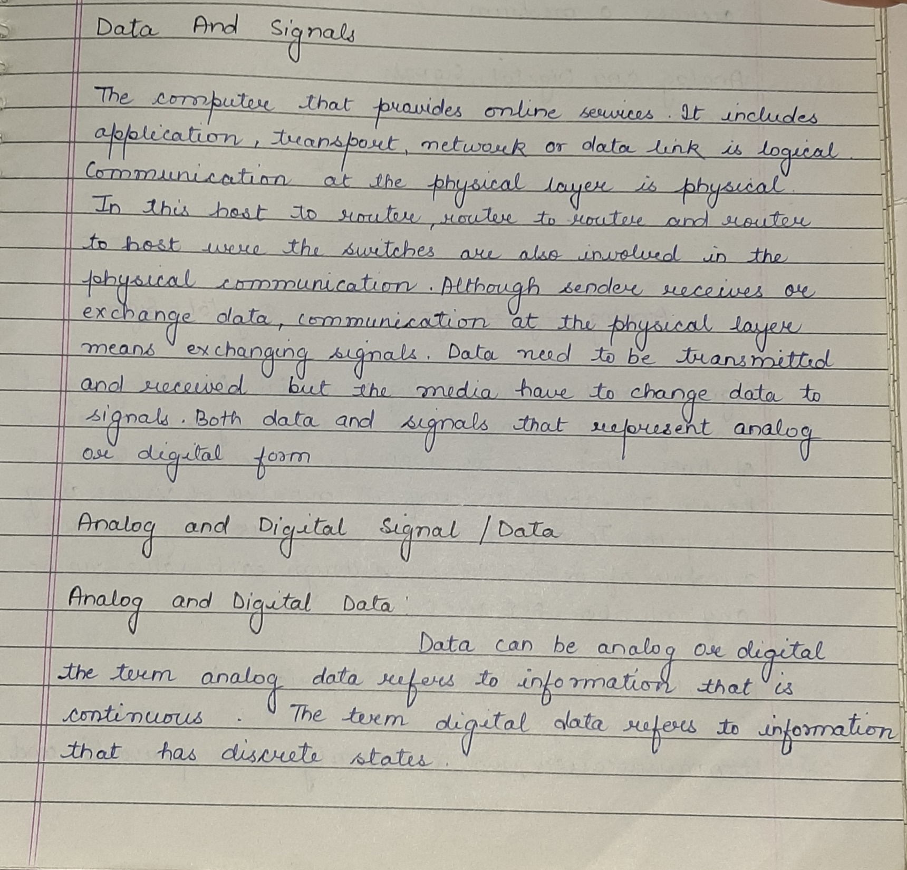

Slide 4
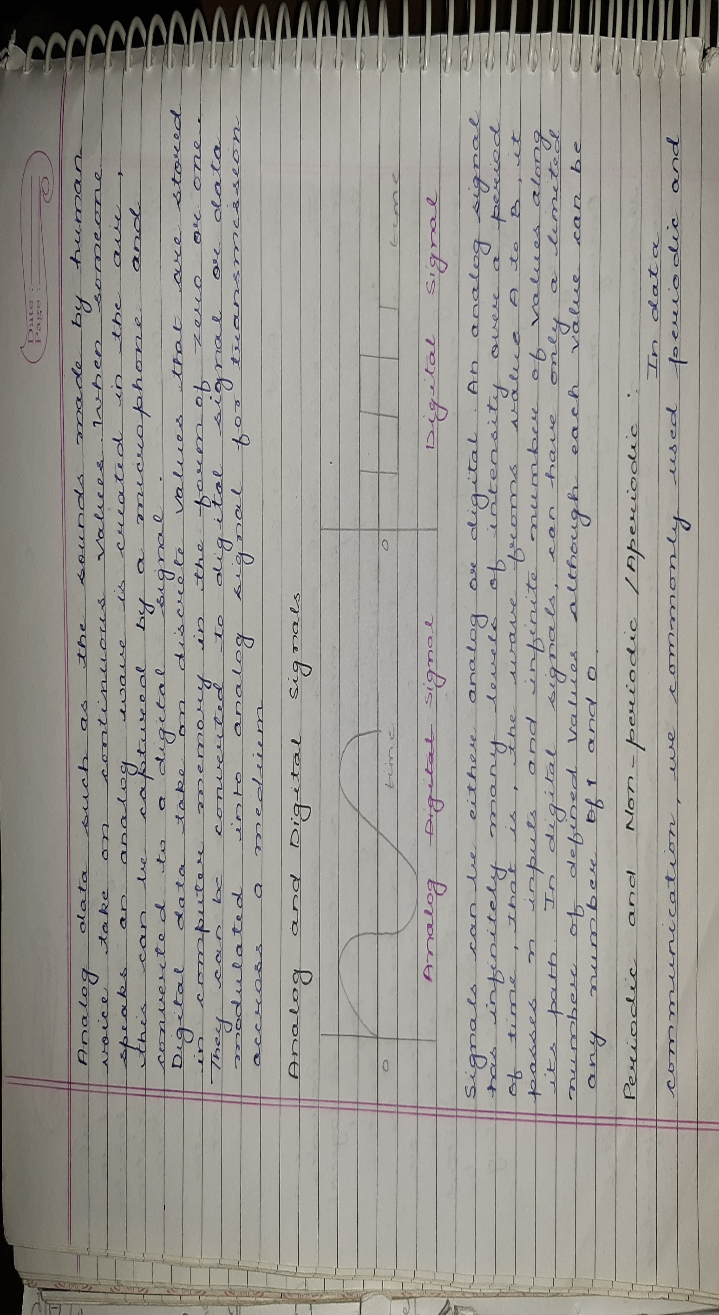

Slide 5
