Slide 1
Transmission Impairment
Unit2

Slide 2
Attenuation
For the receiver to interpret the data accurately, the signal must be sufficiently strong. When the signal passes through the medium, it tends to get weaker. As it covers distance, it loses strength.
Dispersion
As signal travels through the media, it tends to spread and overlaps. The amount of dispersion depends upon the frequency used.

Slide 3
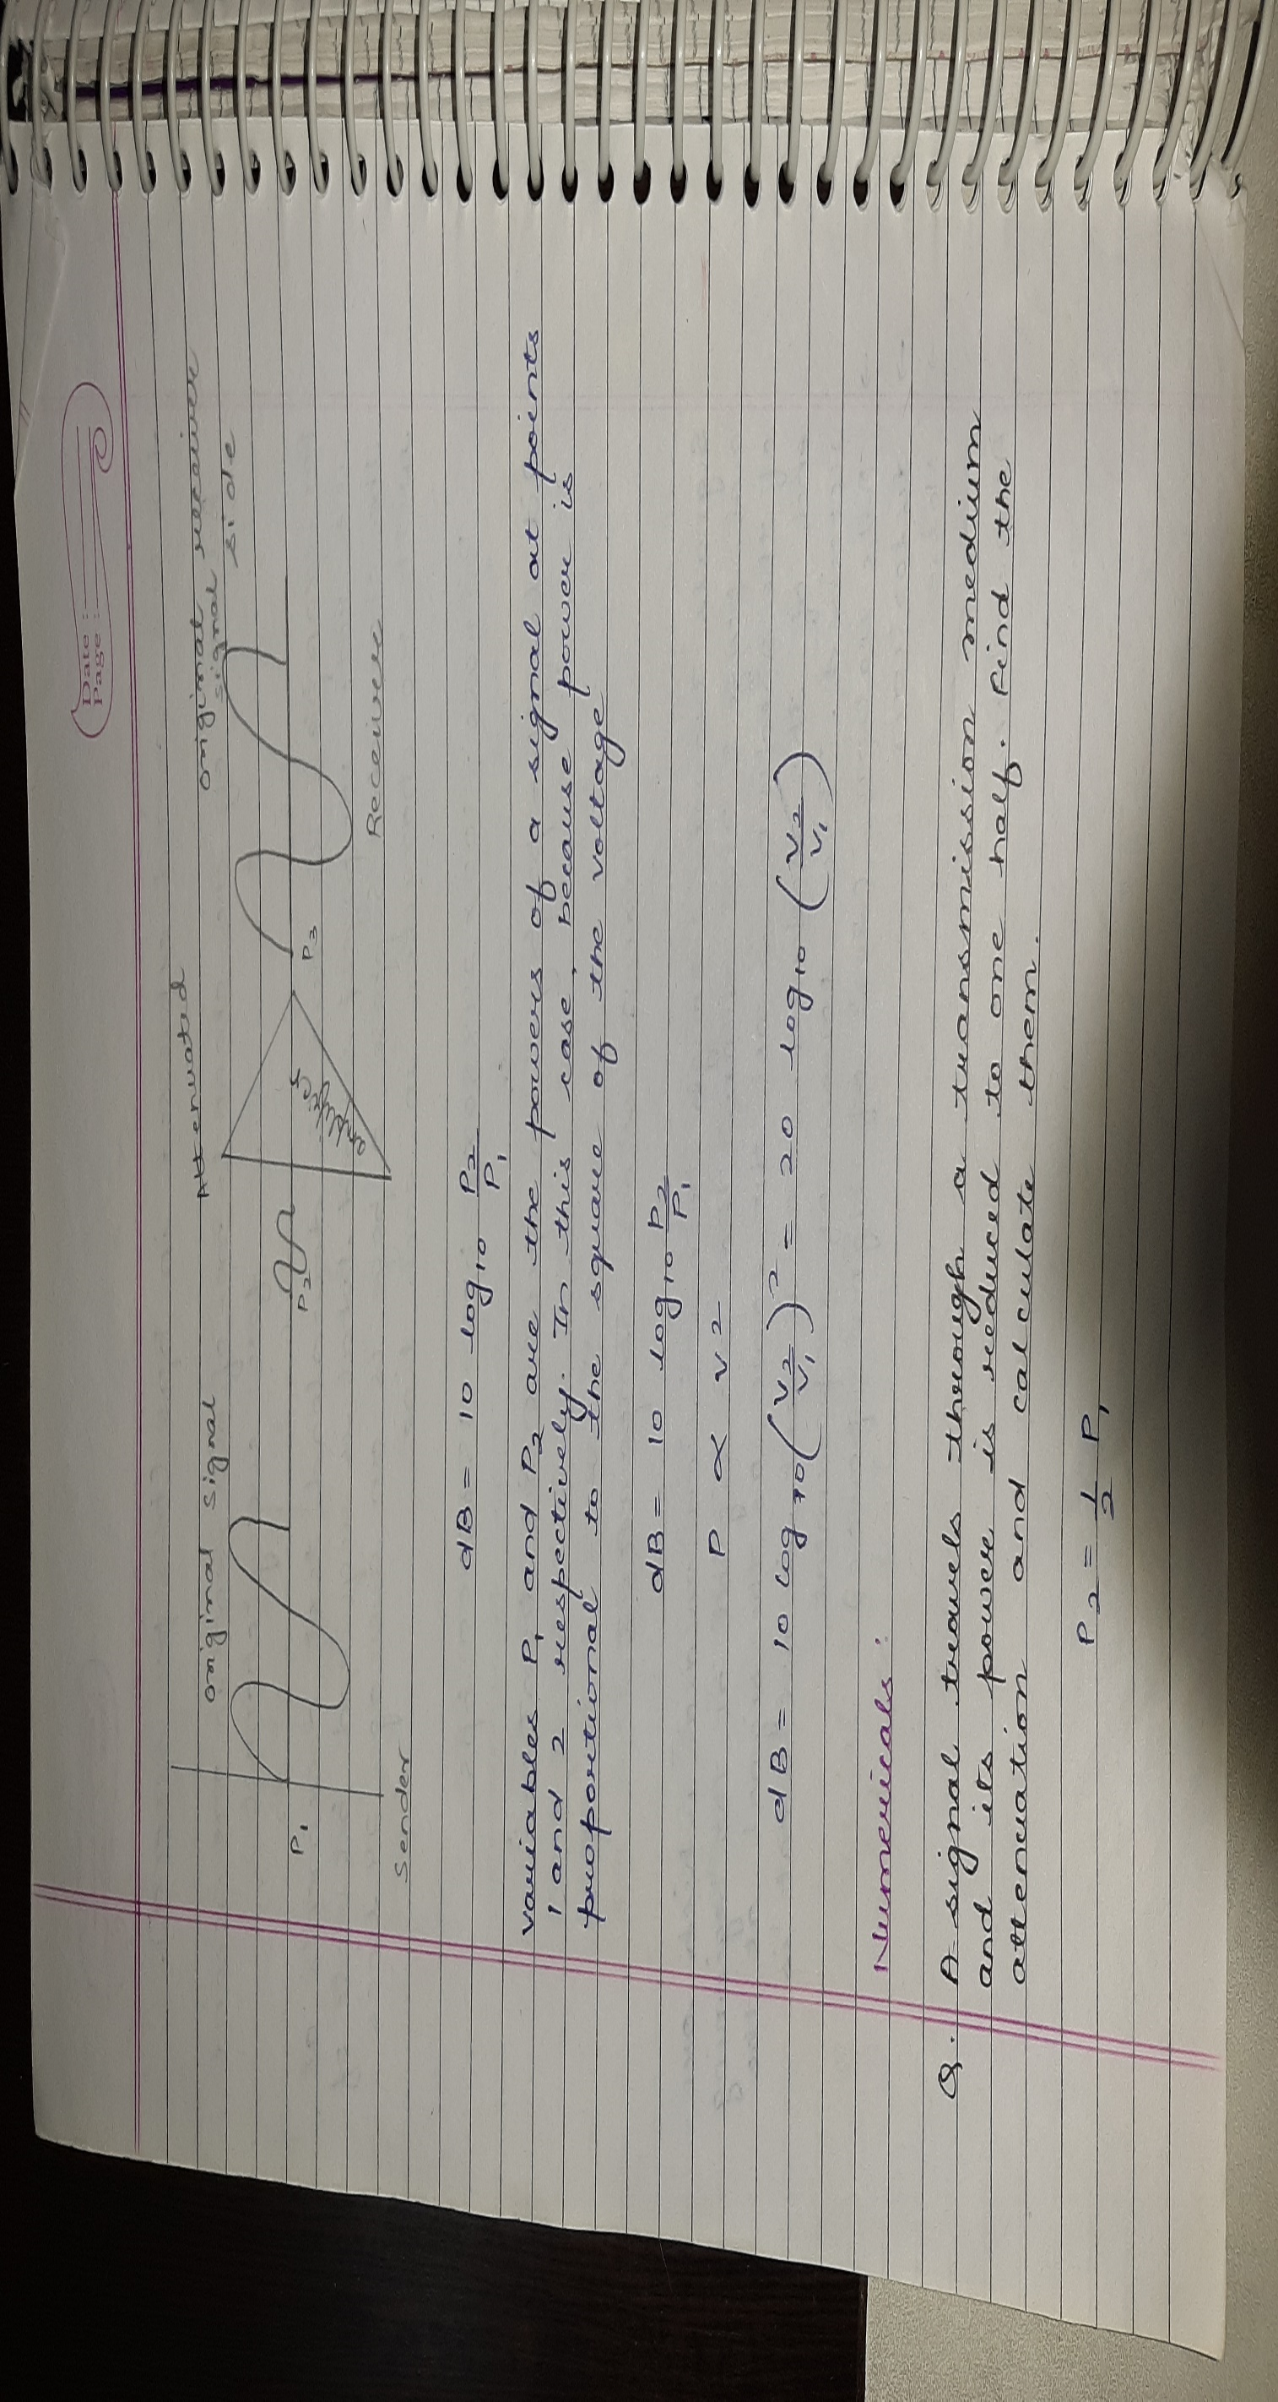

Slide 4
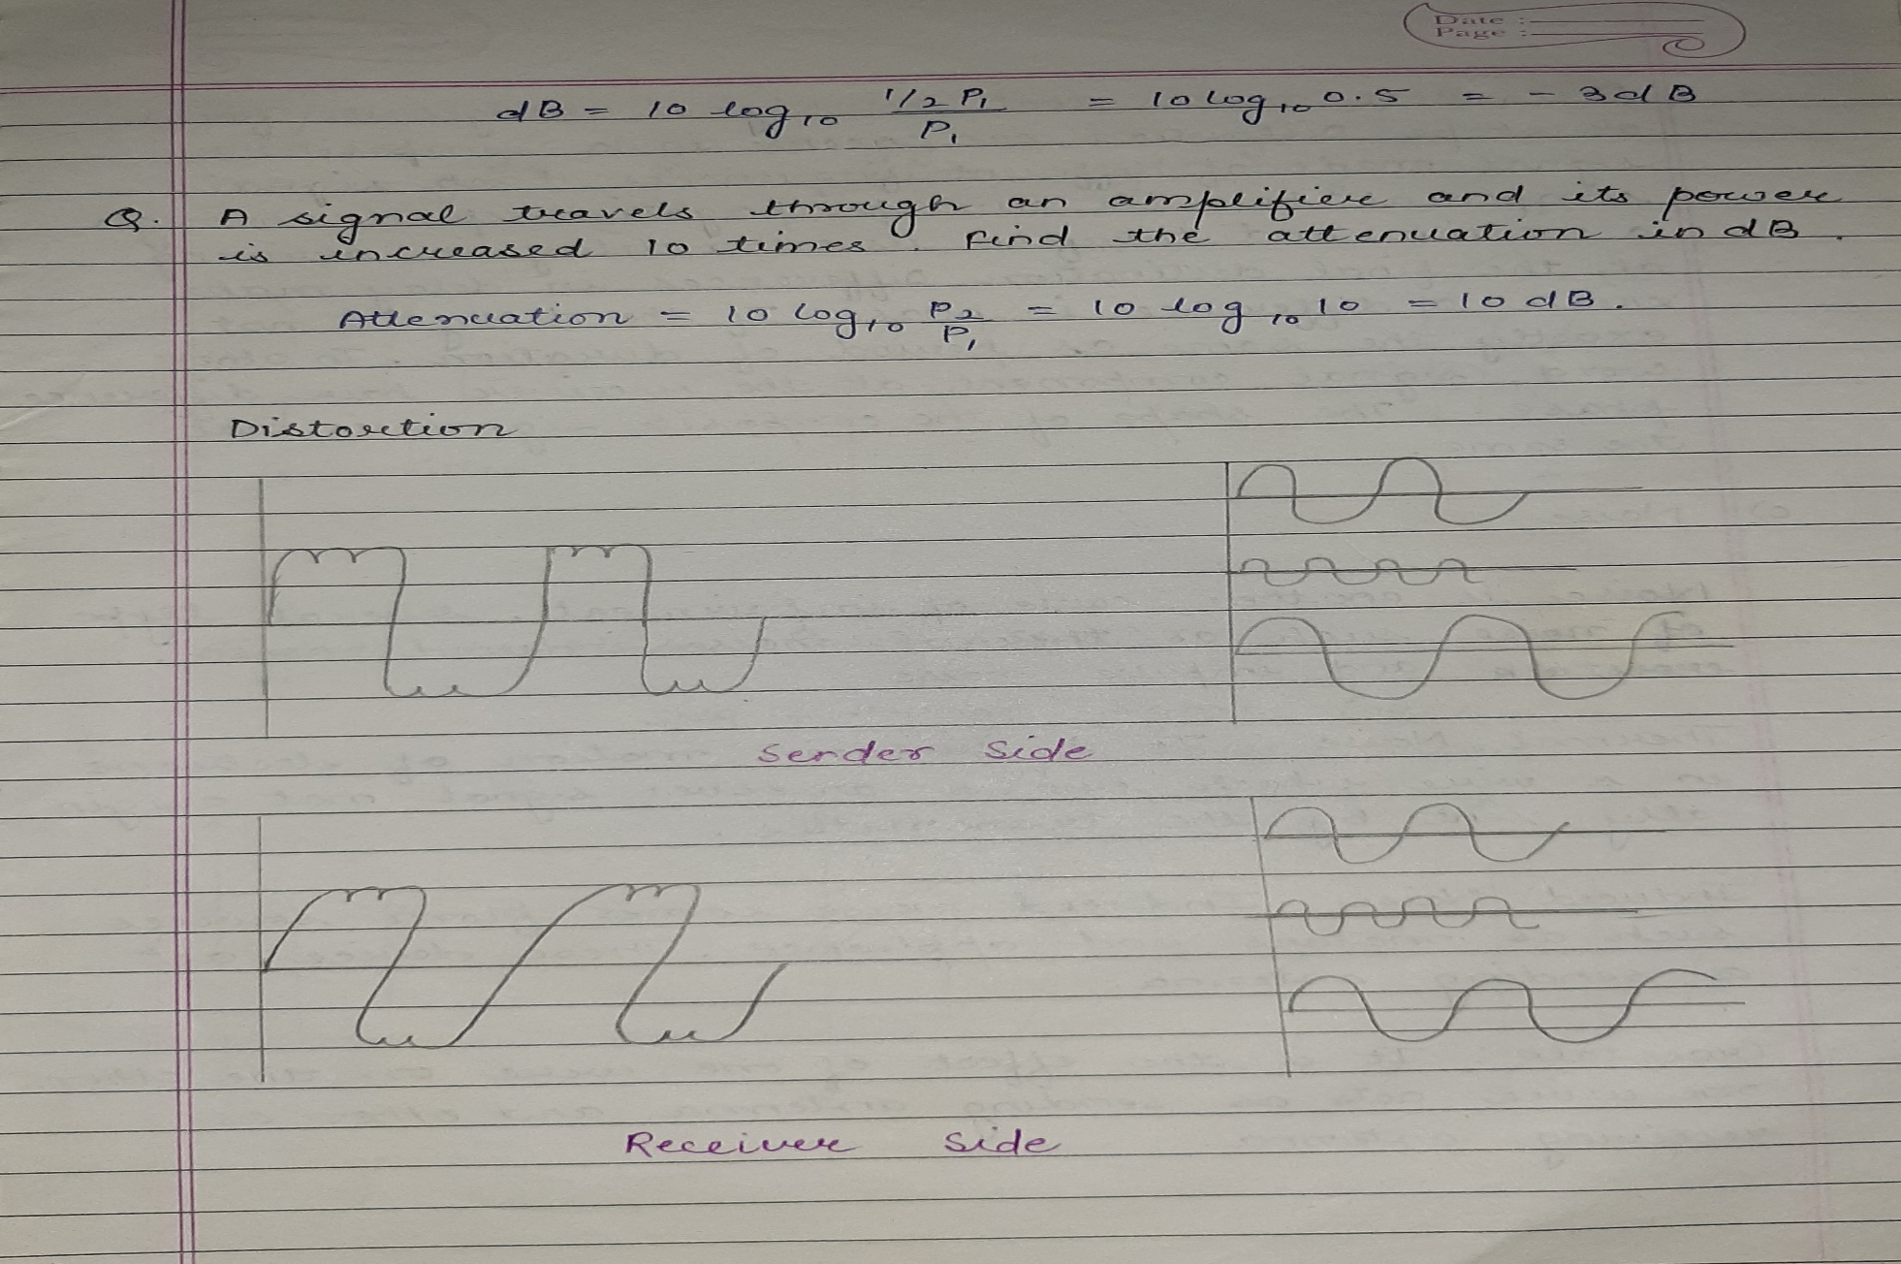

Slide 5
