Slide 1
Acute Rheumatic Fever

Slide 2
INTRODUCTION
Occurs as a result of complex interaction between GROUP A Streptococcus a susceptible host and environment.
An abnormal immune response to a GAS infection leads to an acute inflammatory illness that most commonly affects the joints, heart ,brain or skin.
Major public health problem among children and young adults in developing countries.
Most important acquired heart disease in children.
It is most important acquired heart disease in children and commonly found in 4 to 15 years of ago with incidence rate 5.0/1000 approximately

Slide 3
EPIDEMIOLOGY
The incidence of rheumatic fever is closely related the incidence of group A Streptococcal PHARYNGITIS
AGES : 5 -15 YEARS ARE MOST SUSCEPTIBLE
RARE: < 3 YEARS
GIRLS / BOYS : BOTH SEXES ARE EQUALLY AFFECTED .
COMMON : WORLD COUNTRIES.
ENVIROMENT FACTORS : OVERCROWDING , POOR SANITATION, POVERTY,…
INCIDENCE MORE DRING : WINTER SEASON , FALL , TEMPERTURE.

Slide 4
DEFINITION
ACUTE RHEUMATIC FEVER IS AN ACUTE AUTOIMMUNE COLLAGEN DISEASE OCCURS AS A HTPERSENSTIVITY REACTION TO GROUP A BETA HEMOLYTIC STREPTOCOCCAL INFECTION. IT IS CHARACTERIZED BY INFLAMMATOY LESION OF AEECETS THE HEART , JOINT, BLOOD VESSELS AND OTHER CONNECTINE TISSUE

Slide 5
ETIOLOGY
The etiology of rheumatic fever is not clear.
GROUP A BETA HEMOLYTIC Streptococcal INFECTION.
Delayed non- suppurative squeal URTI with GAB
Diffuse inflamatory disease of connective tissue.
Primalily involving heart, blood, vessels , joint subcutaneous tissue and CNS.

Slide 6
RISK FACTORS
Most common age group involvex in 5 to 15 years
Both sexes are equally affected.
Poor nutrition
Poor hygiene.
Low immunological status increasing susceptibility.

Slide 7
PATHOPHYSIOLOGY
The exact etiopathogenesis or ARF is not well understood.
Preceding streptococcal infetion may not always critically manifest it is considered as a sort of hypersensitivity reaction.
There is an antigen antibody reaction usually following streptococcal sore throat.
Ag streptococcal antibody titr elevated in majority of the patients , although the streptococci have never been isolated from rheumatic lesion in joint , heart or in the blood – stream.
The auto antibodies attack the myocardium , pericardium and cardiac valves.
Severe myocarditis may result dilation of the heart and hear failure.

Slide 8
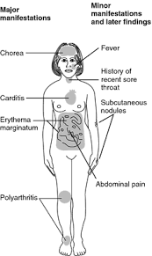
CLINICAL MANIFESTATIONS
MAJOR
MINOR
ESSENTIAL
OTHER

Slide 9
MAJOR MANIFESTATIONS
CARDITIS : EARLY MANIFESTATION
EXAMPLE : PERICARDITIS , ENDOCARDITIS, MYOCARDITIS EVIDENCED AS PRESENCE OF SIGNIFICANT – MURMUR , ECG CHAGES , CARDIAC ENLARGEMENT , FRICTION RUB.

Slide 10
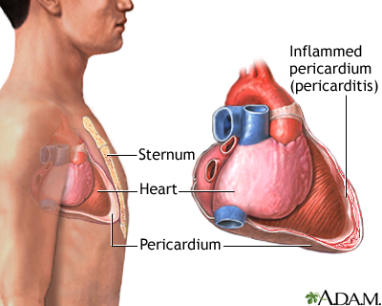
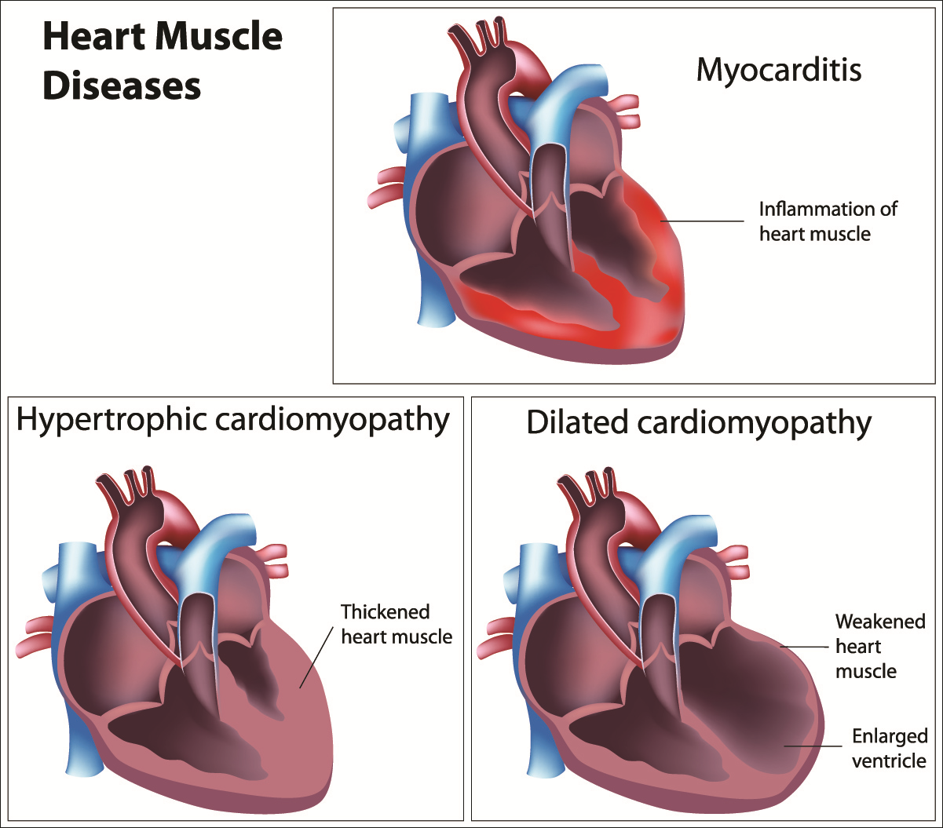

Slide 11
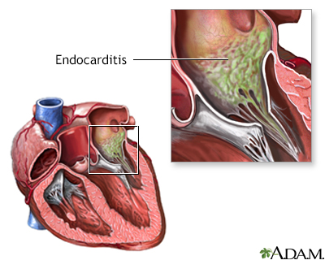

Slide 12
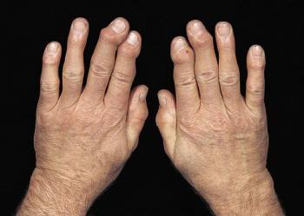
POLYARTHRITIS
Migratory type of joint inflammation s/s-pain , decrese acyive movements, warm tenderness, redness and swelling
Two or more joints are affected.
Commonly knees, ankles and elbow are involved , but smaller joint may also be affected.

Slide 13
CHOERA
PURPOSELESS INVOLUNTARY, RAPID MOVEMENTS USUALLY ASSOCIATED WITH MYSCLE.
WEAKNESS, INCORDINATION,INVILUNTARY FACIAL GRIMACE, SPEECH DISTRUBANCE,AWKWARD GAIT AND EMOTIONAL DISTRUBANCES.

Slide 14
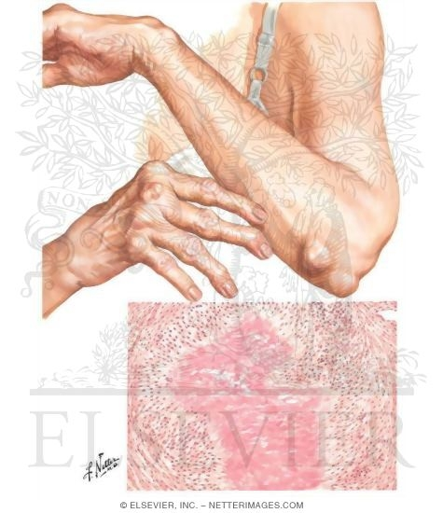
SUBCUTANEOUS NODULES
It is found as firm painless movements nodule over the extensor surface of certain joints.
Joints- elbow , knee, wrists.

Slide 15
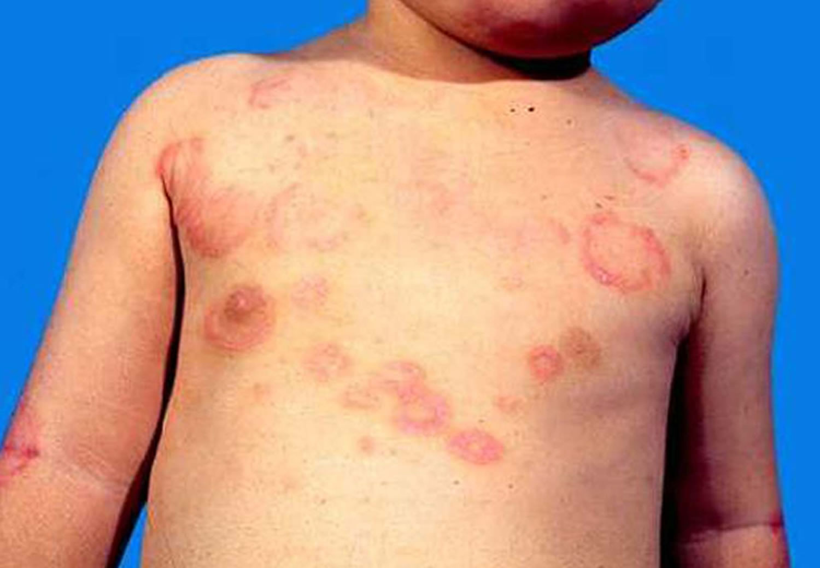
ERYTHEMA MARGINATUM
Pink macular non-itching rash
Found mainly over the trunk, sometimes on the extremities but never on face

Slide 16
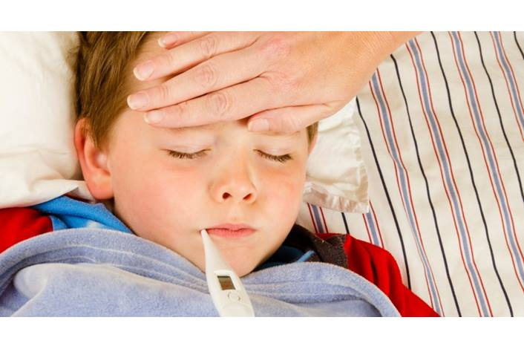
MINOR MANIFESTATIONS
FEVER
ARTHRALGIA
PREVIOUS ATTACK OF ARF
ECG CHANGES
ELREVATED ESR
FEVER- increase in the body temperture is common findings.
It rarely goes above 39.5 c.

Slide 17
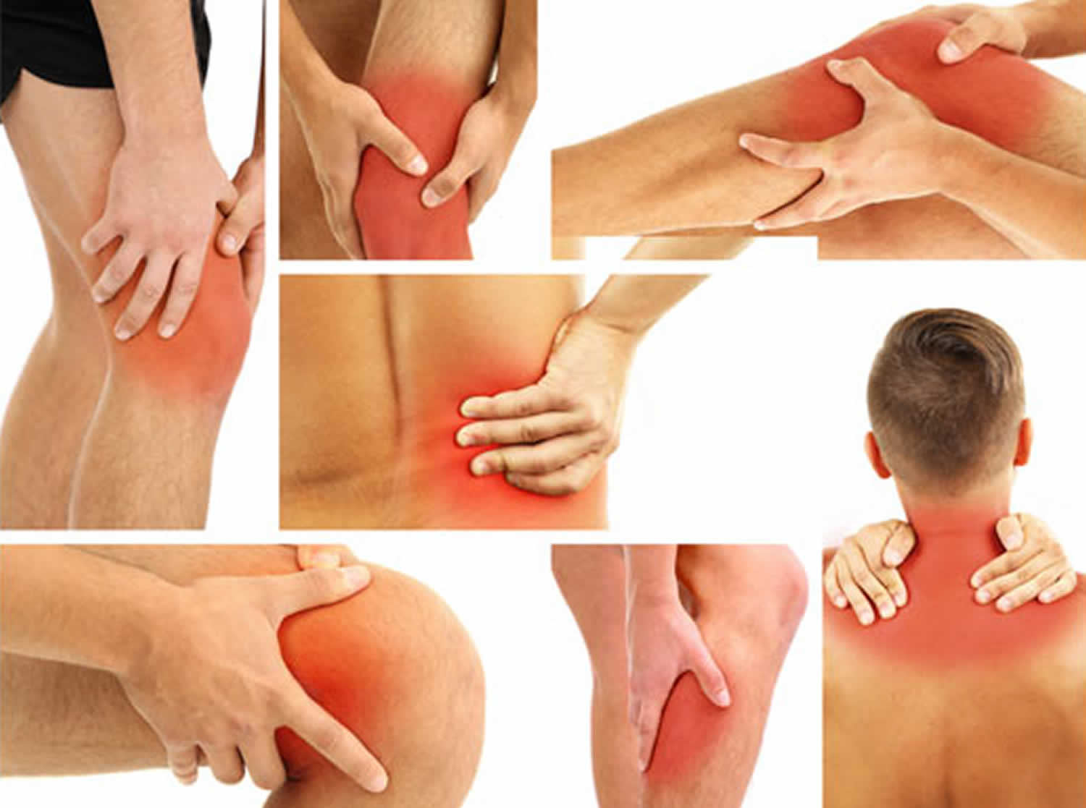
ARTHRALGIA
Pain in the joints occurs in about 90 percent of cases.
It present along with arthritis.

Slide 18
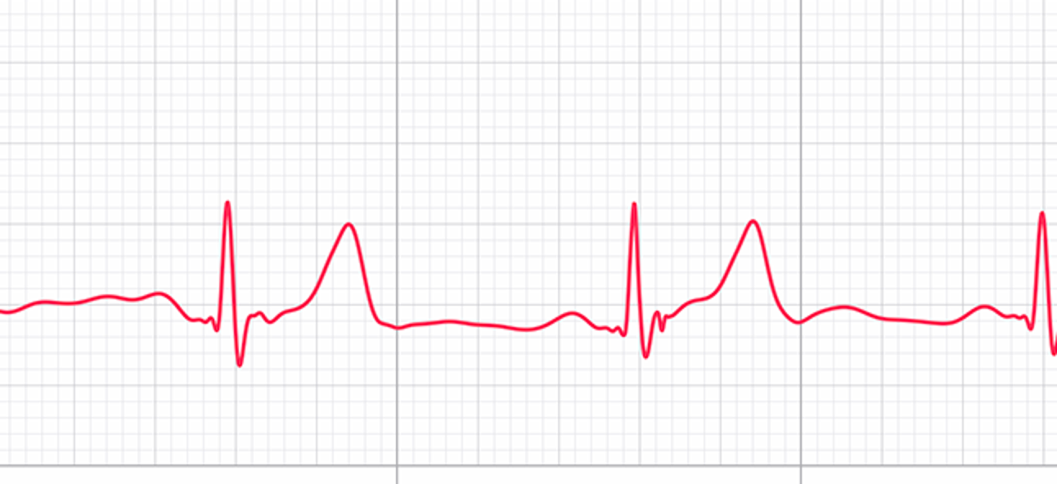
PREVIOUS ATTACK OF ARF
Previous attack of rheumatic fever or rheumatic heart disease.
Applicable for a second attack of rheumatic fever.
ECG CHANGES
ECG Changes with prolonged P-R interval is considered as minor criterion .
It is not diagnostic of carditis.

Slide 19
ELEVATED ESR
ELEVATED ESR OR PRESENCE OF C – REACTIVE PROTEIN MAY BE CONSIDEED AS MINOR CRITERIA.
ESSENTIAL CRITERIA:- Elevated antistreptolysin-o-titer indicates previous streptococcal infection.
Normal – 200 IU/ML
Positive throat swab culture may show streptococcal infection. (sore throat, scarlet fever etc.)

Slide 20
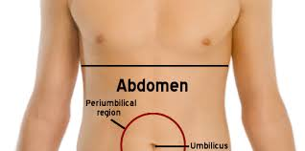
OTHER MANIFESTATIONS
Precordial pain
headache
Abdomen pain
vomiting
sweating
malaise

Slide 21
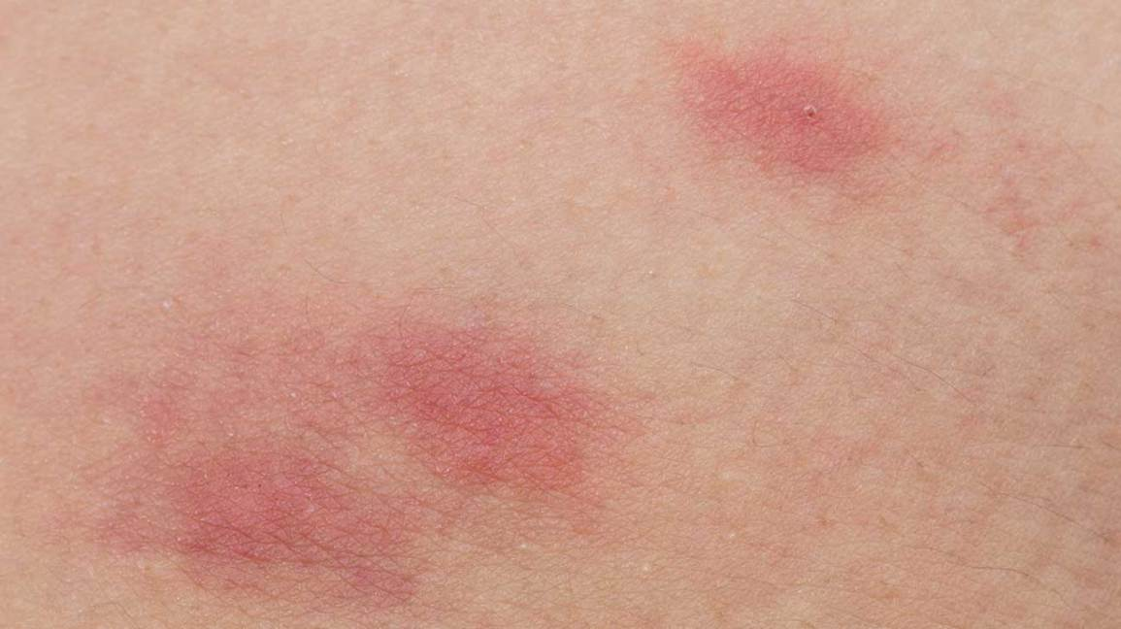
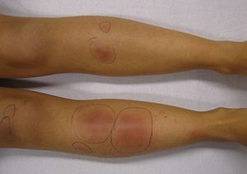
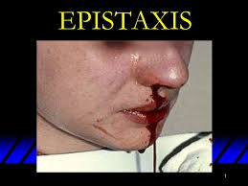
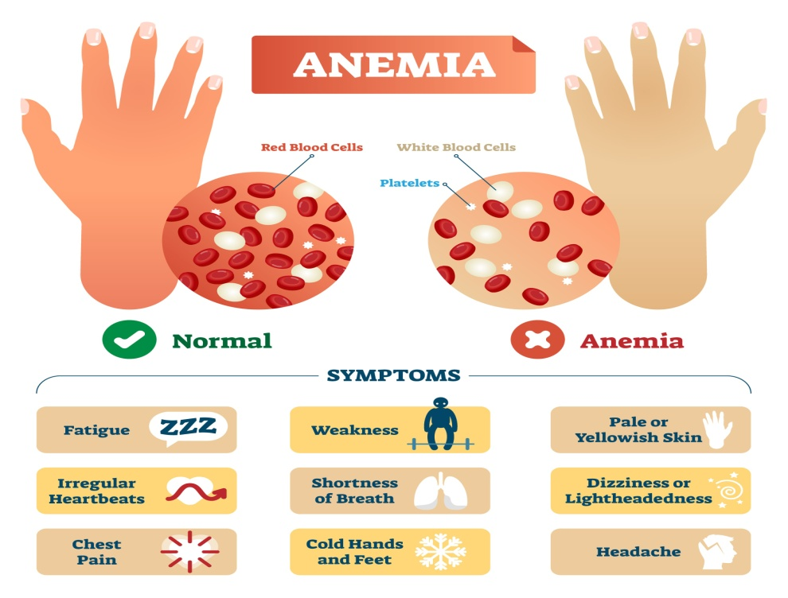
Skin rash
Erythema nodosum

Slide 22
DIAGNOSTIC EVALUATION
Artificial subcutaneous nodule
Doppler echocardiography
Endomyocardial biospy
Chest x- ray
Electrocardiography
Blood test for ESR, WBC counts.

Slide 23
MANAGEMENT
INVESTIGATIONS- History collection
Physical examination
Complete blood count
Acute phase reactants
Throat swab culture
Antistreptolysin o titer
Chest radiograph
Electrocardiogram
Echocardiography

Slide 24
TREATMENT
BED REST
DIET
ANTIBIOTIC THERAPHY, PENICILLIN
COUNSELLING
ANTIINFLAMMATORY THERAPY- Aspirin steroid

Slide 25
PREVENTION
PRIMARY PREVENTION
Health education the people to avoid streptococcal sore throat and elimination of predisposing factors of the disease.
Treatment of streptococcal pharyngitis with penicillin or other medication.
SECONDARY PREVENTION
1.Patient with documented histories of rheumatic fever, heart disease and also isolated cases of chorea must receive prophylaxis.
DURATION : every 3 weeks till the age of 25 to 30 years.
after the age of 30 years fever is not known to occur.

Slide 26
METHOD
Long acting BENZATHINE PENICILLIN given to 6,00,000 unit to be given to patient weighing 27 kg .
Less 1.2 million units for patients weight more than 27 kg.
Route : intramuscularly
DURATION: every 21 days

Slide 27
DRUGS
Erythromycin-40 Mg/Kg 24 Hours To Be Given Once A Day
Oral Sulfadiazine – 0.59 Once A Day For Less Than 27 Kg And 1 G Once A Day For Those More Than 27 Kg.
PROGNOSIS
Prognosis of rheumatic fever depend upon the age, presence of heart lesions, stage of detection of the disease, available treatment facilities and number of previous disease.
Prognosis is worst in patients with carditis is an early childhood.

Slide 28
References
Textbook of Medical Microbiology by Ananthnarayan, Paniker, D.R. Arora
Textbook of Medical Microbiology by C.P Baweja

