Slide 1
CHHATRAPATI SHAHU JI MAHARAJ UNIVERSITY.KANPUR
BY– DR AAMENA ZAIDI
Assistant Professor
School of Health Sciences

Slide 2
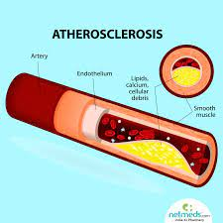
Atherosclerosis
CONTENT
. Introduction
. Causes
. Symptom
. Diagnose
. Complications
. Treat
. Diet for atherosclerosis

Slide 3
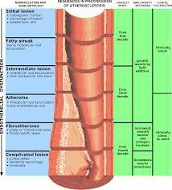
Introduction
Atherosclerosis [also know as arteriosclerotic vascular disease or ASVD]
. The condition in the which an artery wall thickens as the result of a build-up of fatty material such as cholesterol .
. Affecting arterial blood vessels , a chronic inflammatory response in the wall of arteries .
. Its is commonly referred to as a hardening or furring of the arteries .
. Its is caused by the formation of multiple plaques within the arteries
.Its can restrict blood flow . These plaques can also burnt , causing Causes blood clot

Slide 4
A build up of cholesterol plaque in the walls of arteries, causing obstruction of blood flow. Plaques may rupture, causing acute occlusion of the artery by clot.
Atherosclerosis often has no symptoms until a plaque ruptures or the build-up is severe enough to block blood flow.
A healthy diet and exercise can help. Treatments include medication, procedures to open blocked arteries and surgery.

Slide 5
Causes
Atherosclerosis starts with damage or injury to the inner layer of an artery. The damage may be caused by
. High blood pressure
. High cholesterol
. An irritant, such as nicotine
. Certain diseases , such as diabetes

Slide 6
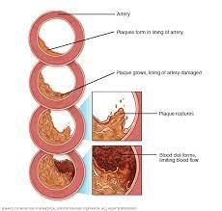
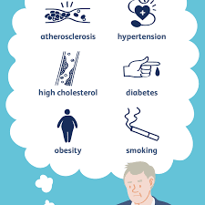
Step in atherosclerosis development
Fatty streak
Fibrous plaque
Calcification plaques
Atheromsa

Slide 7
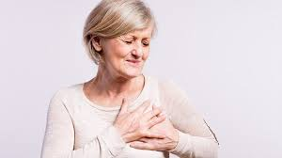
Symptoms
If you have atherosclerosis in the arteries leading to your brain, you may have signs and symptoms such as sudden numbness or weakness in your arms or legs, difficulty speaking or slurred speech, temporary loss of vision in one eye, or drooping muscles in your face.

Slide 8
Symptom
You might not have symptoms until your artery is nearly closed or until you have a heart attack or stroke. Symptoms can also depend on which artery is narrowed or blocked.
Symptoms related to your coronary arteries include:
Arrhythmia, an unusual heartbeat
Pain or pressure in your upper body, including your chest, arms, neck, or jaw.

Slide 9
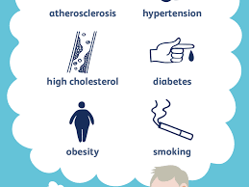
Symptoms related to the arteries that deliver blood to your brain include:
Numbness or weakness in your arms or legs
A hard time speaking or understanding someone who’s talking
Drooping facial muscles
Severe headache

Slide 10
Risk Factors for Atherosclerosis
Atherosclerosis starts when you’re young. Research has found that even teenagers can have sign
these risk factors are behind more than 90% of all heart attacks:
Abdominal obesity ("spare tire")
High blood pressure
High cholesterol
Not eating fruits and vegetables
Not exercising regularly
Smoking

Slide 11
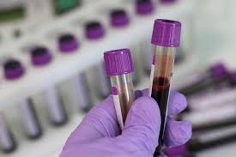
Diagnose Atherosclerosis
Doctors have an arsenal of diagnostic tests and tools they can access to confirm the presence of Atherosclerosis
These include
an angiogram (Arteriogram),
cholesterol tests,
a chest x-ray, a CT (computed tomography)
Blood test
an exercise stress test

Slide 12
Lifestyle changes: You can slow or stop atherosclerosis by taking care of the risk factors. That means a healthy diet, exercise, and no smoking. These changes won't remove blockages, but they’re proven to lower the risk of heart attacks and strokes
Fibrinolytic therapy: A drug dissolves a blood clot that’s blocking your artery.

Slide 13
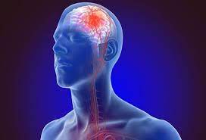
Complications of Atherosclerosis
Complications of atherosclerosis include:
Angina
Chronic kidney disease
Coronary or carotid heart disease
Heart attack
Peripheral artery disease
Stroke
Unusual heart rhythms

Slide 14
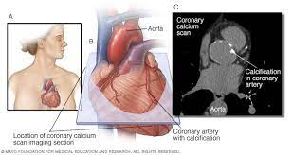
Treat Atherosclerosis
Medication: Drugs for high cholesterol and high blood pressure will slow and may even halt atherosclerosis. They lower your risk of heart at
Bypass surgery: Your doctor takes a healthy blood vessel, often from your leg or chest, and uses it to go around a blocked segment.
tack and stroke.

Slide 15
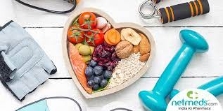
Diet for atherosclerosis
A heart – healthy diet includes fruit , vegetable , whole grain ,fish , meat , nut ect
Rich omega 3 and fiber
Chia, flaxseed
Brown bread
Vitamin c – orange, mango,tomato sauce

