Slide 1
BIOFEEDBACK
AAKANKSHA BAJPAI

Slide 2
History & philosophy
Biofeedback is one of the earliest behavioural medicine treatments and has been practiced in clinical settings since the 1970’s.
Biofeedback achieves its results through psychophysiological (mind-body) self-regulation. Today, biofeedback is used widely by physicians, nurses, psychologists, physical therapists, drug rehabilitation counselors, dentists and other professionals to treat an array of disorders.
In biofeedback therapy, individuals are trained on electronic monitors to exert control over vital bodily processes, such as heart rate, respiration, blood pressure, muscular tension, and brain activity.

Slide 3
Definitions
"Bio" means life. "Feedback" is returning knowledge to origin. Then "biofeedback" means returning the biological knowledge created by the origin to origin in order to make the origin understand and control that knowledge.
“A method of controlling the system by re-inserting into it the results of its past performances” - Wiener,1948.

Slide 4
The idea behind biofeedback is that, by harnessing the power of your mind and becoming aware of what's going on inside your body, you can gain more control over your health.
Biofeedback is built on the concept of “mind over matter.” The idea is that, with proper techniques, you can change your health by being mindful of how your body responds to stressors and other stimuli.

Slide 5
Principle
Two aspect-
It should be appropriate for the change required,
It should be easily recognized and used by the patient.

Slide 6
Purpose
To enhance an individual's awareness of physical reactions to physical, emotional, or psychological stress , and their influence on their own physiological responses.
To develop self regulation skills that play a role in improving health and well-being.

Slide 7
Biofeedback is aimed at combating stress through relaxation techniques. You consciously manipulate your breathing, heart rate, and other usually “involuntary” functions to override your body’s response to stressful situations.
Biofeedback appears to be most effective for conditions that are heavily influenced by stress. Some examples include: learning disorders, eating disorders, bedwetting, and muscles spasms.

Slide 8
Stages
Rest
Recovery
Stress

Slide 9
Biofeedback equipments
Electromyograph- provides data on muscle tension

Slide 10
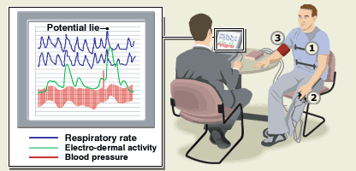
Galvanic skin response (skin conductance)-
A change in the electrical resistance of the skin caused by emotional stress, measurable with a sensitive galvanometer, e.g. in lie-detector tests.

Slide 11
Precisely monitors stress
levels by translating tiny
tension-related changes in
skin conductance into a
rising or falling tone.

Slide 12
Temperature or thermal biofeedback
-Sensors monitor body temperature and changes in blood flow.

Slide 13
Heart rate biofeedback
-A pulse monitor placed on the fingertip monitors pulse rate,
-Increases in heart rate are associated with emotional arousal, such as being angry or fearful,
-Decreases in heart rate are associated with relaxation.

Slide 14
Capnometry
Capnometry uses a capnometer and optional graphing capability (capnograph) to measures carbon dioxide concentration in expired gases. It is used during anesthesia and intensive care, and in lung function studies.

Slide 15
EEG
Sensors attached to the scalp monitor brain wave activity in different parts of the brain.

Slide 16
Electrodermographs (EDG)
This measures sweating and can be used for pain and anxiety.

Slide 17
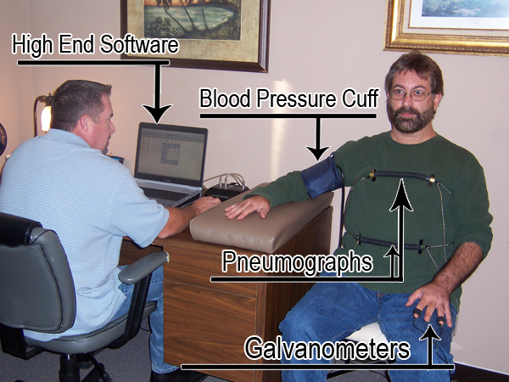
Pneumographs
measures chest expansion, chest contraction, and respiration rate.

Slide 18
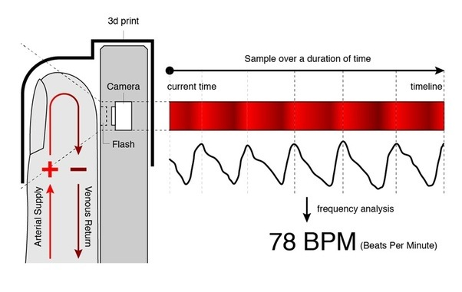
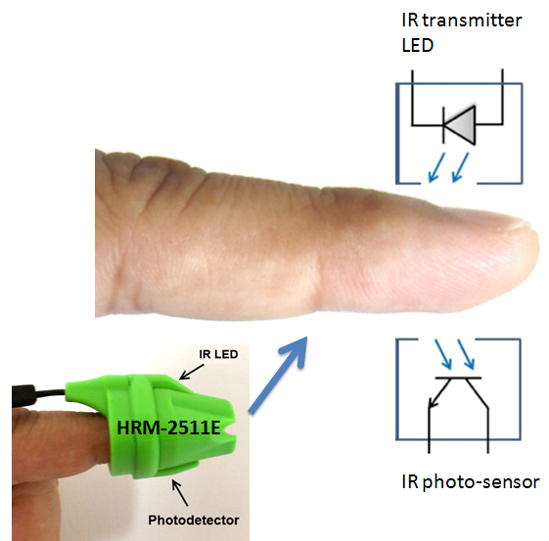
Photoplethysmographs (PPG)
provides data on blood flow through a digit (for example, a finger), blood volume pulse, heart rate, and heart rate variability.

Slide 19
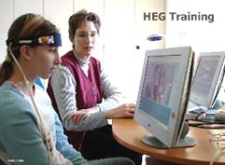
Hemoencephalographs (HEG)
-popular neurofeedback equipment ;
-change the signal generated by their brain and measured via some neuro feedback.

Slide 20
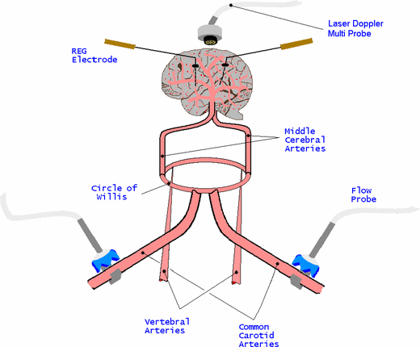
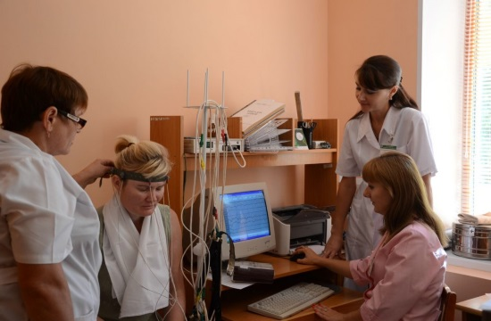
Rheoencephalographs (REG)
measures blood blow in the brain

Slide 21
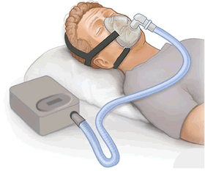
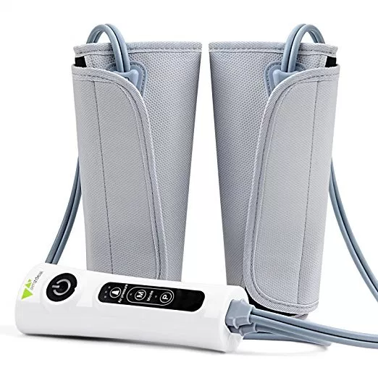
Air pressure devices
commonly used to measure muscle performance.

Slide 22
Mechanism
Biofeedback may utilizes electronic sensors, or electrodes, attached to various parts of the body to detect changes in physical responses.
Signals then inform the individual of these changes by means of visual or auditory signals such as a light display or a series of beeps.
While the individual views or listens to feedback, he or she begins to recognize thoughts, feelings, and mental images that influence his or her physical reactions.

Slide 23
By monitoring this mind-body connection, the individual can use the same thoughts, feelings, and mental images as cues or reminders to become more relaxed, or to change heartbeat, brain wave patterns, body temperature, and other body functions.
The individual uses trial-and-error to change the signals change in the desired direction.

Slide 24
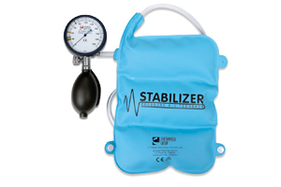
Static biofeedback stabilizer

Slide 25
For example, individuals trying to control their blood pressure levels may see a light flash whenever the pressure drops below a certain level.
They may then try to remember what their thoughts and feelings were at the moment and deliberately maintain them to keep the blood pressure level low.
Through training, the individual learns to control the targeted physical response and, over time, is able to recognize what is required to reduce problematic symptoms.
Eventually, the external biofeedback becomes unnecessary as the individual learns to perceive internal physical responses and make the desired changes. The individual then has a powerful, portable, and self administered treatment tool to deal with problematic symptoms.

Slide 26
Uses
Migraines,
Headaches,
Anxiety,
Urinary incontinence,
Chronic pain disorder,
Hypertension,
Seizure,
Stroke,
Cerebral palsy,
Post-Orthopaedic surgery,
Raynaud’s disease,
Attention deficit hyperactivity disorder (ADHD)

Slide 27
Chronic obstructive pulmonary disease (COPD),
Constipation,
Epilepsy,
Rheumatoid arthritis.

Slide 28
Dosage
Each biofeedback therapy session lasts about 30 minutes. Usually, you can start to see biofeedback benefits within 10 sessions or less. E.g.- high blood pressure, can take 20 or more sessions to improve.

Slide 29
Recent advances
“Effects of biofeedback treatment on gait in children with cerebral palsy”-Ebril et al.
“Audio-Biofeedback Improves Balance in Patients With Bilateral Vestibular Loss”-Marco Dozza et al.
“Visual EMG Biofeedback to Improve Ankle Function in Hemiparetic Gait”-D.H.Gates et al.
“Biofeedback Intervention for Stress, Anxiety, and Depression among Graduate Students in Public Health Nursing”-Paul et al.

Slide 30
Fig 1. Experimental setup. The centre of pressure (COP) displacements illustrated are from 1 participant with BVL standing on the foam with eyes closed, with (light grey) and without (dark grey) ABF information available. The smaller the dimension of the COP displacement in the graphs, the smaller is the participant’s sway. Consequently, the graphs show how, using ABF, people can reduce their postural sway. Abbreviation: Acc- acceleration.

Slide 31
Ongoing Research
De Charms, R. C., Maeda, F., Glover, G.H., Ludlow, D., Pauly, J.M., Soneji, D., & Mackey, S.C. (2005). Learned volitional control over brain fMRI activation and pain and developed a real-time fMRI for the purpose of training the brain to activate its own endogenous opiates. deCharms believes this will revolutionize the treatment of chronic pain. Proceedings of the National Academy of Sciences USA.

Slide 32
THANK YOU

