Slide 1
Bacterial Spore

Slide 2
Bacterial Spores
Highly resistant resting (or dormant) stage of the bacteria formed in unfavourable environmental conditions
Bacterial spores formed within the parent cell, are called as endospores and the remaining part of the bacteria is called as the sporangium.

Slide 3
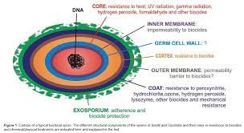
Structure of a spore
Bacterial spore comprises of several layers.
From innermost towards the outermost, the layers are- core→ cortex→ coat→ exosporium.

Slide 4
Sporulation
Sporulation (or sporogenesis) refers to the process of formation of spores from vegetative stage of bacteria.
It is not a method of reproduction because the bacteria do not divide during sporulation.
Sporulation commences when growth ceases due to lack of nutrients. It is a complex process, takes about 10 hours which may be divided into seven stages.

Slide 5
Sporulation
Stage I (axial filament formation)
Stage II (septum formation)
Stage III(engulfment of forespore)
Stage IV
Stage V
Stage VI
Stage VII (release)

Slide 6
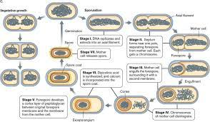
Sporulation

Slide 7
Germination
Transformation of dormant spores into active vegetative cells when grown in a nutrient-rich medium. It comprises of three stages-
Activation
Germination
Outgrowth

Slide 8
Shape and Position of Spores
For a given species, the precise position, shape and relative size of the spore are constant.
Position-Spores may be central, subterminal or terminal.
Shape-They may be oval or spherical in shape.

Slide 9
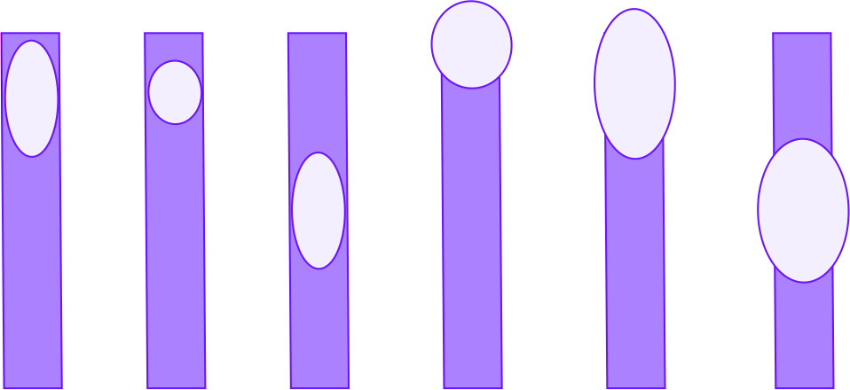
A
B
C
D
E
F
A. Non-bulging, oval and terminal; B. Non-bulging, round, and subterminal;
C. Non-bulging, oval and central; D. Bulging, round and terminal;
E. Bulging, oval and terminal; F. Bulging, oval, and central

Slide 10
Sporicidal agents
Spores are resistant to most of the routinely used disinfectants.
Sporicidal agents are:
Ethylene oxide Formaldehyde Glutaraldehyde Hydrogen peroxide | 5. O-Phthalic acid 6. Peracetic acid 7. Autoclave 8. Hot air oven 10. Plasma sterilization

Slide 11
Demonstration of spores
Gram staining-Spores appear as unstained refractile bodies within the cells.
Modified Ziehl-Neelsen staining
Special techniques for endospore staining include the Schaeffer–Fulton stain and the Moeller stain.

Slide 12
Applications
Indicators for proper sterilization.
Spores of Geobacillus stearothermophilus are used as sterilization control for autoclave.
Spores of non-toxigenic strains of Clostridium tetani are used as sterilization control for hot air oven.
Spores have also been used as agents of bioterrorism;

Slide 13
References
Textbook of Medical Microbiology by Ananthnarayan, Paniker
Textbook of Medical Microbiology by C.P Baweja
Textbook of Medical Microbiology by S. Bhat, A.S.Sastry
Textbook of Medical Microbiology by D.R.Arora, Brij bala Arora

