Slide 1
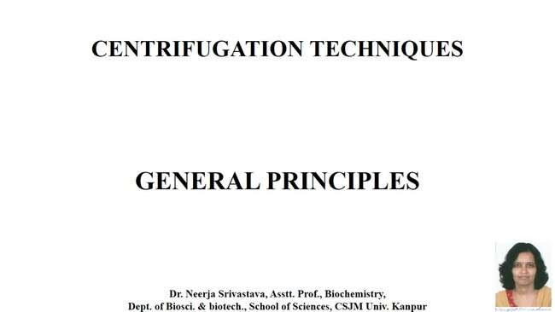
CENTRIFUGATION TECHNIQUES

Slide 2
CENTRIFUGATION TECHNIQUES

Slide 3
PRINCIPLE OF CENTRIFUGATION

Slide 6
Sedimentation

Slide 7
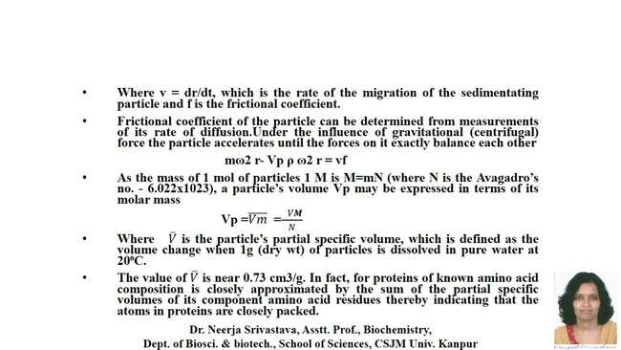

Slide 8
Sedimentation Coefficient

Slide 10
Frictional Ratio

Slide 13
TYPES OF CENTRIFUGE

Slide 15
HIGH-SPEED CENTRIFUGES

Slide 16
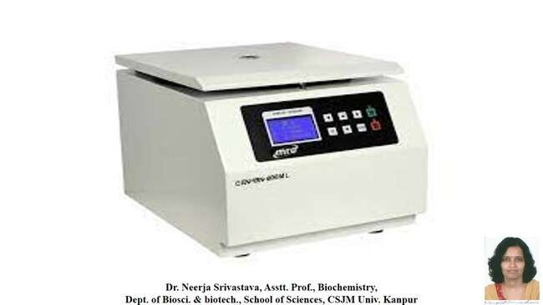

Slide 17
ULTRACENTRIFUGES

Slide 18
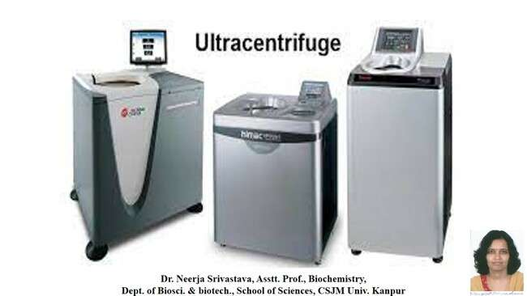

Slide 19
TYPES OF ROTORS

Slide 24
CONTINUOUS ACTION ROTOR

Slide 25
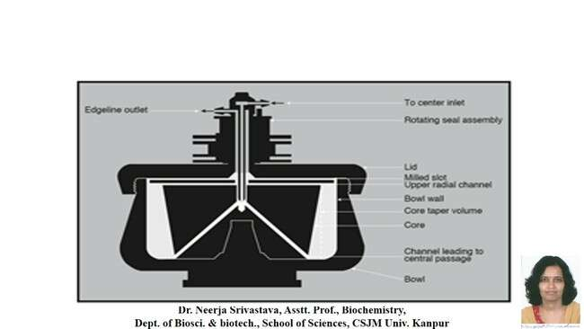

Slide 26
THE ANDERSON OR ZONAL ROTOR

Slide 27
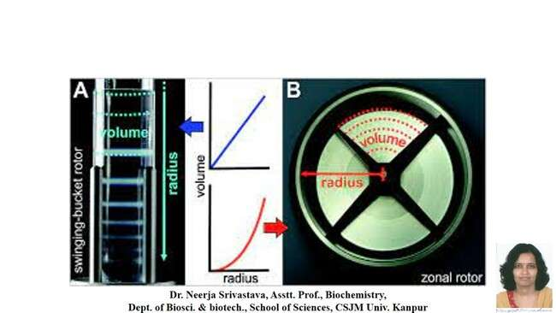

Slide 28
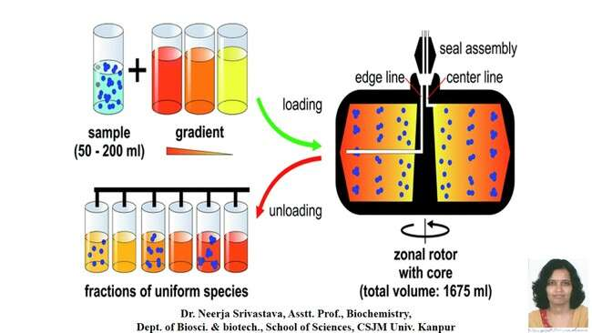

Slide 31
ROTOR FOR ANALYTICAL CENTRIFUGATION

Slide 33
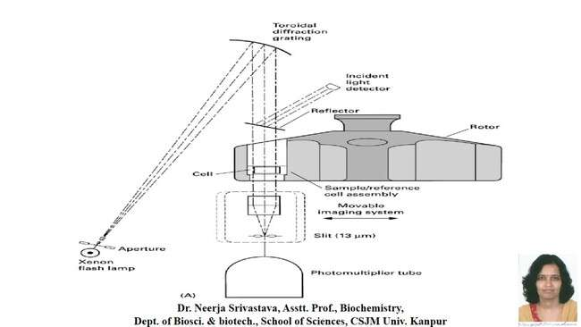

Slide 34
References: 1. Physical Biochemistry By Freifelder 2. Modern Experimental Biochemistry By Boyer

