Slide 1
CAPACITOR
Aakanksha Bajpai
Assistant Professor
School of Health Sciences

Slide 2
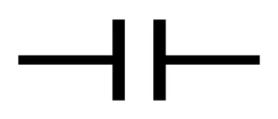
Device that store electric charges
Consists of two plates
Separated by an insulator
Non-conductive region can either be a vacuum or an electrical insulator known as dielectric (glass, air, paper, semi-conductor).
Variety of sizes and shapes
Symbol

Slide 3
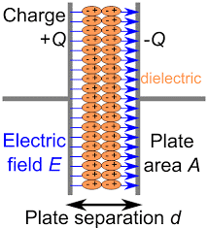
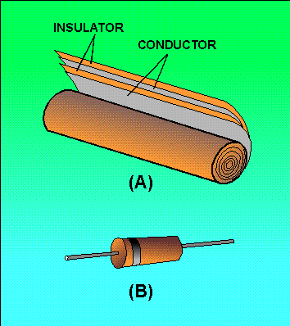
Types of Capacitor
Parallel plate capacitor
Cylindrical capacitor

Slide 4
Capacitance
Ability to store charge.
Unit of capacitance is Farad(F).
Capacitance values are normally smaller, such as µF, nF or pF.
C=Q/V
Capacitance of capacitor is directly proportional to Charge store on that capacitor and inversely proportional to Voltage.

Slide 5
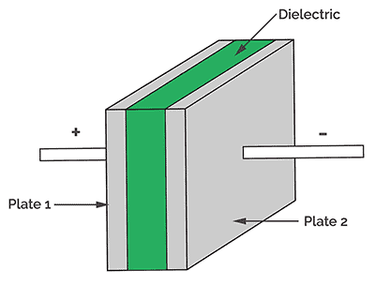
Basic Capacitor Construction
Two Plates.
Dielectric(air, glass, paper or semi-conductor material).
Due to dielectric charges store on capacitor plates.

Slide 6
Storing Charge On Capacitor
Connect to a voltage source.
Positive charges start flowing towards one plate of capacitor and negative towards other.
Due to dielectric charges start accumulating on plate surface.
Potential rises from zero.
Flow of charges stops when capacitor potential become equal to potential of battery.
Same case with negative charges.
So, charge store on the capacitor

Slide 7
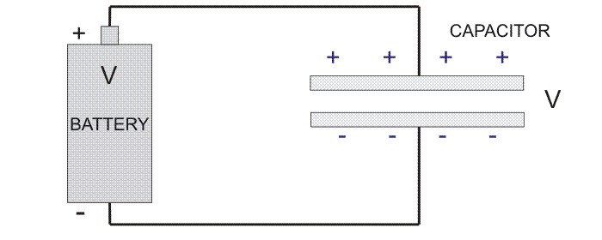

Slide 8
Capacitors In Parallel
• Voltage remain same
• The equivalent capacitance of two capacitors connected in parallel is the sum of the individual capacitances.

Slide 9
Capacitor In Series
Charge remain same.
The reciprocal of the equivalent capacitance of two capacitors connected in series is the sum of the reciprocals of the individual capacitances.

Slide 10
Uses of Capacitor
To reduce the variations in the intensity of a rectified current
To control the timing of electronic interrupters and surgers
To make current more comfortable for the patient
To produce a high frequency current
To tune SWD machine for maximum transfer of energy from machine circuit to patient circuit.

Slide 11
THANK YOU

