Slide 1
Chromatin:
The compacting of DNA is accomplished by the binding of the DNA to many different cellular proteins.
The formation of a highly organized DNA-protein complex, termed as chromatin, which is a nucleoprotein complex completes the packing.
Chromatin can be defined as highly condensed chromosomes at metaphase stage, and very diffuse structures in course of interphase.

Slide 2
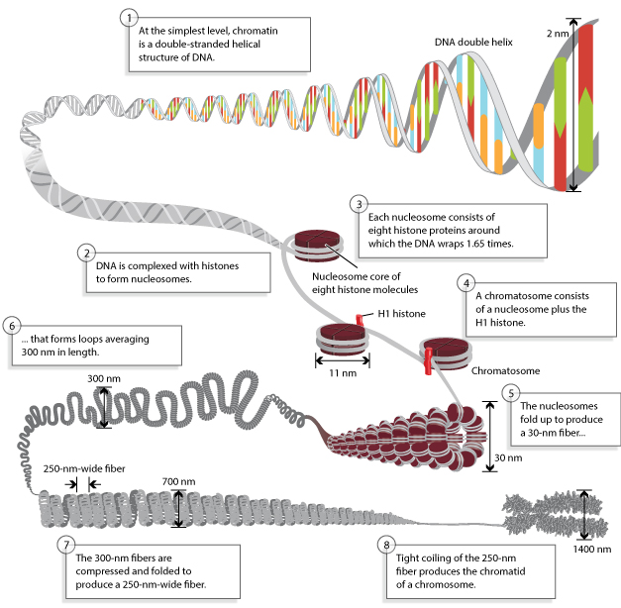
Chromatin composition and packaging

Slide 3
Histones:
Histones are most abundant proteins in chromatin.
Histones are small and positively charged proteins and are of 5 major types: H1, H2A, H2B, H3 and H4.
Histones are characterized by the presence of high percentage of basic amino acids arginine and lysine.
These amino acids are positively charged that give the histones a net positive charge facilitating the binding of histones to the negatively charged DNA.
Histone and DNA are present in equal amounts in chromatin.
A heterogenous variety of non-histone chromosomal proteins also are found in eukaryotic chromosomes.
The amino acid sequences of histones H2A, H2B, H3 AND H4 are highly conserved, even between distantly related species.
Evolutionary conservation of these amino acid sequences highly indicates that histones perform the same basic role in organizing the DNA in the chromosomes of all eukaryotes.

Slide 4
Role of H1:
The next level of condensation of chromatin is brought about by histone H1.
H1, in contrast to the other histones is not the part of the core particle.
H1 binds to 20-22 bp of DNA, where the DNA joins and leaves the octamer.
H1 binds both to the linker DNA at one end of the nucleosome and to the middle of the DNA segment wrapped around core histones.
H1 serves to restrict the DNA into place and functions as a clamp around the nucleosome octamer.
The core particle and it’s associated H1 histone are altogether called as the chromatosome.

Slide 5
Nucleosomes:
When the chromatin is isolated from the nucleus of a cell and observed under an electron microscope, it resembles beads on a string.
The repeating core of protein and DNA produced by digestion with nuclease enzymes is the nucleosome.
Nucleosome is the basic structural and fundamental unit of chromatin and is the simplest level of chromatin.
Nucleosome is a core particle formed when the DNA is wrapped about 2 times around an octamer of eight histone proteins (2 copies each of H2A, H2B, H3, H4).
The DNA in direct contact with the histone octamer is between 145 and 147 bp in length.
This configuration compacts the DNA by six times.

Slide 6
Linker DNA:
Each chromatosome encloses about 167 bp of DNA (147bp around nucleosome+20bp bound by H1).
Chromatosomes are present at regular intervals along the DNA molecule and are apart from each other by linker DNA.
The size of linker DNA varies among cell types, in most cells, linker DNA comprises of about 30-40 bp.
The 30nm chromatin fiber:
The nucleosomes compact themselves into a structure about 30nm in diameter, now termed as the 30nm chromatin fiber.
There are two possible models for the 30nm fiber.
They are:
Solenoid model: In this model, a linear array of nucleosomes are coiled into a higher order left handed helix, entitled as solenoid, with around six nucleosomes per turn.
Helix model: In this model, nucleosomes are arranged in a zigzag ribbon that twists or supercoils.

Slide 7
Higher order structure of chromatin:
The next higher level of chromatin structure is represented by a series of loops of 30nm fibers, each anchored at its base by proteins in the nuclear scaffold.
On average, each loop encloses some 20-100kb of DNA and measures about 300nm in length.
The 300nm loops are packed and folded to result a 250nm wide fiber.
Tight helical coiling of the 250 nm, in turn, yields the structure that is visible in metaphase- individual chromatids approximately 700nm in width.

