Slide 1
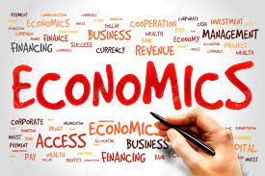
Demand Forecasting
Dr. Pooja Singh Assistant Professor, Department of Economics, School of Arts, Humanities And Social Sciences, Chhatrapati Shahu Ji Maharaj University, Kanpur

Slide 2
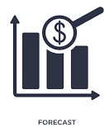
Demand Forcasting
Demand Forecasting
Art of predicating demand for a product or service at some future date on the basis of present and past behaviour of some related event.
Estimate the demand of product or service within given situation

Slide 3
Usefulness of Demand Forecasting
Demand Forecasting
Planning and decision making
Business forecasting
Production analysis
Useful to the consumers
Factors of production

Slide 4
Factors Affecting Demand Forecasting
Demand Forecasting
For non-durable consumer goods
For durable consumer goods
Disposable income
Price
Demography
Social status, Prestige
Existence of growth and infrastructural facilities
Tax policy and intensity of consumers
Price and Credit Facilities

Slide 5
Method of Forecasting
Demand Forecasting
Survey of Buyers Intension- The most direct method of estimating demand in short run is to ask customers about their purchase planning in future reference.
Collective Opinion Method- Consolidation of expected sales, estimated by salespersons in their respective area.
Expert opinion method (Delphi Method)- Opinions of experts are collected and exchanged among them without revealing their identity. This process goes on until some sought of unanimity is arrived at among all the experts.
Controlled Method- Under this method an efforts is made to vary separately certain determinants of demand which can be manipulated and conduct the experiments that the other factor remain constant.[The effect of demand determinants like price, advertisement ,packaging etc., on sales can be assessed by either varying them over different markets or by varying them over different time period in the same market.]

Slide 6
Demand Forecasting
Business Barometer- Use of business indicators of various phenomenon
Some of important indicators which aid businessmen in demand forecasting are follow-
Gross National Product (GNP)
Industrial production
Consumer credit
Disposable personal income
Stock price

Slide 7
Demand Forecasting
Statistical Method-
Trend Projection Method-This method depends upon time series. Considerable records on sale pertaining to different time periods are collected and then effective demand is forecasted.
Graphical Method- In this, the forecasting is done with the help of graphs. The sales belonging to previous years are plotted on a graph and a free hand curve is drawn passing through as many points as possible to know the trend in past years..
Least Square Method- It is a mathematical procedure for fitting a line to a set of observed data in such a manner that the sum of squared difference between the calculated and observed value is minimised. This technique is used to find a trend line which best fits the available data. This trend is used to project dependent variable in the future.
Regression Method- A relationship is established between quantity demanded and dependent and independent variable such as income ,price and price of related goods.

Slide 8
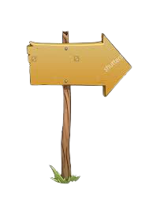
Demand Forecasting
Determination of Objective
Selection of Method
Interpreting the Result
Selection of Product
Steps in Demand Forecasting

Slide 9
Reference
Demand Forecasting
Salvatore, S., Managerial Economics, Mc Graw Hill Publications.
Dwivedi D N, Managerial Economics, Vikas Publishing House Pvt. Ltd, 2006

