Slide 1
Descriptive Data Mining
MBI304- Data Mining & Data Analytics
Mamta Sagar
Department of Bioinformatics
University Institute of Engineering & Technology, CSJM University, Kanpur

Slide 2
describe the data
The first and simplest analytical step in data mining is to describe the data — summarize its statistical attributes (such as means and standard deviations), visually review it using charts and graphs, and look for potentially meaningful links among variables

Slide 3
The final step is to empirically verify the model. For example, from a database of customers who
have already responded to a particular offer, you’ve built a model predicting which prospects are likeliest to respond to the same offer.
Can you rely on this prediction? Send a mailing to a portion of the new list and see what results you get

Slide 4
But data description alone cannot provide an action plan.
You must build a predictive model based on patterns determined from known results, then test that model on results outside the original
sample.
A good model should never be confused with reality (you know a road map isn’t a perfect
representation of the actual road), but it can be a useful guide to understanding your business.

Slide 5
Data mining employs algorithms and techniques from statistics, machine learning, artificial intelligence, databases and data warehousing etc.
Some of the most popular tasks are classification, clustering, association and sequence analysis, and regression.
Depending on the nature of the data as well as the desired knowledge there is a large number of algorithms for each task. All of these algorithms try to fit a model to the data (Dunham, 2002). Such a model can be either predictive or descriptive.

Slide 6
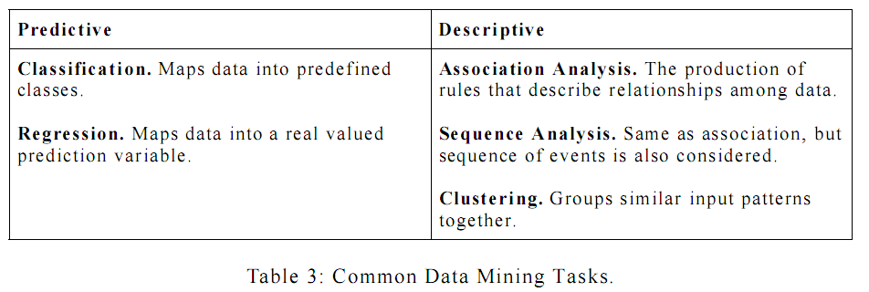

Slide 7
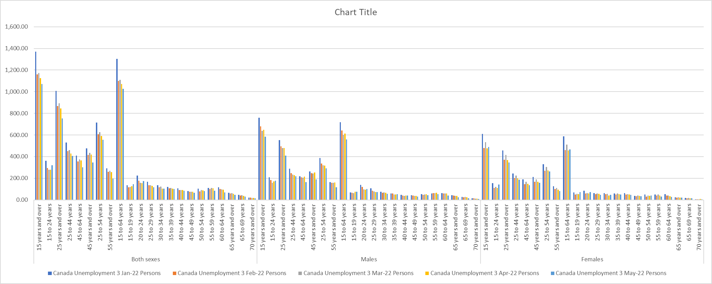

Slide 8
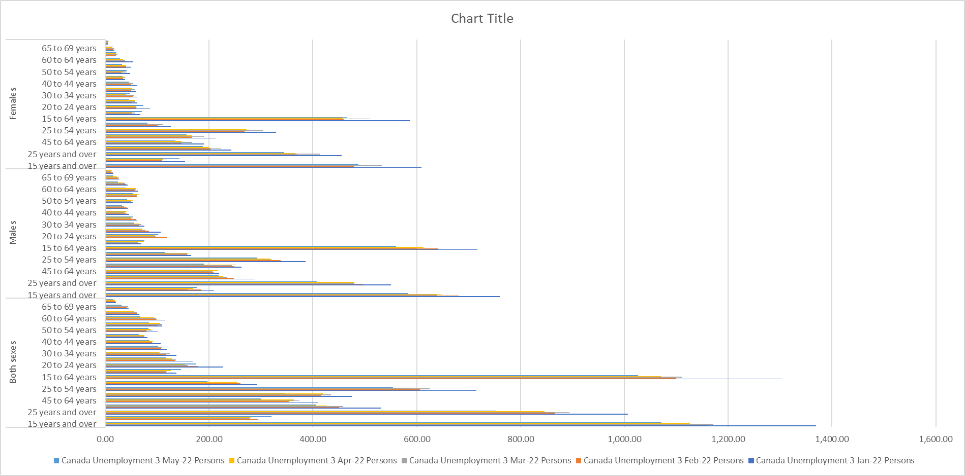

Slide 9
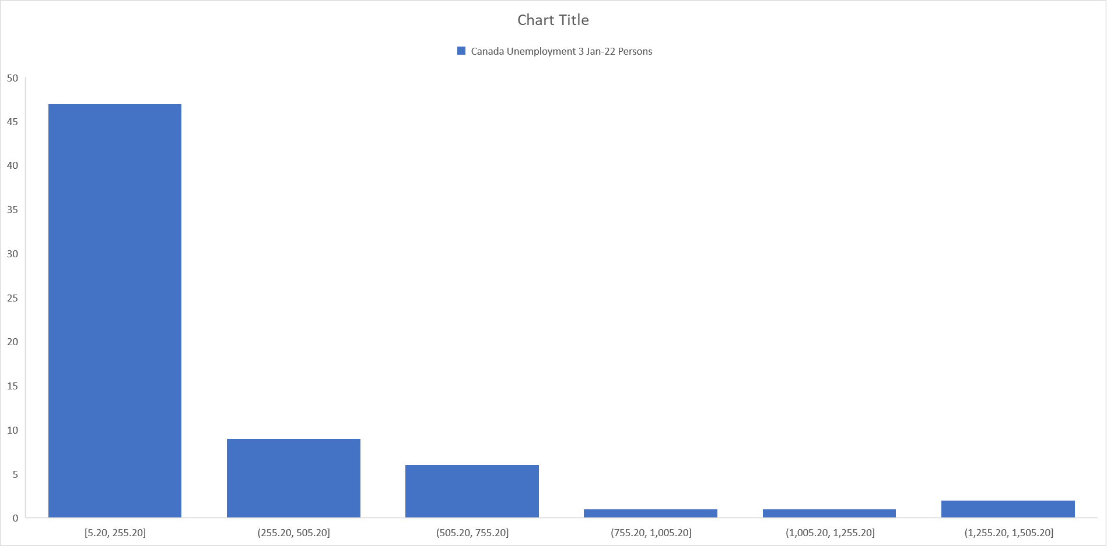

Slide 10
Clustering
Clustering divides a database into different groups. The goal of clustering is to find groups that are very different from each other, and whose members are very similar to each other. Unlike classification (see Predictive Data Mining, below), you don’t know what the clusters will be when you start, or by which attributes the data will be clustered.

Slide 11
Often it is necessary to modify the clustering by excluding variables that have been employed to group instances, because upon examination the user identifies them as irrelevant or not meaningful. After you have found clusters
that reasonably segment your database, these clusters may then be used to classify new data. Some of the common algorithms used to perform clustering include Kohonen feature maps and K-means.

Slide 12
Don’t confuse clustering with segmentation. Segmentation refers to the general problem of identifying groups that have common characteristics.
Clustering is a way to segment data into groups that are not previously defined, whereas classification is a way to segment data by assigning it to groups that are already defined.

Slide 13
Link analysis
Link analysis is a descriptive approach to exploring data that can help to identify relationships among values in a database.
The two most common approaches to link analysis are association discovery and sequence discovery.
Association discovery finds rules about items that appear together in an event such as a purchase transaction. Market-basket analysis is a well-known example of association discovery.
Sequence discovery is very similar, in that a sequence is an association related over time.

Slide 14
Some terminology In predictive models, the values or classes we are predicting are called the response, dependent or target variables. The values used to make the prediction are called the predictor or independent variables. Predictive models are built, or trained, using data for which the value of the response variable is
already known.
This kind of training is sometimes referred to as supervised learning, because calculated or estimated values are compared with the known results. (By contrast, descriptive techniques such as clustering, described in the previous section, are sometimes referred to as unsupervised learning because there is no already-known result to guide the algorithms.)

