Slide 1
ENTERIC FEVER

Slide 2
INTRODUCTION
The enteric fever is a disease caused by Salmonella Typhi (causing typhoid fever) or Salmonella paratyphi A, B and C (causing paratyphoid fever).
The term enteric fever includes both typhoid and paratyphoid fever.
CAUSATIVE AGENTS
Salmonella Typhi
Salmonella Paratyphi A
Salmonella Paratyphi B
Salmonella Paratyphi C
These salmonellae are primarily intestinal parasites of vertebrates which infect man, leading to enteric fever.
They belongs to family enterobacteriaceae.

Slide 3
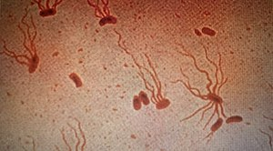
MORPHOLOGY
Salmonellae are Gram negative bacilli measuring 1-3 micrometer (μm) × 0.5 micrometer (μm).
They are motile, non-sporing and non-capsulated.
Motility is due to peritrichous flagella.

Slide 4
PATHOGENESIS AND CLINICAL COURSE
1.TYPHOID FEVER
The infection is acquired by ingestion through contaminated food and water.
Minimum of 10^{3 to} 10⁶ bacteria are required to initiate infection.
The incubation period is usually 7-14 days but appears to be related to the dose of infection.
On reaching the small intestine the bacilli attach to the epithilial cells of the intestinal villi and penetrate the lamina propria and submucosa.
They are phagocytosed by neutrophils and macrophages.
These bacteria resist intracellular killing and multiply within these cells.
They enter the mesenteric lymph nodes, multiply there and, via the thoracic duct, enter the blood stream.

Slide 5
A transient bacteraemia follows and internal organs like liver, gall bladder, spleen, bone marrow, lungs, lymph nodes and kidneys are infected.
Salmonellae multiply abundently in the gall bladder as bile is a good culture medium for the bacillus.
The clinical course may vary from a mild pyrexia to a fatal fulminating disease.
The illness is usually gradual, with headache, anorexia and congestion of mucous membranes.
The characteristic features are hepatosplenomegaly, stepladder pyrexia with relative bradycardia and leucopaenia.
Skin rashes known as rose-spots may appear during the second or third week.
The infecting organisms appear in stool during second to third week and in urine during third to fourth week.
‘Rose spots’ appear on the skin during the second or third week.

Slide 6
2. PARATYPHOID FEVER
Paratyphoid fever resembles typhoid fever but is milder.
S. Paratyphi A, B and C cause paratyphoid fever.
S. Paratyphi C more often leads to a frank septicaemia with suppurative complications.
Some other salmonellae have also been reported to cause enteric fever occasionally.
These include S. Dublin, S. Barielly, S. Sendai, S. Enteritidis, S. Typhimurium, S. Eastbourne, S. Saintpaul, S. Oranienburg and S. Panama.

Slide 7
CLINICAL FEATURES
Fever (step ladder pattern): It rises gradually to a higher level with each spike and then falls down but does not touch normal level.
Headache
Skin rashes (known as rose spots).
Anorexia, nausea, vomiting, abdominal pain.
Hepatosplenomegaly
Relative bradycardia
Epistaxis
Neurological manifestations occur rarely such as coma and meningitis.
COMPLICATIONS
Intestinal haemorrhage (bleeding)
Intestinal perforation

Slide 8
EPIDEMIOLOGY
Enteric fever is endemic in all parts of india.
Typhoid fever is more common than paratyphoid fever.
S. Paratyphi A is prevalent in india.
S. Paratyphi B is rare and C very rare.
Enteric fever occurs at all ages but is probably most common in the 5-20 years age group.
CARRIERS
ACCORDING TO SHEDDING OF BACILLI
Faecal carriers: Bacilli multiply in the gall bladder and are excreted in faeces. These carriers are more common.
Urinary carriers: Bacilli multiply in kidneys and are excreted in urine.

Slide 9
OTHER CLASSIFICATION
Healthy carrier (subclinical infection)
Covalescent carrier (3 weeks to 3 months excretion of bacilli).
Temporary carrier (>3 months but <1 year excretion)
Chronic carrier (>1 year excretion)
LABORATORY DIAGNOSIS
1. ISOLATION OF BACILLI
This may be done by culture of specimens like blood, faeces, urine, aspirated fluid etc.
Selection of relevant specimen depends upon duration of illness which is very important for the laboratory diagnosis of enteric fever.

Slide 10
DURATION OF DISEASE | SPECIMEN EXAMINATION | % POSITIVITY
1st week | Blood culture | 90
2nd week | Blood culture Faeces culture Widal test | 75 50 Low titre
3rd week | Widal test Blood culture Faeces culture | 80-100 60 80
Relevance of examination of different specimens at different phases of enteric fever.

Slide 11
BLOOD CULTURE
10 mL of blood is collected by venepuncture under aseptic conditions and transferred into blood culture bottles (glucose broth and taurocholate broth).
Single bottle containing brain heart infusion broth (BHI) can be used instead of two bottles of glucose broth and taurocholate broth.
Blood containing substances that inhibit the growth of the bacilli and hence it is essential to dilute out these sustances (mL blood into the 50 mL culture media, 1:10 dilution).
Blood culture bottles are incubated at 37°C overnight.
In case of BHI broth, subcultures are made on both blood agar and MacConkey’s agar from that bottle after overnight incubation.
In case of two blood culture bottles, the glucose broth is subcultured on blood agar and the taurocholate (bile) broth on MacConkey’s agar.

Slide 12
Taurocholate broth is inhibitory to Gram positive bacteria, therefore, Gram negative bacilli are selected out.
Pale non-lactose fermenting (NLF) colonies appear on MacConkey’s agar and are picked out for biochemical reactions and motility.
CLOT CULTURE
It is an alternative to blood culture. 5 mL of blood is withdrawn aseptically into a sterile container and allowed to clot.
The serum is separated and used for widal test.
The clot is broken up with a sterile glass rod and added to bile broth containing streptokinase (100 units/mL) which digests the clot causing its lysis and thereby the bacteria are released from the clot.
Serum used for Widal test may be negative due to the early stage of the disease.

Slide 13
AUTOMATED BLOOD CULTURE
BacT/ALERT 3D and BACTEC are two commercially available blood culture systems.
Blood specimen is inoculated into liquid culture medium bottle and incubated at 37°C in the automated system.
When microorganisms grow in liquid culture bottle, automated system gives the signal.
FAECES CULTURE
As normal flora is present in faeces, successful culture will depend on use of enrichment and selective media.
Faecal samples are inoculated into one tube each of selenite and tetrathionate broth (both enrichment media) and are also plated directly on MacConkey’s agar, DCA, XLD and wilson-blair media.

Slide 14
Salmonellae appear as pale yellow (NLF) colonies on MacConkey’s agar and DCA media.
On Wilson-Blair medium, S. Typhi forms large black colonies with metallic sheen whereas S. Paratyphi A produces green colonies due to the absence of H2S prodution.
URINE CULTURE
Urine culture is less frequently positive than the culture of blood or faeces.
Cultures are generally positive only in the second and third weeks.
After third week, only about 25 percent cases may be positive.
Reapeated cultures improve the chances of isolation.
Urine samples are centrifuged and the deposit is inoculated into enrichment and selective media.

Slide 15
OTHER SPECIMENS FOR CULTURE
Bone marrow culture is valuable as it is positive even when blood cultures are negative.
Culture of bile is usually positive and may be useful in detection of chronic carriers.
Other materials which may be used for culture are rose spot’s discharge.
At autopsy, cultures may be done from the gall bladder, liver, spleen and mesenteric lymph nodes.
COLONY MORPHOLOGY AND STAINING
On MacConkey’s agar or DCA, salmonellae grow as pale yellow, non lactose fermenting (NLF) colonies.
Gram staining from these colonies show Gram negative bacilli and on hanging drop preparation, these are motile bacilli.

Slide 16
BIOCHEMICAL REACTIONS
Salmonellae are catalase positive.
Oxidase negative.
Nitrate reduction positive.
Ferments glucose, mannitol but not lactose or sucrose.
S. Typhi ferments glucose and mannitol with production of acid only but paratyphi bacilli (S. Paratyphi A, B and C) from acid and gas.
SLIDE AGGLUTINATION TEST
A loopful of the growth from a nutrient agar slope is emulsified in two drops of saline on a ,microscopic slide.
One emulsion acts as a control and other as a test.
Control is to show that the strain is not autoagglutinable.
Agglutination is first carried out with the polyvalent O and the polyvalent H antisera.
Positive agglutination indicates that the isolate belongs to genus Salmonella.

Slide 17
Further agglutination tests are done with single factor sera for determining the O and H antigens.
If S. typhi is suspected , agglutination with O antiserum is done.
Prompt agglutination indicates that the isolate belongs to group-D salmonella.
Its identity as S. typhi is established by agglutination with H antiserum (anti-d serum).
Sometimes fresh isolates of S. typhi are in V form and do not agglutinate with O antiserum. Such strains should be agglutinated with anti-Vi serum.
ANTIBIOTIC SENSITIVITY TESTING
Antibiotic sensitivity testing can be performed either by disc diffusion method or by automated methods such as VITEK.

Slide 18
DEMONSTRATION OF ANTIBODIES
WIDAL TEST
It is an agglutination test for detection of agglutinins (H and O) in patients with enteric fever.
Salmonella antibodies start appearing in the serum at the end of first week and rise sharply during the third week of enteric fever.
Two specimens of sera at an interval of 7 to 10 days are preferred to demonstrate a rising antibody titre.
PROCEDURE
Two types of tubes were originally used for the test- Dreyer’s tube (narrow tube with a conical bottom) for the H agglutination and Flex tube (short, round bottomed tube), for the O agglutination.
Equal volumes (0.4 mL) of serial dilutions of the serum (1:10 to 1:160) and the H and O antigens are mixed and incubated in a water bath at 37°C.

Slide 19
Control tubes containing the antigen and normal saline are included to check for autoagglutination.
H agglutination leads to the formation of loose, cottonwool clumps, while O agglutination appears as a granular deposit at the bottom of the tube.
The highest dilution of the serum showing agglutination (carpet formation) indicates the antibody titre against that particular antigen.
Control tubes show a compact deposit (button formation).
The antigens used in the test are the H and O antigens of S. typhi (TH and TO antigens) and H antigens of S. paratyphi A (AH antigen) and S. paratyphi B (BH antigen).
RESULT
The highest dilution (titre) of patient’s serum in which agglutination occurs is noted i.e. if the dilution is 1 in 160, the titre is 160.

Slide 20
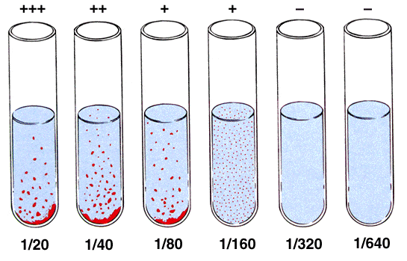
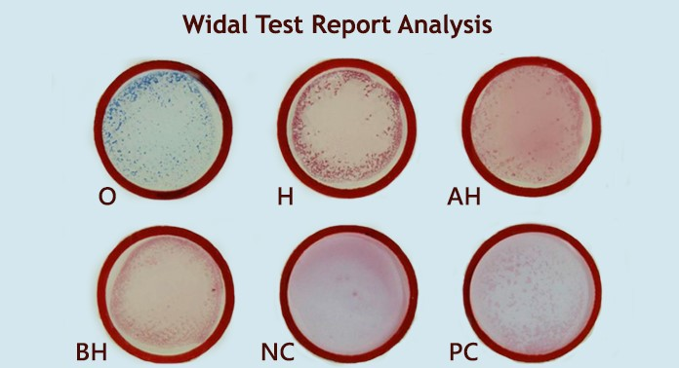

Slide 21
OTHER SEROLOGICAL TESTS
ELISA is a sensitive method of measuring antibody against the lipopolysaccharide of salmonellae.
Detection of porins, the outer membrane proteins of S. Typhi by ELISA method is useful for early serodiagnosis of typhoid fever.
DEMONSTRATION OF CIRCULATING ANTIGEN
Typhoid bacilli antigens are present in the blood in the early phase of the disease, and also in the urine of proteins.
The antigens can be detected by ELISA.

Slide 22
OTHER NON-SPECIFIC LABORATORY TEST
TOTAL LEUCOCYTE COUNT (TLC)
Leucopaenia with a relative lymphocytosis is found.
TREATMENT
Third generation cephalosporins (ceftriaxone) and azithromycin are used for treatment of enteric fever.
Chloramphenicol amoxycillin and cotrimoxazole were used in past.
Multiple drug resistance S. Typhi is increasingly being recognised in many countries and has become a problem in india too.
Multidrug resistent (MDR) S. Typhi is defined as resistant to chloramphenicol, ampicillin and co-trimoxazole.
Resistance to ceftriaxone has also been reported recently but is rare.

Slide 23
PROPHYLAXIS
1. GENERAL MEASURES
Typhoid fever can be effectively controlled by sanitary measures for disposal of sewage, clean water supply and supervision of food processing and handling.
Infected meats and eggs should be throughly cooked.
2. CARRIERS
Carriers should not be engaged in food preparation and should observe strict personal hygiene.
3. VACCINATION
Vaccine is indicated for travellers or who live in endemic areas.

Slide 24
1. TAB VACCINE
It is heat killed whole cell vaccine containing S. Typhi. 1000 millions, S. Paratyphi A and B, 750 millions each per ml and preserved in 0.5 percent phenol.
DOSE SCHEDULE: The vaccine was given subcutaneously in two doses of 0.5 mL at an interval of 4-6 weeks followed by booster every three years.
It is no longer used because of significant side effects.
2. LIVE ORAL (TY2 1a) TYPHOID VACCINE
Avirulent mutent strain of S. Typhi (Ty2 1a) lacking the enzyme UDP-galactose-4-epimerase (Gal E mutant) has been used as a live oral vaccine.
These mutants initiate infection in the intestine but ‘self-destructs’ after four to five cell divisions and threfore cannot induce any illness.
DOSE SCHEDULE: Three doses are given on alternative day (Days 1,3 and 5). No antibiotic should be taken during this period. It gives 65-96% protection for 3-5 years and is safe.

Slide 25
3. Vi CAPSULAR POLYSACCHARIDE VACCINE (Vi-CPS)
It contains purified Vi capsular polysaccharide antigen derived from S. Typhi strain Ty2.
DOSE SCHEDULE: It is injected intramuscularly or subcutaneously in a single dose of 25 microgram (μg). The efficacy is about 75%.
Vi-CPS vaccine is given to persons aged two years and above.
4. Vi-TT
Vi antigen is conjugated to tetanus toxoid (TT). One dose (0.5 mL) contains Vi antigens of S. Typhi (5 microgram (μg)) conjugated to TT Protein (5 microgram).
5.MULTIVALANT COMBINATION VACCINE
It consists of combination of ViCPS and hepatitis A vaccines.
It contains 25 microgram (μg) of ViCPS of S. Typhi with inactivated hepatitis A virus grown in human deploid cells.

Slide 26
REFERENCE BOOKS
TEXTBOOK OF MICROBIOLOGY BY ANANTHANARAYAN AND PANIKER’S.
TEXTBOOK OF MICROBIOLOGY BY D R ARORA AND BRIJ BALA ARORA.
Textbook of Medical Microbiology by Baweja

