Slide 1
Elasticity of Supply
Dr. Pooja Singh Assistant Professor, Department of Economics, School of Arts Humanities And Social Science, Chhatrapati Shahu Ji Maharaj University, Kanpur

Slide 2
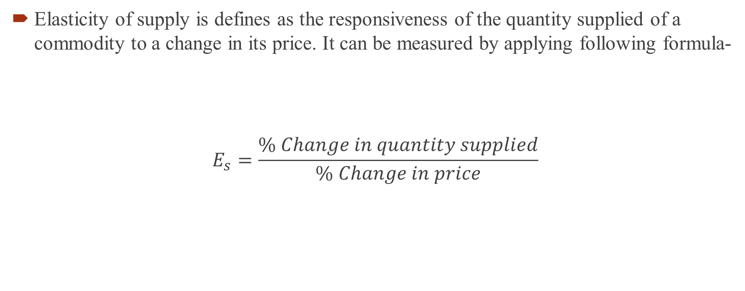
Elasticity of Supply
Elasticity of Supply
Elasticity of supply is defines as the responsiveness of the quantity supplied of a commodity to a change in its price. It can be measured by applying following formula-
$$E_{s}=\frac{\% Change in quantity supplied}{\% Change in price}$$

Slide 3
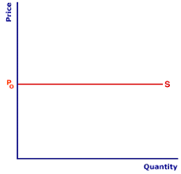
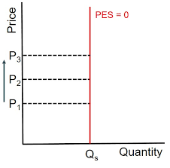
Degree of Elasticity of Supply
Elasticity of Supply
Perfectly Elastic-
E=∞
2. Perfectly Inelastic-
E=∞

Slide 4
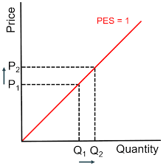
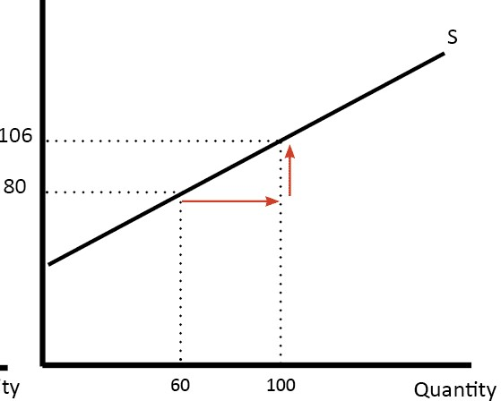
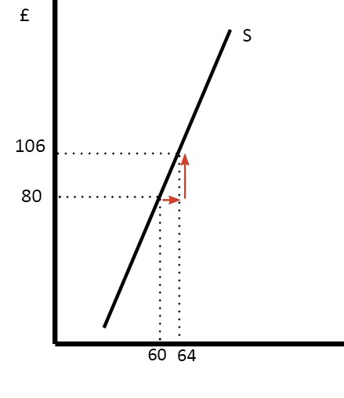
Elasticity of Supply
Unitary Elastic Supply
E=1
Highly Elastic Or Relatively Elastic
E>1
Less Inelastic Relatively Inelastic
E<1

Slide 5
Reference
Elasticity of Supply
Dwivedi D N, Managerial Economics, Vikas Publishing House Pvt. Ltd, 2006

