Slide 1
Electrode placement-tens
Aakanksha Bajpai
Assistant Professor
School of Health Sciences

Slide 2
General rules for placements of electrodes for application of TENS:
• Carbon rubber plate electrodes of equal sizes (2 cm × 3 cm) are commonly used.
• The electrodes may have two or four pole arrangement, depending upon the extent of area to be covered and the type of equipment available.

Slide 3
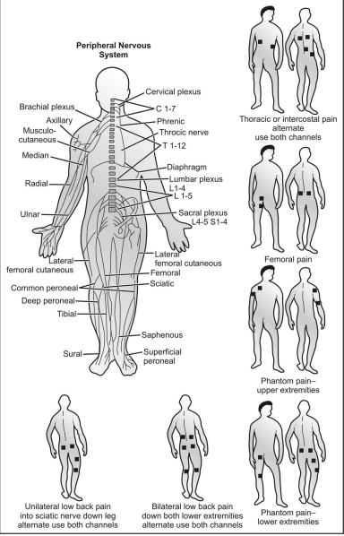

Slide 4
Specific placement of electrodes for application of TENS for various painful conditions on the posterior surface of the body

Slide 5
Specific placement of electrodes for application of TENS for various painful conditions on the anterior surface of the body

Slide 6
THANK YOU

