Slide 1
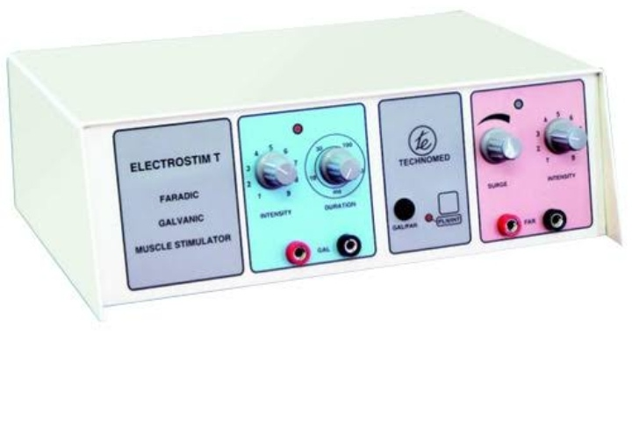
Faradic and Galvanic current

Slide 2
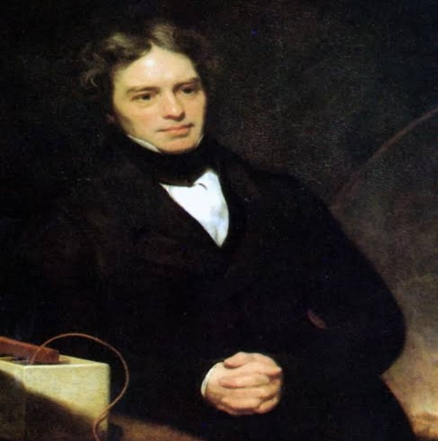
FARADIC CURRENT
Introduction-
Low frequency current
Short duration interrupted direct current
Pulse duration-0.1 to 1ms
FREQUENCY-50-100 pulse per sec
History-
MICHAEL FARADAY (1791-1867),he discovered the principle of induction in 1831 and electric currents produced by these coils were called FARADIC CURRENT to honor him.
The term faradism was originally used to represent the type of current produced by faradic coil which is a type of induction coil.

Slide 3
MODIFICATION OF FARADIC CURRENT
Faradic current was modified to make it more useful for treatment purposes.
These currents are surged for treatment purposes to produce a near normal tetanic like contraction and relaxation of muscle.
The current is surged so that the intensity of successive impulses increases gradually i.e., Each impulse reaching a peak value and falls suddenly or gradually.

Slide 4
WAVEFORM OF FARADIC CURRENT
-WAVEFORM
Biphasic ,Asymmetrical,Unbalanced
-POSITIVE PORTION
Short duration,High amplitude ,Spiked
-NEGATIVE PORTION
Long duration ,Low amplitude and Curved

Slide 5
SURGING OF FARADIC CURRENT
TRAPEZOIDAL SURGING
Impulses increases slowly,maintained there for sometime and decreases gradually forming trapezoid.
TRIANGULAR SURGING
Impulses increases and decreases gradually forming triangular shape

Slide 6
RECTANGULAR
Impulses increases rapidly, maintained there for sometime & falls abruptly.
SAW TOOTH
Impulses increases gradually but suddenly falls.

Slide 7
ACCOMODATION
When a constant current flows ,the nerve adapts itself .this effect is known as ACCOMODATION or ADAPTATION.
When the current rises ,the impulse is initiated but a fall in current can also intiate an impulse,while the current flows at a constant level the accomodation of nerve takes place.
According to waveform accomodation-
TRAPEZOIDAL >TRIANGULAR > SAW TOOTH >RECTANGULAR

Slide 8
EFFECT OF NERVE STIMULATION
When a sensory nerve is stimulated, then the downward travelling impulse has no effect but the upper travelling impulse is appreciated when it reaches conscious level of Brain.
When a motor nerve is stimulated ,then upper travelling impulse is unable to pass first synapse , as it is travelling downward impulse passes through the muscles supplied by the nerve causing them to contract.

Slide 9
EFFECT OF FREQUENCY STIMULATION
When a single stimulus is applied, impulses passes simultaneously to a number of motor unit so that in normal circumstances is a sudden brisk contraction followed by the immediate relaxation.
If increasing the frequency of stimuli, shortens the period of relaxation.

Slide 10
STRENGTH OF CONTRACTION
Depends upon the motor units activated or recruited (which in turn depends upon intensity of current).
If the intensity of current rises suddenly then there is no time for ACCOMODATION to take place,resulting in muscle contraction
If the current rises more slowly as trapezoidal, triangular and saw tooth impulses, there is some ACCOMODATION and greater intensity of current is needed to produce contraction

Slide 11
GALVANIC CURRENT
INTRODUCTION-
It is also LOW FREQUENCY CURRENT
Long Duration Interrupted Direct Current
PULSE DURATION –more than 1ms which may be upto 300ms.
FREQUENCY-less than 50 Hz
HISTORY-
LUIGI GALVANI (1737-1798) discovered the Galvanic current in 1780s.

Slide 12
Procedure of treatment

Slide 13
Procedure of treatment
While giving treatment with neuromuscular electrical stimulation to the patient.it shluld be kept in mind that treatment must be effective,comfortable and in a proper way. So treatment should be done umder following procedure
1 Apparatus Preparation
2 Patient Preparation
3 Application of different techniques

Slide 14
APPARATUS PREPARATION
FOR FARADIC=Before applying to patient therapist must consider following points
1 Testing of apparatus=
Attach the leads and electrodes to the terminals holding the two current in moistened hand and turning up the current until the mild prickling sensation is experienced and muscle contraction is produced
Describe the experience the patient will feel and make sure that patient can see the produced muscle contraction
Duration and frequency of the surge should be set

Slide 15
Apparatus should be atleast 2 metre far enough to prevent output disturbance by Radio frequency
Electrode should be dipped in tap water or in warm 1 percent saline to reduce the resistance

Slide 16
Qualities of an electrode
Pad should be made of atleast 8 layers of lint to make good contact wuth the tissues and electrode and to absorb the chemical if formed
They should be evenly folded with no cease to prevent uneven distribution of current and consequent discomfort
Electrodes should be 1cm small all around the pads to elimimate the danger of their coming in contact with skin,causing uncomfortable and possible damage to tissues from chemical action
Corner of electrode should be rounded

Slide 17
ACTIVE ELECTRODE= It should be disc electrode or a small lint sponge pad with a flat plated electrode
Indifferent electrode= It shlould be flat plate electrode lint ,sponge pad

Slide 18
Electrode size
Size of muscle to be stimulated for example for small muscles or localized stimulation small electrodes are used and for large muscles or a group of muscles,large electrodes are used

Slide 19
FOR GALVANIC=Procedure will be same as with faradic
Electrode padding should be proper as long duration pulses are liable to cause chemical burns
No metal should be allowed to come in contact with patients tissue

Slide 20
PATIENT PREPARATION
Before giving treatment it should be watched
1 Patient is warm so that muscle responds ti stimulation
2 Clothes from the area to be treated are removed
3 Properly,support the area to be treated to relax or shorten the muscles of the part.this position can be modified according to effect required

Slide 21
Skin should be washed with soap to remove naural oils
Before applying the pad,the skin is moistened with saline water which will reduce the skin resisitance as skin has high resistance due to dryness and presence of few ions
If skin breaks it is protected by little petroleum jelly covered with small piece of non-absorbent cotton wool to protect the Pad
Indifferent pad should be larege to reduce the current density which is kept to minimum.It prevent excessive skin stimulation and reduce the comtraction of unwanted muscle

Slide 22
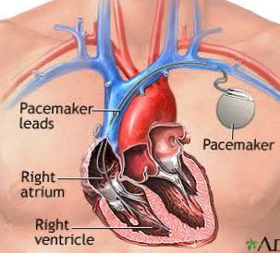
Contraindications
Cardiac pacemaker and arrythmia:
Electrical stimulation may interfere with the functioning of the cardiac pacemaker and could alter the heart rate.
It may interfere with the electrical activity of the heart.
It may also increase the chances of unstable arrythmia in those cases which are not treated with pacemakers.

Slide 23
2. UNCONCIOUS PATIENT
3. RECENT RADIOTHERAPY
4. CAROTID SINUS
5. PLACEMENT OF ELECTRODES TANGENTIAL TO THE HEART
6. PRESENCE OF MALIGNANCY
7.CANCEROUS LESION
8. SITE OF INFECTION
9. UNCONTROLLED HEMORRHAGE

Slide 24
Physiological Effects of Faradic and Galvanic Current

Slide 25
Physiological effects of faradic current
Stimulation of sensory nerves
Stimulation of motor nerves
Effect of muscle contraction
Faradic current will not stimulate denervated muscles
Reduction of swelling and pain
Chemical changes

Slide 26
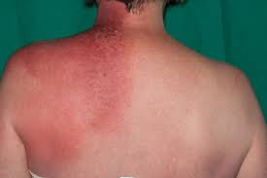
Stimulation of sensory nerves
Mild prickling sensation is experienced.
It is not very marked because of short duration.
Causes reflex vasodilatation of superficial blood vessels leading to slight erythema.
Vasodilatation is confined to superficial tissues so is of little practical importance.

Slide 27
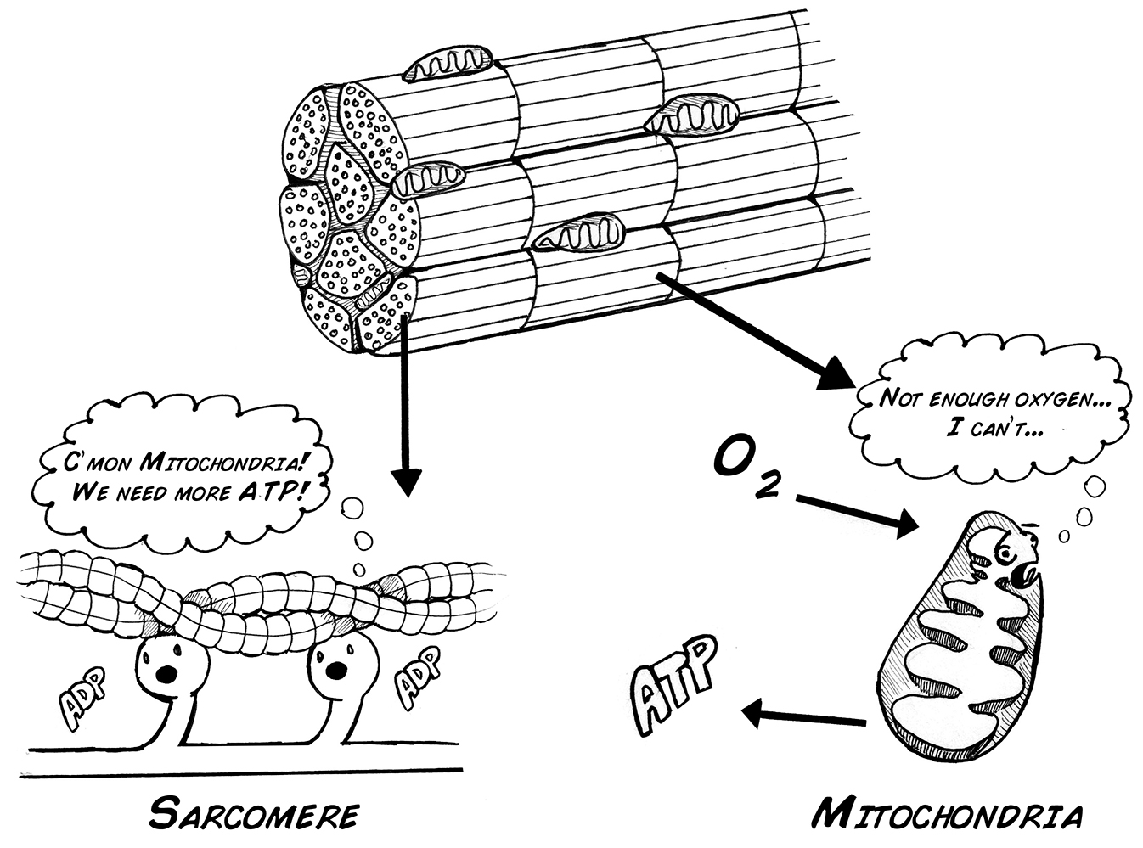
Stimulation of motor nerves
It occurs if the current is of sufficient intensity, causing contraction of muscles which they supply.
The contraction is tetanic in type as stimulus is repeated 50 times or more per sec.
If this type of contraction is maintained for more than a short
period of time, muscle fatigue occurs. So, the current is commonly surged to allow for muscle relaxation.

Slide 28
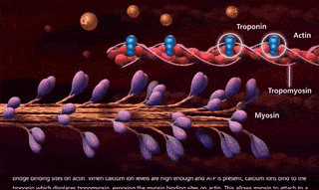
Effect of muscle contraction
When muscle contracts, changes taking place within a muscle are increase in metabolism, increase in demand for oxygen and nutrients and increase output of waste products.
As muscle contracts & relax, exert a pumping action on veins and lymphatic vessels thus, increases the venous and lymphatic return.

Slide 29
Faradic current will not stimulate denervated muscles
The current required to produce a contraction of denervated muscle with an impulse lasting for 1 ms is usually too great to be tolerable for treatment purposes.

Slide 30
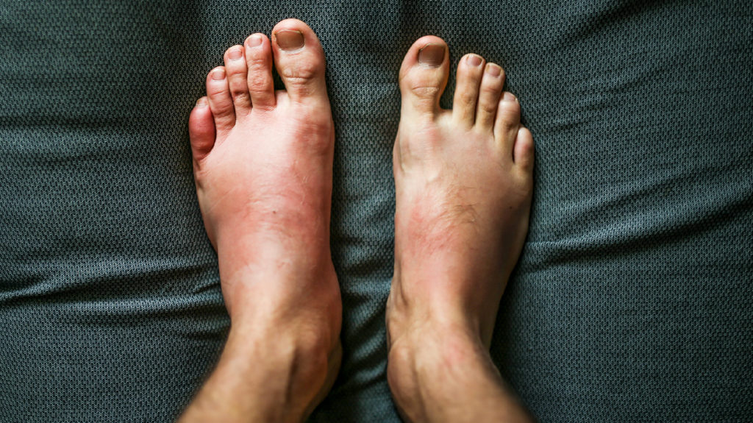
Reduction of swelling and pain
It occurs due to alteration of the permeability of the cell membrane, leading to acceleration of fluid movement in the swollen tissue and arterial dilatation.
Moreover, it leads to increase metabolism and get rid of waste products.

Slide 31
Chemical changes
The ions move one way during one phase of the current and in the reverse direction during the other phase of the current if it is alternating.
If the two phases are equal, the chemicals formed during one phase are neutralized during the next phase but if phases are not similar there are chemical changes which can cause electrolyte burn.
In faradic current, chemical formations are not great enough to give rise to a serious danger of burns because of the short duration of impulses.

Slide 32
Physiological effects of galvanic current
Contraction of denervated muscles
Stimulation of sensory nerves
Stimulation of motor nerves

Slide 33
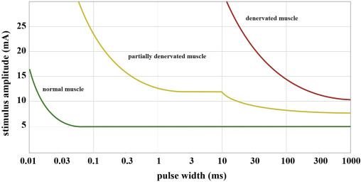
Contraction of denervated muscles
Occurs only when intensity and duration of current is adequate.
The contraction is sluggish.
Normal contraction and relaxation of denervated muscles is slower than that of innervated muscles.

Slide 34
Stimulation of sensory nerves
Impulses are of longer duration as the effect is rather marked.
Results in stabbing or burning pain.
Reflex vasodilation of superficial blood vessels resulting in skin erythema.

Slide 35
Stimulation of motor nerves
Contraction of muscles but at very high intensity.
Brisk contraction followed by relaxation of innervated muscles.

Slide 36
Precautions and danger of faradic and galvanic current

Slide 37
Precautions:-
Not to be applied over eyes.
Not to be applied internally.
Not to be applied trans-cranially or upper cervical region in patient with history of seizures as it may produce seizures.
Transient ischemia attacks[brief episode of neurological dysfunction caused by lose of blood flow]ischemia in the brain, spinal cord or retina.
Cerebrovascular attacks stroke [blood flow to one part stops due to blockage or rupture of vessel]
Phychogenic pain - pain is induced by prolong or increase mental, behaviour or social prolong. Patient suffer from back pain, headaches etc. they are usually by social rejection, heart break etc.

Slide 38
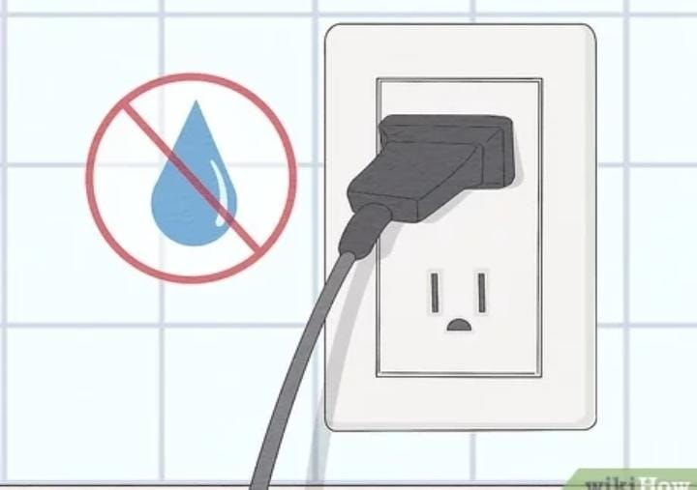
Dangers/complications
1. Shock
it is caused by:-
Inadiquate earthing of the apparatus.
Wet floor with faulty earthing of the apparatus.
Increasing or decreasing the current quickly.
Burns
It is caused by:-
Contact of the matel to the skin.
Over dosage or current density is high.

Slide 39
Technically interferential current is not capable of producing a burn as the current is evenly alternating still there is a chance of skin burn .if a bare electrodes touches the skin or the electrodes on the skin are too close that allows a skin current to pass between them.
3. Skin irritation
4. Systemic effects:-
Can cause with treating large area.
Occur with anticholinergic drug
Cause headache, abdominal pain, mild dryness of mouth.
Increased pain
As a rule the patient is expected to get sensation of mild tingling type , but the intensity is too high or if the electrodes are placed close to each other , the patient may feel pain.

Slide 40
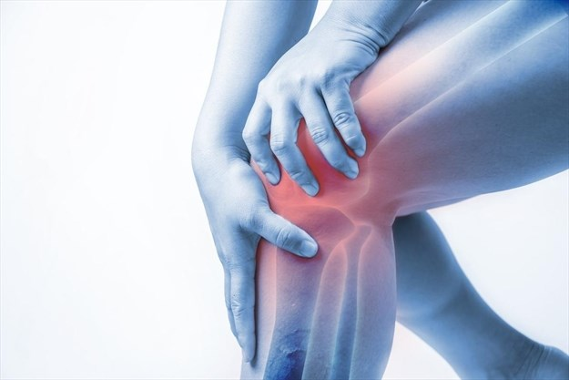
Therapeutic effect of faradic
Facilitation of muscle contraction
When a patient is unable to produce a muscle contraction and find difficulty in doing so due to pain or injury, then electrical stimulation may be used in assisting voluntary contraction.
Re education of muscle
In situation where muscle action is not readily under voluntary control without practice such as disuse atrophy or faulty posture habit such as in case of long standing flat foot due to disuse of intrinsic foot muscle or poor posture due to disuse of incorrect use of back muscle. In the circumstances , faradic type current is applied to produce movement so that the lost movement is produced to the entre range of motion, replicating the voluntary action. Total treatment time should be about 15 minutes, repeated several time daily.

Slide 41
Improved venous and lymphatic drainage
Increase venous and lymphatic return is brought by pumping action of muscle (contraction and relaxation). This treatment is most effective when applied by the method of faradism under pressure. It is used for the treatment of oedema and gravitational ulcer.
Spasticity reduction
Electrical stimulation is widely used by the therapist for reduction of spasticity and to regain voluntary control.
Prevention of loosening of adhesion
Where there is effusion into the tissue , adhesion are likely to be formed. Active exercise is not possible then electrical stimulation can be used for this purpose .

Slide 42
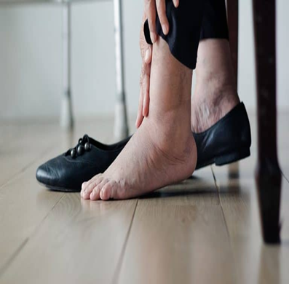
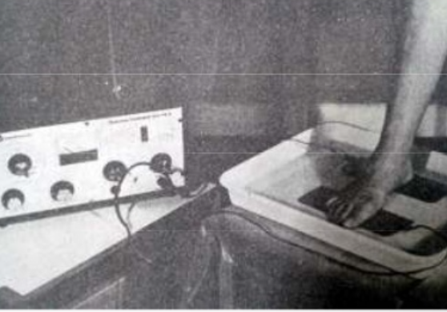
Reduction of limb oedema
Electrical stimulation of the muscles that generally act as the muscle pump may be continued with compresses and elevation of the limb to increase venous and lymphatic return and so relieve oedema. This technique is sometime know as faradism under pressure. The repetition rate is slow also, give time to relaxation. Treatment time 15-30 mint
Faradic foot bath
Electrical stimulation by faradic type current so applied in water filled baths for re-education of weaker muscle of foot. Application of faradic current to the body parts(foots) in a tube , tray or tank containing water is termed as faradic foot bath.
Pulse duration:- 150-200 microsec, for small muscle or 200-350 microsec, for large muscle.
On off time =1:2
Total treatment time = 15-20 mint, 2-3 times a day

Slide 43
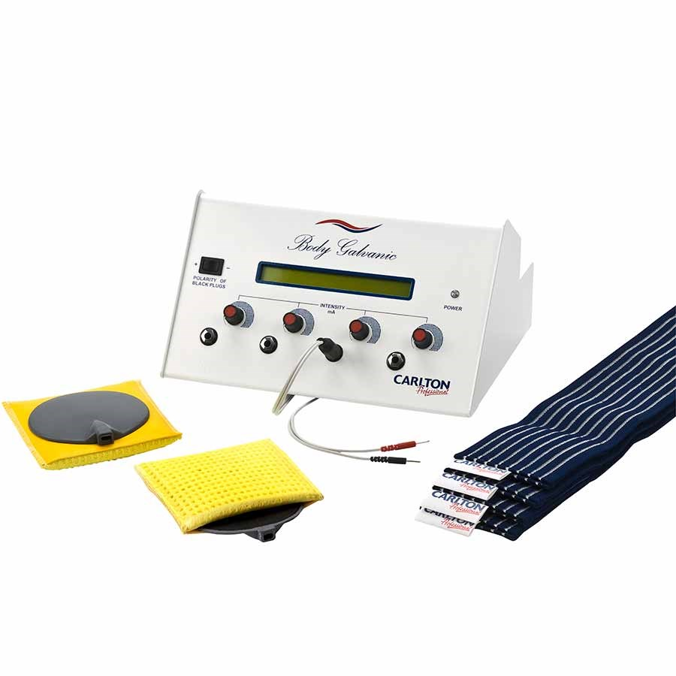
Therapeutic effect of galvanic current
Galvanic current for treatment is to maintain the muscle in a healthy state and to retard atrophy, making muscle contract with electrical stimuli would substitute for the beneficial effect of normal muscle contraction.
When muscle in de-innervated , many structural and functional changes occur such as :-
loss of voluntary and reflex activity .
Atrophy, degeneration and fibrosis.
Fibrillation (shivering-no complete contraction
and relaxation)
Electrical stimulation of muscle fibers using galvanic current may slow these changes .

Slide 44
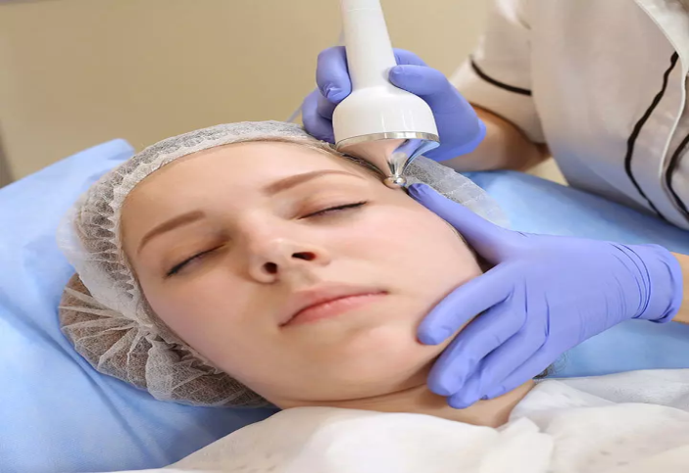
Galvanic current use in facial treatment
Reduces Dullness And Makes Skin Glow.
Reduce Fine Lines And Wrinkles and tightness of face.
Improves The Elasticity Of Your Skin.
increases oxygen supply to your face.

Slide 45
THANK YOU

