Slide 1
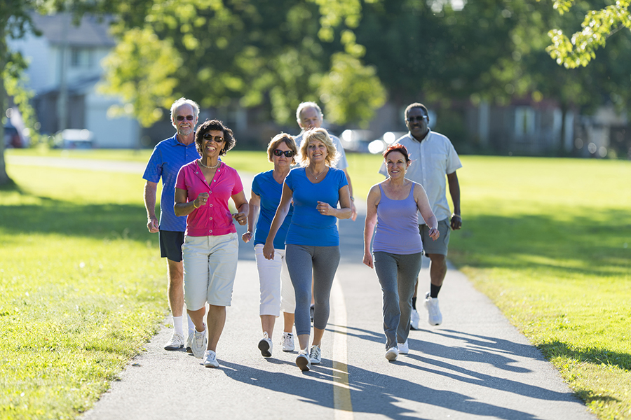
GAIT

Slide 2
INTRODUCTION
Study of human locomotion .
Gait is defined as "Series of rhythmic cyclic movements of the limbs in relation to the trunk resulting in forward progression of the body".

Slide 3
GAIT CYCLE
It is defined as "a series of events in which heel of one extremity strikes the ground to the next heel strike of the same extremity".
Two steps , a right and a left step form a stride and a stride is equal to a gait cycle.

Slide 4
Gait in various stages of life
Notes:
Normal Gait Requires
Equilibrium
Locomotion
Musculoskeletal integrity
Coordination and balance
Neurological control

Slide 5
The Main Tasks Of The Gait Cycle
According to the professional staff at Rancho Los Amigos Medical Center in California : (1),(2)
Weight acceptance
Single limb support
Limb advancement

Slide 6
Phases Of Gait Cycle
Gait
Stance (60%)
Weight acceptance
Swing (40%)
Limb advancement
Single limb support
Initial contact
Loading response
Mid stance
Terminal stance
Pre swing
Initial swing
Mid swing
Terminal swing

Slide 7
Comparison of Gait Terminology
To avoid the confusion associated with earlier terminology , Perry and colleagues from Rancho Los Amigo National Rehabilitation Center developed a generic terminology to describe the 8 functional phases of Gait
TRADITIONAL
Heel strike
Foot flat
RLS (RONCHO LOS AMIGOS SCALE)
Initial contact
Mid stance
Mid stance
Heel off
Toe off
Acceleration
Mid swing
Deceleration
Loading response
Pre swing
Terminal stance
Initial swing
Mid swing
Terminal swing

Slide 8
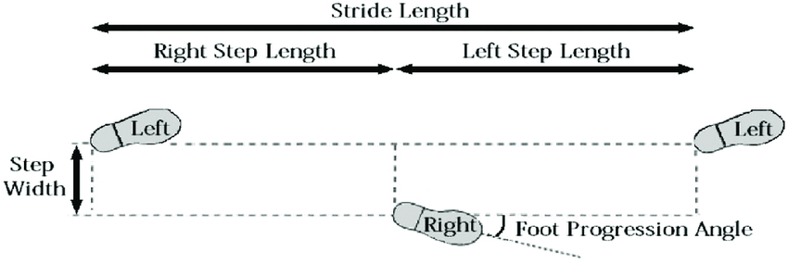
SPATIAL AND TEMPORAL VARIABLES
Spatial variables
Stride length
Step length
Step width
Foot angle

Slide 9
Temporal Variables
Stance time
Single limb time
Double limb support time
Swing time
Stride time
Step time
Cadence
Speed
Free speed
Slow and fast speed

Slide 10
Normal Gait Cycle
Stance Phase : 60% Swing Phase : 40%
Double Support period

Slide 11
Running Gait
Stance Phase : 30% Swing Phase : 70%
Double Float Period

Slide 12
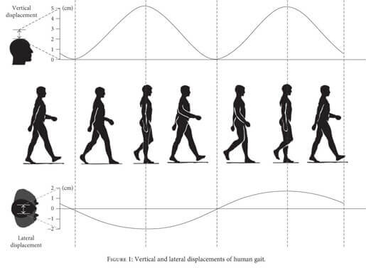
Determinants of Gait
Displacement of COG
Vertical displacement
Horizontal displacement

Slide 13
Factors responsible for minimizing displacement of COG
Pelvic rotation
Pelvic tilt
Knee flexion during stance
Ankle mechanism
Foot mechanism

Slide 14
Pelvic Rotation
Notes:
Forward rotation of the pelvis in the horizontal plane approx. 8 degree on the swing phase side
Reduced the angle of hip flexion & extension
Enables a slightly longer step-length w/o further lowering of CG

Slide 15
Pelvic Tilt
Notes:
5 degree dip of the swinging side (i.e. hip adduction)
In standing, this dip is appositive trendelenberg sign
Reduces the height of the apex of the curve of CG

Slide 16
Knee flexion in stance phase
Notes:
Approx 20 degree dip
Shortens the leg in the middle of stance phase
Reduces the height of the apex of the curve of CG

Slide 17
Ankle Mechanism
Notes:
Lengthens the leg at heel contact
Smoothens the curve of CG
Reduces the lowering of CG

Slide 18
GAIT Analysis
Kinematic Gait Analysis
Kinetic Variables
Qualitative
Quantitative
Force Plate Technology
Plantar Pressure Measures
OGA*
Digital Video recording
Functional Ambulation Profile & Modification
Lowa level of assistance
Measurement of gait Spatial Temporal Variables
Kinetic Gait Analysis
Timed walk Tests (5, 10, 30)
Accelerometers
FIM (Functional Independence Measure)
FAM (Functional Assessment Measure)
Community and balance scale
Dynamic Gait Index
Functional Gait Assessment
Walkways
Footswitches and Footswitches system
Video Based Motion Analysis System
Electromagnetic Motion Analysis System
6 – Minute Walk Test
Notes:
Other example of Qualitative Kinematic Gait Analysis are:
High level Mobility
Assessment Scale
Fast Evaluation of Mobility
Balance and Fear
Figure of 8 Test

Slide 19
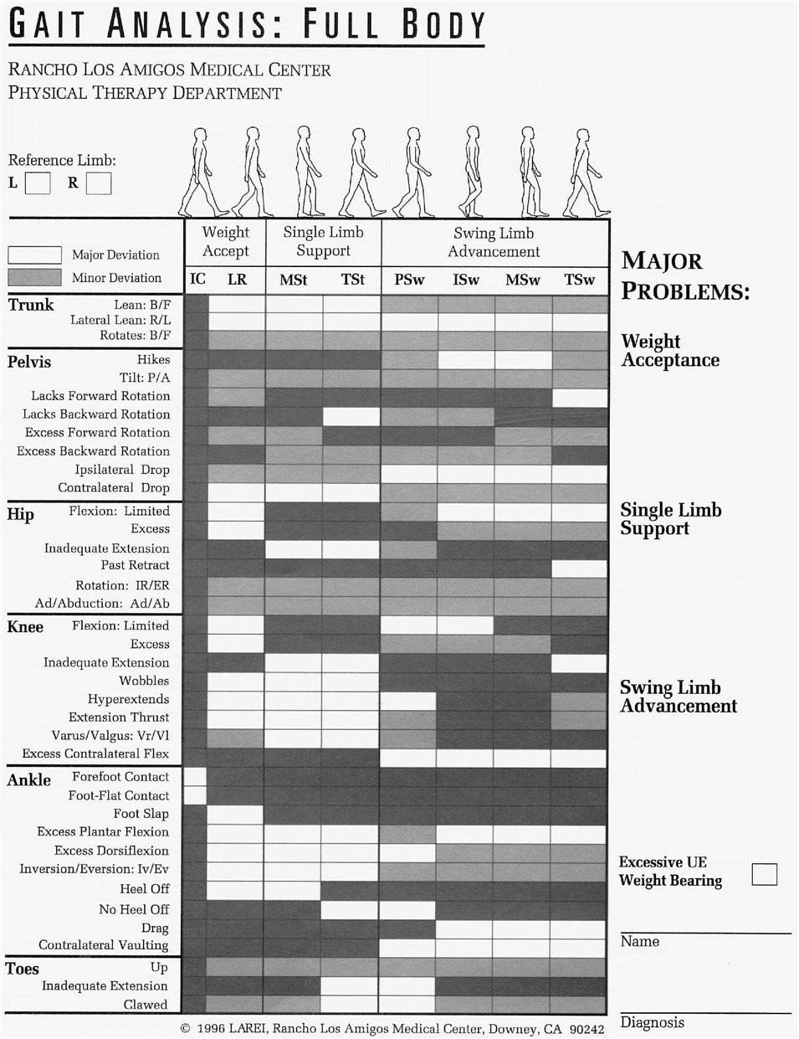
Observational Gait Analysis
The Roncho Los Amigos Observational Gait Analysis is mostly used OGA system by Physical therapist. (1) , (2)

Slide 20
Force Plate Technology

Slide 21
Plantar Pressure Measures

Slide 22
Walkways

Slide 23
Electro goniometer

Slide 24
PATHOLOGICAL GAIT
Antalgic gait
Parkinson’s gait
In going gait
Out going gait
High stepping gait
Circumduction gait
Waddling gait
Trendelenburg gait
Knock knee gait
Genu recurvatum gait
Short limb gait
Quadriceps gait
Gluteus medius gait
Gluteus maximus gait
Stiff hip gait

Slide 25
SUMMARY
We have learned briefly about Gait, it’s cycle, phases. Comparison over the terminologies used. Some of pathological gaits are also presented.
Many of the common variables examined in gait analyses have been defined and described, and examples of studies using gait analyses have been presented.
OGA and temporal and spatial variables have been emphasized, because they appear to be the most common types of analyses used in the clinical setting.
The study of human gait, like the study of human posture. illustrates the inter- dependence of structure and function and the large variety Of postures and gaits available to the human specie.
The ability to perform a gait analysis that accurately describes a validity studies regarding these systems. The ability to perform a gait analysis that accurately describes a patient's gait will provide important quantifiable information necessary for optimal treatment planning.

Slide 26
REFERENCES
1. Sullivan.S , Schmitz.T. Physical Rehabilitation. 6E:251-301.
3. Oatis.C Norkins .C . Joint Structure And Function ,6E :435-482.
2.. Kinesiology The Mechanics And Pathomechanics of Human Movement. 2E: 908,909.
4. Neumann.D. Kinesiology of the Musculoskeletal System.523-569.

