Slide 1
General Bacteriology

Slide 2
MORPHOLOGY Gram positive bacteria
Bacteria |  | Example
Gram positive cocci arranged in
 | Cluster | Staphylococcus
 | Chain | Streptococcus
 | Pairs, lanceolate shaped | Pneumococcus
 | Pair or in short chain, spectacle eyed shape | Enterococcus
 | Tetrads | Micrococcus
 | Octate | Sarcina
Gram negative cocci arranged in
 | Pairs,lens shaped | Meningococcus
 | Pairs, kidney shaped | Gonococcus

Slide 3
Morphology of Gram negative bacteria
Bacteria |  | Example
Gram negative bacilli arranged in
 | Pleomorphic (various shapes) | Haemophilus, Proteus
 | Thumb print appearance | Bordetella pertussis
 | Comma shaped (fish in stream appearance) | Vibrio cholerae
 | Curved | Campylobacter (Gull-wing shaped) and Helicobacter
 | Spirally coiled, flexible | Spirochetes
 | Rigid spiral forms | Spirillum
 | Bacteria that lack cell wall | Mycoplasma
Bacteria |  | Example
Gram positive bacilli arranged in
 | Chain(bamboo stick appearance) | Bacillus anthracis
 | Chain | Streptobacillus
 | Chinese letter or cuneiform pattern | Corynebacterium diphtheriae
 | Palisade pattern | Diphtheroids
 | Branched and filamentous form | Actinomyces and Nocardia

Slide 4
Different morphology of bacteria and Gram staining property

Slide 5
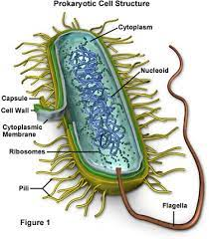
Structure of Bacterial Cell

Slide 6
Bacterial cell wall
The cell wall has following functions:
Provides protection to the cell against osmotic lysis.
Confers rigidity
Accounts for the shape of the cell.
Takes part in cell division.
Protect a cell from toxic substances and is the site of action of several antibiotics.
Virulence factors-Bacterial cell wall contains certain virulence factors (e.g. endotoxin), which contribute to their pathogenicity
Immunity: Antibody raised against specific cell wall antigens (e.g. antibody to LPS) may provide immunity against some bacterial infection.

Slide 7
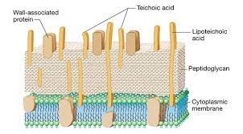
Gram Positive Cell Wall

Slide 8
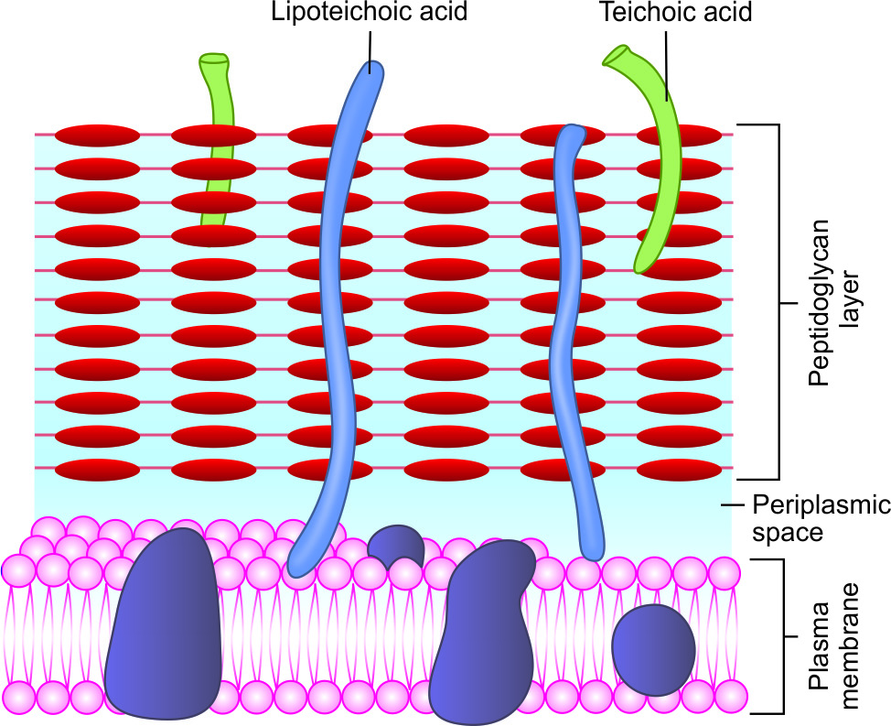
Gram Positive Cell Wall
Teichoic acid:
Teichoic acids are of two types:
Cell wall teichoic acid- covalently linked to NAM molecules of peptidoglycan.
Lipoteichoic acid-attached to lipid groups of cell membrane.

Slide 9
Gram-negative cell wall
Peptidoglycan layer :
Very thin (1-2 layer, 2nm thick).
Composed of a mucopeptide chain similar to that of Gram positive cell wall, and consists of alternate NAM and NAG molecules.

Slide 10
Gram-negative cell wall
Outer membrane:
Phospholipid layer which lies outside the thin peptidoglycan layer.
Serves as a protective barrier to the cell.
Outer membrane proteins (OMP) or porin proteins

Slide 11
Gram-negative cell wall
Lipopolysaccharide (LPS): consists of:
Lipid A or the endotoxin
Core polysaccharide
O side chain (or O antigen)
Periplasmic space: It is the space between the inner cell membrane and outer membrane. It encompasses the peptidoglycan layer

Slide 12
Differences between Gram positive and Gram negative cell wall
Characters |  | Gram Positive cell wall | Gram Negative cell wall
Peptidoglycan layer |  | Thicker (15-80nm) | Thinner (2nm)
 | At 3rd position of tetrapeptide side chain | L- Lysine present | Mesodiaminopimelic acid present
 | Pentaglycine bridge | Present | Absent
Lipid content |  | Nil or scanty (2-5%) | Present(15-20%)
Lipopolysaccharide |  | Absent | Present(endotoxin)
Teichoic acid |  | Present | Absent
Variety of amino acids |  | Few | Several
Aromatic amino acids |  | Absent | Present

Slide 13
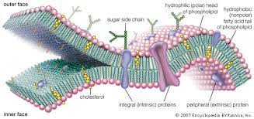
CELL MEMBRANE

Slide 14
Functions of cell membrane
Semi permeable membrane - osmotic barrier
Transport system
Site for metabolic processes
Special receptor molecules located in the membrane help the bacteria to detect and respond to chemicals in their surroundings.

Slide 15
CYTOPLASMIC MATRIX
Bacterial cytoplasm, lacks membrane-bound organelles.
Composed of water and is packed with ribosomes, storage granules called inclusions and cell membrane invaginations called mesosomes.
Lack true cytoskeleton, but do have a cytoskeleton-like system of proteins.
The plasma membrane and everything within it is called as the protoplast.

Slide 16
Ribosomes
Ribosomes are the sites for protein synthesis.
Composed of ribosomal RNA (rRNA) and ribosomal proteins.
Ribosomes are integrated in linear strands of mRNA to form polysomes.
At this site, the genetic codons of the mRNA are translated into peptide sequences.
Each 70 S unit consists of a 30 S and a 50S subunits.

Slide 17
Intracytoplasmic inclusions
Storage sites of nutrients/ energy present in some bacteria.
Formed by the bacteria under nutritional deficiency conditions
There are two types of inclusions-
Organic inclusion bodies
Inorganic inclusion bodies

Slide 18
Mesosomes
Mesosomes are invaginations of the plasma membrane in the shape of vesicles, tubules, or lamellae
Mesosomes often are found next to septa in dividing bacteria or sometimes seen attached to the bacterial chromosome.
Involved in-
Site of bacterial respiration
Cell wall formation during division
Chromosome replication and distribution to daughter cells.

Slide 19
NUCLEOID
Bacteria possess a single haploid chromosome
Comprises of super coiled circular double stranded DNA
Bacterial DNA lacks basic proteins.
Divides by simple binary fission.
Nucleoid demonstrated by electron microscopy or staining with the Feulgen stain
Bacteria possess extra-chromosomal DNA called plasmids.

Slide 20
CELL WALL APPENDAGES
Capsule and slime layer
S layer
Flagella
Fimbriae or pili
Spore

Slide 21
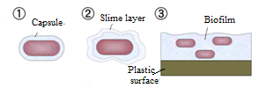
Capsule and slime layer
Capsule -well organized and not easily washed off
Slime layer - diffuse, unorganized loose material that can be removed easily

Slide 22
Capsulated organisms
Capsules - Polysaccharide in nature
Except in Bacillus anthracis where it is polypeptide in nature.
Cryptococcus neoformans (the only fungus to be capsulated).
Both capsule and slime layer as in Streptococcus salivarius.
Capsulated bacteria | Composition
Pneumococcus | Polysaccharide
Meningococcus | Polysaccharide
Haemophilus influenzae | Polysaccharide
Klebsiella pneumoniae | Polysaccharide
Pseudomonas aeruginosa | Polysaccharide
Bacteriodes fragilis | Polysaccharide
Bacillus anthracis | Polypeptide (glutamate)
Streptococcus pyogenes (some stains) | Hyaluronic acid
Capsulated fungus
Cryptococcus neoformans | Polysaccharide

Slide 23
Demonstration of capsule
Negative staining
M’Faydean capsule stain
Serological test
Quellung reaction

Slide 24
Functions of capsule
Bacterial virulence-
Prevent cell from drying out (desiccation)
Protects the bacterium from the action of lysozyme and bacteriophages.
Toxic to the host cells and induces abscess formation (e.g. Bacteroides fragilis)

Slide 25
Source of nutrients and energy - Streptococcus mutans, which colonizes teeth, ferments the sugar in the capsule and so formed acid by-products contribute to the tooth decay.
Capsules as vaccine
Capsular vaccines are available for bacteria such as Pneumococcus, Meningococcus and Haemophilus influenzae serotype-b.

Slide 26
Biofilm formation and adhesion
Made of millions of adherent bacterial cells embedded within a self-produced matrix of extracellular polymeric substance
Capable of adherence to damaged tissues and plastic surfaces
Adhesion is a first step in colonization and sometimes leads to disease

Slide 27
S layer
Protect the cell against ion and pH fluctuations, osmotic stress, enzymes, and also helps to maintain the shape and envelope rigidity.
Prevents bacteria from phagocytosis and cell adhesion.

Slide 28
Flagella
Thread-like appendages, protruding from the cell wall, composed of protein subunits called flagellin.
Organs of locomotion, confer motility to the bacteria.

Slide 29
Arrangement of flagella
Monotrichous (single polar flagellum) - e.g. Vibrio cholerae, Pseuodmonas and Camplylobacter
Lophotrichous - e.g. Spirillum.
Peritrichous - e.g. Salmonella Typhi, Escherichia coli.
Amphitrichous- e.g. Alcaligenes faecalis

Slide 30
Bacterial motility
Types of motility | Bacteria shown
Tumbling motility | Listeria
Gliding motility | Mycoplasma
Stately motility | Clostridium
Darting motility | Vibrio cholerae, Campylobacter
Swarming motility | Proteus, Clostridium tetani
Corkscrew, lashing, flexion extension motility | Spirochaete

Slide 31
Fimbriae or pili
Fine, hair-like appendages that are thinner than flagella and not involved in motility, called as fimbriae or pili (singular fimbria or pilus).
Pili are made up of protein called pilin.
Antigenic (but, antibodies against fimbrial antigens - not protective).
Functions-
Fimbriae are called as the organ of adhesion (enhances virulence).
Certain fimbriae called sex pili also help in bacterial gene transfer.
Fimbriae are not related to motility.

Slide 32
Fimbriae or pili
Size- 0.5µm long and 10 nm in thickness. A bacterium can have as many as 1,000 fimbriae.
Types-
Common pili
Sex or F (fertility) pili
Col I (colicin) pili

Slide 33
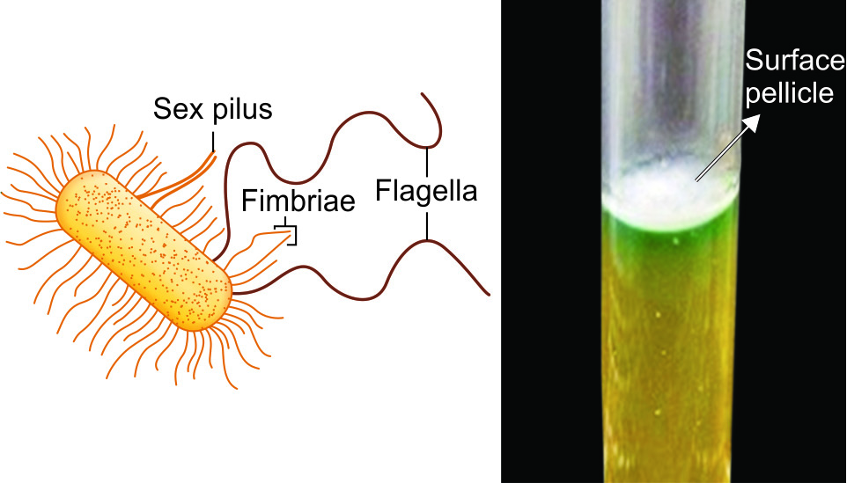
Detection of fimbriae
Electron microscopy.
Hemagglutination
Surface pellicle-Some aerobic fimbriated bacteria form a thin layer at the surface of a broth culture called as pellicle.

Slide 34
Atypical forms of bacteria
Involution forms- Swollen and aberrant forms of bacteria (e.g. Gonococci and Yersinia pestis) in ageing cultures in high salt concentration
Pleomorphic bacteria – Exhibit great variation in the shape and size of individual cells, e.g., Proteus and Yersinia pestis.

Slide 35
L form (Cell wall deficient forms)
L forms are the cell wall deficient bacteria, discovered by E.Klieneberger, while studying Streptobacillus moniliformis
She named it as L form after its place of discovery i.e. Lister Institute, London (1935)
L forms play a role in the persistence of pyelonephritis and other chronic infections

Slide 36
Types of L-forms
Unstable L-forms- Bacteria lose the cell wall in presence of penicillin, a mechanism of resistance shown by the bacteria against penicillin.
Maintained only in presence of penicillin.
Capable of dividing, but can revert back to the original morphology once penicillin is removed.
Protoplasts- Gram-positive bacteria whose cell wall is entirely removed
Spheroplasts: Have their cell wall only partially removed and are derived from Gram negative bacteria

Slide 37
Types of L-forms
Stable L-forms, L-forms that are unable to revert to the original bacteria are called as stable L forms.
Mycoplasma do not have a true cell wall; the peptidoglycan layer is replaced by sterol.

Slide 38
REFERENCES
Textbook of Medical Microbiology by Ananthnarayan, Paniker
Textbook of Medical Microbiology by C.P Baweja
Textbook of Medical Microbiology by S. Bhat, A.S.Sastry
Textbook of Medical Microbiology by D.R.Arora, Brij bala Arora

