Slide 1
Medium frequency current Interferential Stimulation
Aakanksha Bajpai
Assistant Professor
School Of Health Sciences

Slide 2
Interferential stimulation (IFS) units generate two ACs on two separate channels. One channel produces a constant high-frequency sine wave (4000 to 5000 Hz), and the other channel produces a sine wave with a variable frequency.

Slide 3
The medium frequency carrier currents penetrate the tissues with very little resistance.
The resulting interference currents are in a range that allows effective stimulation of deeper tissues than other forms of electrical stimulation with relatively little patient discomfort.

Slide 5
Electrode Placement
When an alternating current is used the electrodes should be no more than 5.9 inches (15 cm) apart.
Quadripolar Technique
The four electrodes are positioned around the painful area so that each channel runs perpendicular to the other and the current crosses at the midpoint .
The interference effects branch off at 45-degree angles from the center of the treatment, in the shape of a four-leaf clover.

Slide 6
Tissues within this area receive the maximal treatment effect; however, the distribution of the current is inconsistent, potentially leading to discomfort and decreased treatment effectiveness.
When the electrodes are properly positioned, the stimulation should be felt only between the electrodes, not under the electrodes.

Slide 7
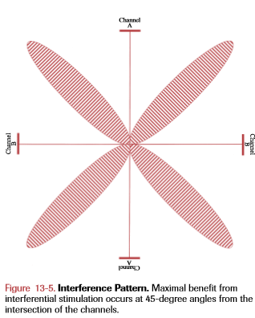

Slide 8
Instrumentation
Power: When the switch is in its ON position, the current is allowed to flow to the internal components of the generator.
Reset: This safety feature ensures that the intensity is reduced to zero before the treatment is started.
Timer: This control sets the duration of the treatment and subsequently displays the remaining time. On some units, the TIMER serves as the master power switch.

Slide 9
Start-stop: This switch is used to initiate and terminate the treatment.
Intensity: This control adjusts the amplitude of the pulse and is displayed in milliamperes (mA). When quadripolar stimulation is used, the intensity control regulates both channels simultaneously or each channel may be individually adjustable.
Mode: This switch allows the user to choose between true interferential therapy and bipolar stimulation. The interferential mode allows the current to stimulate deep tissue.

Slide 10
In the bipolar mode, only one channel is used, and the resultant current flow stimulates relatively subcutaneous nerves.
Beat frequency: The “beat” is the result of the fixed rate of the carrier wave and the variable rate of the second channel causing changes in the amplitude of the applied current.

Slide 11
Balance: This dial allows the user to control the balance of electrical current under each set of electrodes and to equalize the sensory stimulation. It may only be meaningful during quadripolar stimulation.

Slide 12
Setup and Application
Initiation of the Treatment
Turn on the unit by activating the POWER switch.
Reset parameters: Fully reduce the INTENSITY control and depress the RESET button.
Select application mode: Determine the MODE of application: quadripolar, bipolar, or Russian stimulation.
Adjust beat frequency: Select the appropriate BEAT frequencies based on the goals of the treatment.

Slide 13
Adjust sweep frequency: Use the appropriate SWEEP frequency for this treatment protocol.
Adjust treatment duration: Set the duration of the treatment by adjusting the TIMER.
Begin treatment: Press the START button to close the circuit between the generator and the patient’s tissues.
Increase output intensity: Slowly increase the INTENSITY control until the appropriate current level is obtained.

Slide 14
Adjust balance: If necessary, adjust the BALANCE control to obtain maximal treatment comfort.

Slide 15
Treatment Duration
Interferential stimulation may be applied once or twice daily in treatment bouts normally ranging from 11 to 15 minutes.

Slide 16
Indications
Acute pain
Chronic pain
Muscle spasm
Oedema
Hematoma
Chronic ligamentous lesion
Trigger spot
Stress incontinence
Delayed union

Slide 17
Contraindications
Cardiac disability
Demand-type pacemakers
Arterial disease Uncontrolled hemorrhage Sites of infection
Blood clots
Pregnancy
Cancerous lesions Exposed metal implants History of seizures
Sensory or mental impairment Unstable fractures

Slide 18
Precautions
Improper use can result in electrode burns or skin irritation.
Intense or prolonged stimulation may result in muscle spasm and/or muscle soreness.

Slide 19
THANK YOU

