Slide 1
Introduction to electrotherapy
Aakanksha Bajpai
Assistant Professor
School of Health Sciences

Slide 2
What is Electrotherapy?
Electrotherapy includes various forms of therapeutic applications using electricity as the primary source of energy.
Electrotherapy is a non-surgical treatment approach, characterized by treatment of various diseases and disorders by electrical means which includes low, medium and high frequency currents.
By implication it means that electrical forces are applied to body bringing physiological changes for therapeutic purposes.

Slide 3
Electric current
Flow of electric charge or electrons through a medium.
Measured in ampere.
The ampere, which is defined as a flow of one coulomb of charge per second, or 6.2 × 10¹⁸ electrons per second.

Slide 4
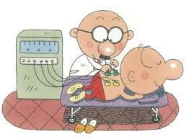
ELECTROTHERAPY
Low Frequency Currents
Medium Frequency Currents
High Frequency Currents
Phototherapy
Electro Diagnosis
Biofeedback

Slide 5
Low Frequency Currents
Frequency - 0-1000 cycles /second.
Their primary use is the stimulation of nerve and muscle.
For example- Direct current, Interrupted direct current, Sinusoidal current (AC), TENS, etc.

Slide 6
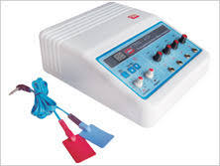
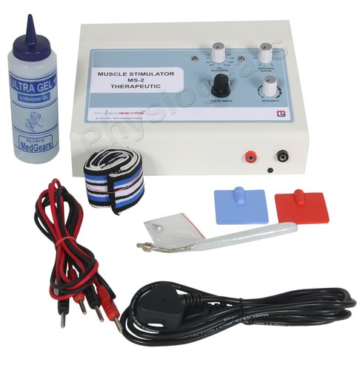
TENS
Electrical Muscle Stimulator (EMS)

Slide 7
Medium Frequency Currents
Frequency – 1000-10000 cycles/second
They are used to stimulate deeply situated muscles and nerves, and for muscle re-education.
For example Russian current, Interferential current (IFT) etc.

Slide 8
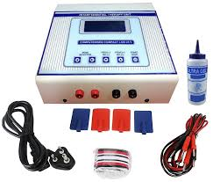
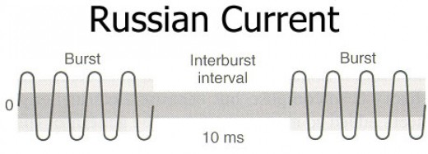
IFT

Slide 9
High Frequency Current
Frequency – more than 10000 cycles/second.
They are used to produce deep heat in the tissues.
For example- Short wave diathermy (SWD), Therapeutic ultrasound, Microwave diathermy, etc.

Slide 10
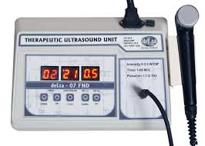
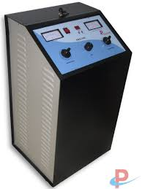
THERAPEUTIC ULTRASOUND
SWD

Slide 11
Phototherapy
Treatment of various diseases with the help of light.
The primary effect is pain relief by heat and acceleration of healing by elevation of temperature.
For example- Infrared rays, Ultraviolet rays, LASER.

Slide 12
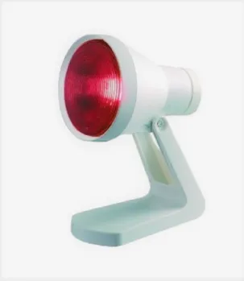
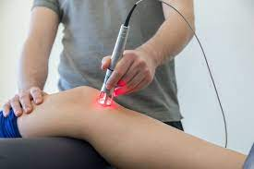
IRR
LASER

Slide 13
Electro Diagnosis
Electrical currents are used for diagnostic purposes.
It means detection of diseases and disorders by the use of electrotherapeutic currents or EMG.
Example- Rheobase, Chronaxie, SD curve, Nerve conduction velocity, etc.

Slide 14
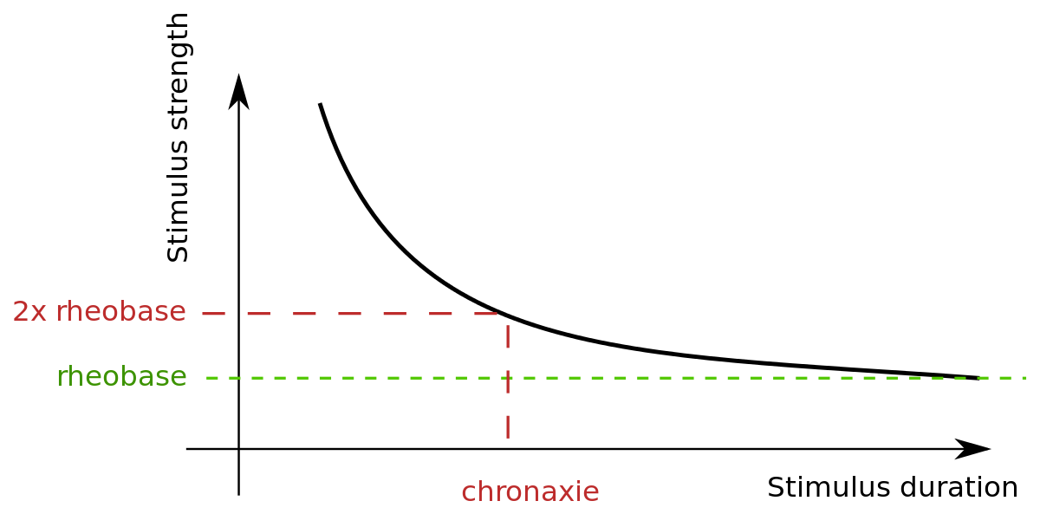
STRENGTH-DURATION CURVE (SD CURVE)

Slide 15
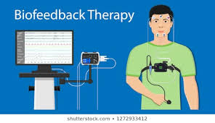
biofeedback
It is the process of furnishing the information to an individual about the body function to get some voluntary control over it.

Slide 16
THANK YOU

