Slide 1
JEAN PIAGET’S COGNITIVE DEVELOPMENT THEORY BY DR. TANUJA BHATT ASSISSTANT PROFESSOR DEPARTMENT OF EDUCATION CSJMU
JEAN PIAGET:
He was a swiss biologist, philosopher and a psychologist. He was also known as father of child psychology.
This Photo by Unknown Author is licensed under CC BY-SA-NC

Slide 2
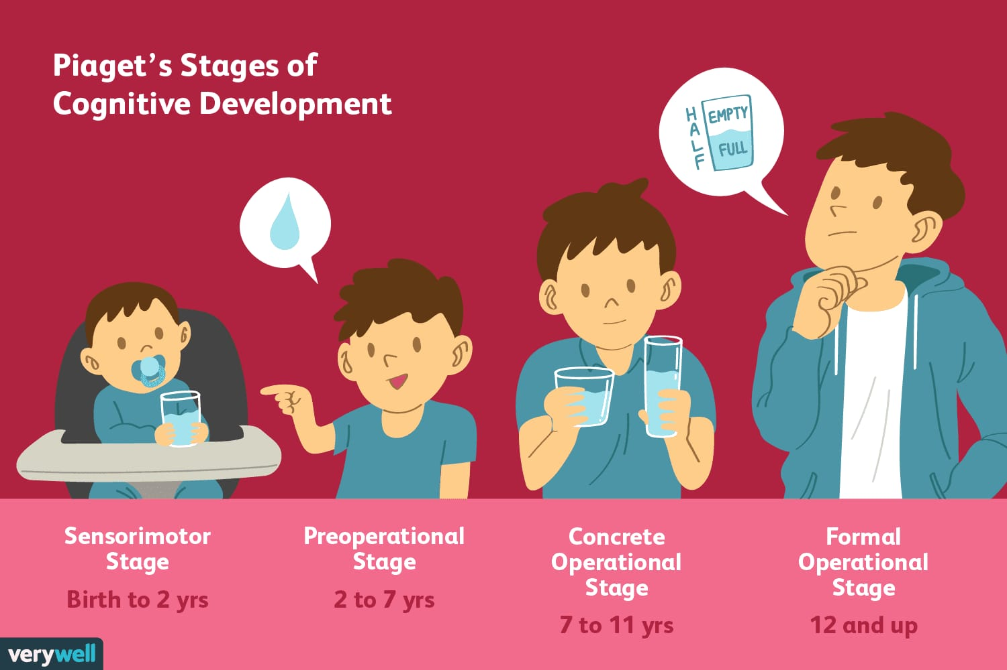
Stages of cognitive development
1.The sensory motor stage
2.The preoperational stage
3.The concrete operational stage
4.The formal operational stage

Slide 3
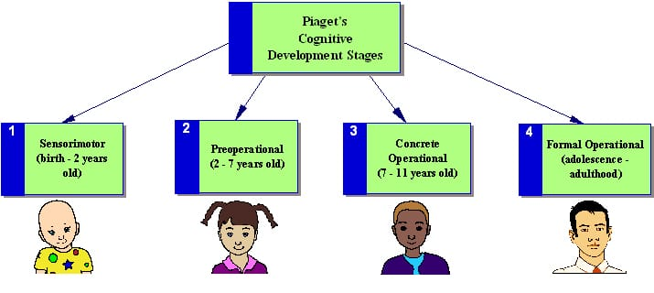
COGNITIVE STRUCTURE
Schema-
A schema is a cognitive framework or concept that helps organize the interpret information .Schemas can be useful because they allow us to take shortcuts in interpreting the vast amount .of information that is available in our environment.

Slide 4
COGNITIVE FUNCTIONING
ASSIMILATION
EQUILIBRATION
NEW SITUATION
DISEQUILIBRIUM
ACCOMODATION

Slide 5
FIRST STAGE OF COGNITIVE DEVELOPMENT
- THE SENSORY MOTOR STAGE (0-2)years:
- Senses are teachers
Imitate behaviour and reflex action
Object permanence
Infants progress from reflexive, instinctual actions at birth to the beginning of problem solving (intellectual) and symbolic activities (language) towards the end of this stage

Slide 6
SECOND STAGE OF COGNITIVE DEVELOPMENT
THE PRE-OPERATIONAL STAGE (2-7)years
Child learns to think first and develop the language later
Ego centrism- ‘I’
Animism(toy stage)
Crucial stage for language development

Slide 7
THIRD STAGE OF COGNITIVE DEVELOPMENT
THE CONCRETE OPERATIONAL STAGE (7-11)years
Stage of logical thinking and concrete operation
Reversibility, transitivity develops
This stage is also known as later childhood stage or pre-group(gang age)

Slide 8
FOURTH STAGE OF COGNITIVE DEVELOPMENT
THE FORMAL OPERATIONAL STAGE (12-15)years
Child develops abstract thinking
Deductive and inductive reasoning both gets developed
Age of divergent, convergent and creative thinking

Slide 9
EDUCATION IMPLICATIONS
Understanding once intelligence as the function of once ability to adapt or adjust.
Acquainting us with thought process of children at particular age.
Emphasising the need for tailoring the education of a child according to the level of functioning of his cognitive structure.
Emphasis on the discovery approach and learning
Cocurricular activities have equal importance as that of co-curricular experiences in the cognitive development of children
Simple to complex and project method of teaching is advocated by this theory
THANK YOU

Slide 10
REFERENCES
Pandey, Ram Shakal (2007). Education psychology, Surya Publication, Meerut
Mangal, S.K.: Advanced educational psychology, New Delhi: Prentice Hall of India pvt. limited

