Slide 1
Law of Demand
Dr. Pooja Singh Assistant Professor, Department of Economics, School of Arts, Humanities And Social Sciences, Chhatrapati Shahu Ji Maharaj University, Kanpur

Slide 2
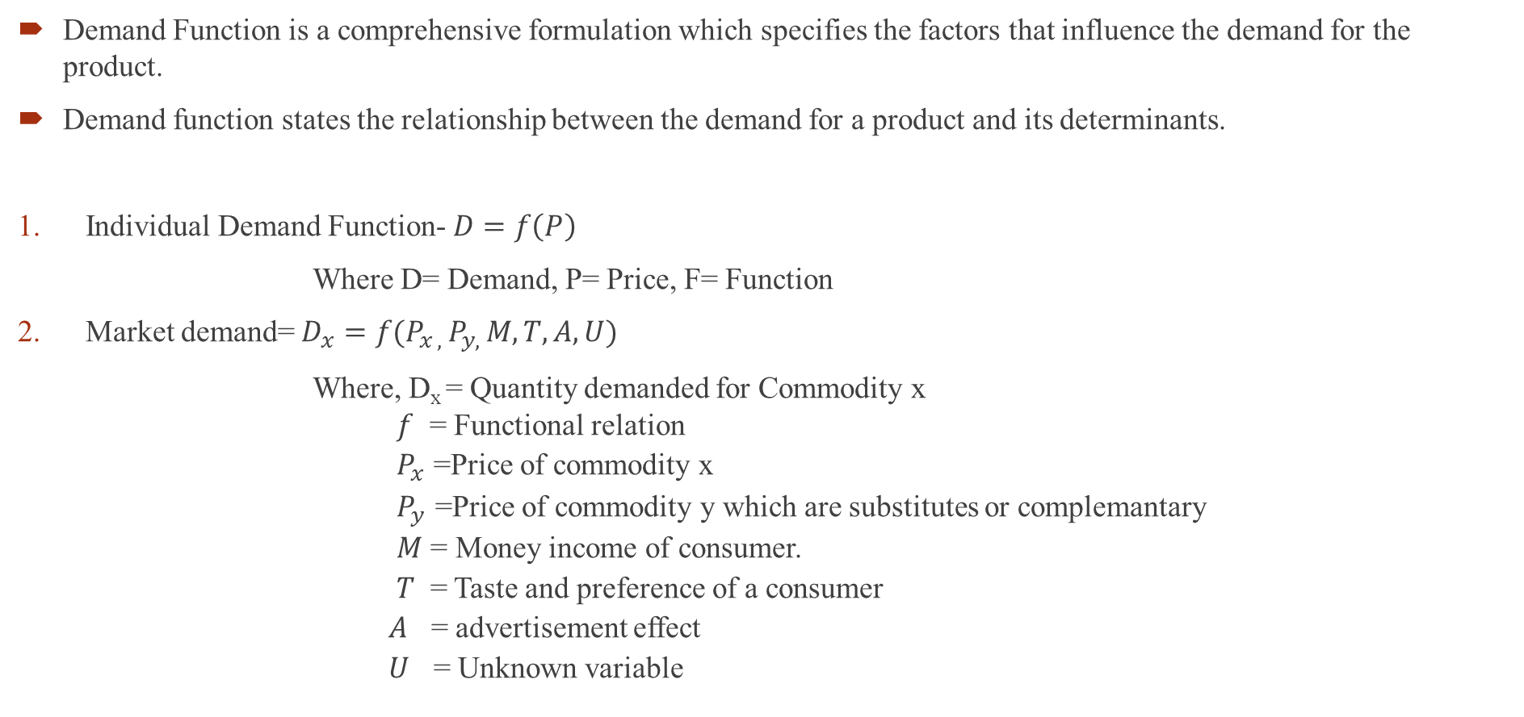
Demand Function
Law of Demand
Demand Function is a comprehensive formulation which specifies the factors that influence the demand for the product.
Demand function states the relationship between the demand for a product and its determinants.
Individual Demand Function- $D=f\left(P\right)$
Where D= Demand, P= Price, F= Function
Market demand= $D_{x}=f(P_{x , }P_{y, }M,T,A,U)$
Where, D_{x} = Quantity demanded for Commodity x
$f$ = Functional relation
$P_{x }$=Price of commodity x
$P_{y }$=Price of commodity y which are substitutes or complemantary
$M$ = Money income of consumer.
$T$ = Taste and preference of a consumer
$A$ = advertisement effect
$U$ = Unknown variable

Slide 3
Law of Demand
Law of Demand
Explain inverse relationship between in quantity demanded and price of a commodity
Higher the price, lower would be the quantity demanded
Price and quantity demanded are negatively related
This law is only qualitative statement not quantitative statement

Slide 4
Law of Demand
According to the law of demand other things being equal, if the price of a commodity falls, the quantity demanded rise and if the price of commodity rises, its quantity demanded falls.
Quantity demanded goes up
When price
goes up
inverse relationship between quantity demanded and price
Quantity demanded goes down
When price
goes Down

Slide 5
Assumptions of Law of Demand or Other thing being equal or Ceteris Paribus-
Price of related goods should not change.
Taste and preferences of consumer should not change
There should be no change in the income of the consumer.
There should be a rational behavior of a consumer
Distribution of income and wealth should be equal.
Government policies should not change
There should be no change in the size of the population.

Slide 6
Law of Demand
Price per Unit (Rs) | Quantity Demanded (unit)
10 | 100
20 | 80
30 | 60
40 | 40
50 | 20
Demand Schedule
Demand Curve

Slide 7
Exception to Law of Demand
Law of Demand
The goods of necessities- Demand unaffected even though their prices are increasing
Giffen paradox- The Giffen Paradox is named after Sir Robert Giffen. He observed that when the price of bread increased, then the low-paid British wage earners bought more of bread and not less. Since the wage earners diet was mainly bread, with the increase in price they were forced to cut down their consumption of meat and other expensive food items. Thus to maintain their food intake, they bought bread even at higher prices. This phenomena was referred to as ‘Giffens Paradox’.
Demand for Giffen goods varies directly with price and thus is an exception to the law of Demand.
Commodities of prestige or status symbol- used by rich people for whom the price is not important factor.

Slide 8
Law of Demand
Expectation of future change in price- If price of a commodity increase and there is an expectation of further increase in its price, demand for such commodity will increase.
Ignorance of consumer- When consumer behave that higher price will have higher quality.
Emergency- Law of demand does not apply in case of war, famine, curfew

Slide 9
References
Law of Demand
Dwivedi D N, Managerial Economics, Vikas Publishing House Pvt. Ltd, 2006

