Slide 1
Cellular Microbiology MIC 1004
Dr Archana Yadav
Department of Microbiology
Department of Biosciences and Biotechnology
Chhatrapati Shahu Ji Maharaj University,Kanpur

Slide 2
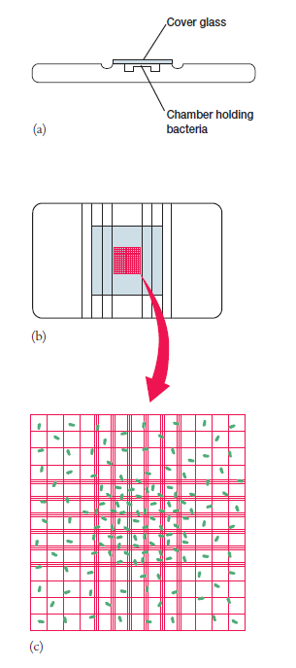
Measurement of growth
Measurement of Cell Numbers by Petroff-Hausser Counting Chamber.
Calculations : Since there are 25 squares covering an area of 1 mm2, the total number of bacteria in 1 mm2 of the chamber is (number/square)(25 squares). The chamber is 0.02 mm deep and therefore,

Slide 3
The Influence of Environmental Factors on Growth
Oxygen Concentration
An organism able to grow in the presence of atmospheric O₂ is an aerobe, whereas one that can grow in its absence is an anaerobe.
Facultative anaerobes do not require O₂ for growth but do grow better in its presence. In the presence of oxygen they will use aerobic respiration.
Aerotolerant anaerobes such as Enterococcus faecalis simply ignore O₂ and grow equally well whether it is present or not.
Microaerophiles, that are damaged by the normal atmospheric level of O₂ (20%) and require O₂ levels below the range of 2 to 10% for growth.

Slide 4
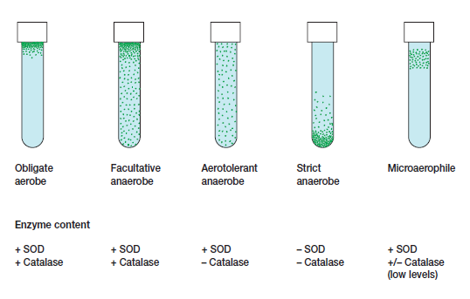
The nature of bacterial O₂ responses can be readily determined by growing the bacteria in culture tubes filled with a solid culture medium or a special medium like thioglycollate broth, which contains a reducing agent to lower O2 levels.
Oxygen and Bacterial Growth

Slide 5
Oxygen accepts electrons and is readily reduced because its two outer orbital electrons are unpaired. Flavoproteins several other cell constituents, and radiation promote oxygen reduction. The result is usually some combination of the reduction products superoxide radical, hydrogen peroxide, and hydroxyl radical.

Slide 6
Why is O2 toxic to many microorganisms and how do they protect themselves?
These products of oxygen reduction are extremely toxic because they are powerful oxidizing agents and rapidly destroy cellular constituents. A microorganism must be able to protect itself against such oxygen products or it will be killed.
Neutrophils and macrophages use these toxic oxygen products to destroy invading pathogens.
Many microorganisms possess enzymes that afford protection against toxic O2 products. Obligate aerobes and facultative anaerobes usually contain the enzymes superoxide dismutase (SOD) and catalase, which catalyze the destruction of superox-ide radical and hydrogen peroxide, respectively. Peroxidase also can be used to destroy hydrogen peroxide.

