Slide 1
Cellular Microbiology MIC 1004
Dr Archana Yadav
Department of Microbiology
Department of Biosciences and Biotechnology
Chhatrapati Shahu Ji Maharaj University,Kanpur

Slide 2
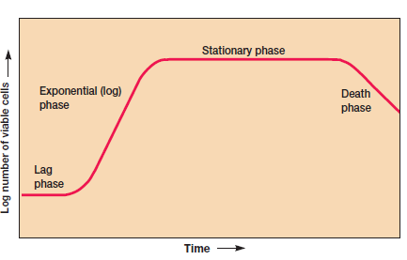
Microbial growth
Microbial Growth: An increase in cell number, not in cell size.
Bacteria grow and divide by binary fission, a rapid and relatively simple process.
Phases of Growth Bacterial Growth Curve :
Microbial growth curve in closed system

Slide 3
Four phases of Bacterial Growth
LAG PHASE: Period of adjustment to new conditions.
No cell division occurs, population size doesn’t increase.
Phase of intense metabolic activity, in which individual organisms grow in size. There is an increase in total protein, ribonucleic acid and cell phosphorus.
May last from one hour to several days.
LOG PHASE: Cells begin to divide and generation time reaches a constant minimum.
Cells are smaller in this phase because they are constantly dividing.
Cells are at highest metabolic activity
Cells are most susceptible to adverse environmental factors at this stage.
•Radiation
• Antibiotics

Slide 4
Decline/death phase: Population size begins to decrease. Number of cells dying > Number of cells produced
Cell number decreases at a logarithmic rate.
Cells lose their ability to divide
A few cells may remain alive for a long period of time.
Stationary phase: Population size begins to stabilize.
Number of cells produced = Number of cells dying
Overall cell number does not increase.
Cell division begins to slow down.
Factors that slow down microbial growth:
• Accumulation of toxic waste materials
• Acidic pH of media
• Limited nutrients
• Insufficient oxygen supply

Slide 5
The mathematics of growth When growing exponentially by binary fission, the increase in a bacterial population is by geometric progression. If we start with one cell, when it divides, there are 2 cells in the first generation, 4 cells in the second generation, 8 cells in the third generation, and so on.
The generation time is the time interval required for the cells (or population) to divide.
G (generation time) = (time, in minutes or hours)/n(number of generations)G = t/n
t = time interval in hours or minutes
During the exponential phase each microorganism is dividing at constant intervals. Thus the population will double in number
during a specific length of time called the generation time or doubling time.
Suppose that a culture tube is inoculated with one cell that divides every 20 minutes .The population will be 2 cells after 20 minutes, 4 cells after 40 minutes, and so forth. Because the population is doubling every generation, the increase in population is always 2n where n is the number of generations. The resulting population increase is exponential or logarithmic

Slide 6
