Slide 1
b.Ed ii year ; paper I Development of Educational System in India and its challenges
TOPIC –NATIONAL COUNCIL OF EDUCATIONAL RESEARCH AND TRAINING (NCERT)
-Anupama Yadav Assistant Professor Department of Education, CSJMU, Kanpur

Slide 2
NATIONAL COUNCIL OF EDUCATIONAL RESEARCH AND TRAINING(NCERT)
This council was constituted by the central government on 1 September , 1961.
The council was formed by merging seven existing national government institutions.

Slide 3
SEVEN NATIONAL GOVERNMENT INSTITUTION
The Central Institute of Education
The Central Bureau of Textbook Research
The Central Bureau of Educational and Vocational Guidance
The Directorate of Extension Programmes for Secondary Education
The National Institute of Basic Education
The National Fundamental Education Center
The National Institute of Audio – Visual Education

Slide 4
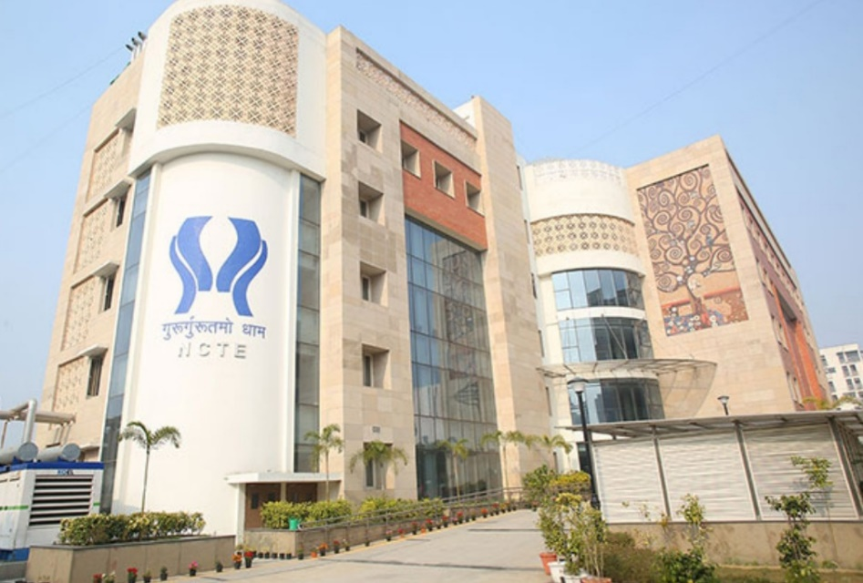
PURPOSE OF FORMATION
For the upliftment of school education (from pre-primary to higher education )
HEAD OFFICE
Aurobindo road , New Delhi

Slide 5
AT PRESENT
17 Regional offices.
The head of which is called field advisor.
The work of office is to look after a state.
Its organization is constituted at three levels:-
(1)General body
(2)Executive committee
(3) Council

Slide 6
GENERAL BODY
Its Chairman is the Union Human Resource Development Minister .
Education ministers of all the states .
Chairman of the UGC.
Some nominated members by the Central government.

Slide 7
EXECUTIVE COMMITTEE
Its chairman is UHRD Minister.
Vice chairman is state education minister of the union.
Central education secretary .
Chairman of UGC.
Director of NCERT .
Of the nominative members 4 are representative of teachers and 2 are educationist.

Slide 8
COUNCIL
Highest officer is Director.
Appointed by central government for a term of five year.
Academic staffs are also there .
Support office staff.

Slide 9
AIMS AND FUNCTIONS OF NCERT
To determine the form and level of different levels of school education.
To determine the aims of school education at different levels and to formulate their curricula.
To prepare textbooks for different levels of school education.

Slide 10
Continued..
To develop methods of teaching for different levels of school education.
To prepare science kits for science education in schools.
To develop objective techniques for evaluation of educational achievement of students at different levels of school education.
To understand the problems confronted by different levels of school education and to solve them.

Slide 11
Continued...
To gather different data pertaining to school education and teacher education, and to publish and propagate them.
To undertake talent search test and admission test for the Jawahar Navodaya schools.
To develop curricula for school teachers training programmes’ (for both pre-service and in-service teachers),and to make arrangements for their training an refresher courses.

Slide 12
Continued...
To provide technical assistance in the field of adult education.
To provide technical assistance in national population education programme.
To provide technical assistance in the national environmental education programme.
To edit and publish journals regarding school education , population education, environmental education, adult education and teacher education.

Slide 13
Continued...
To prepare software for school education , population education , environmental education , adult education and teacher education and to propagate it them.

Slide 14
DEPARTMENTS OF NCERT
Department of pre – school and elementary education.
Department of non-formal education and education for scheduled castes and scheduled tribes.
Department of women studies.
Department of social science and humanities education.
Department of science and mathematics education.

Slide 15
Continued...
Navodaya vidyalaya cell.
Department of teacher education and special education.
Department of educational psychology, counselling and guidance.
Department of extension and field services.
Department of measurement , evaluation , survey and data processing.
Planning , programming , monitoring and evaluation division.

Slide 16
Continued...
Educational research and innovation committee.
Publication Department.
International relation unit.

Slide 17
INSTITUTIONS OF NCERT
The institutions established by this council are as follows –
National Institute of Education(NIE)
Central Institute of Educational Technology(CIET)
Regional Institutes of Education(RIE)
Pandit Sundarlal Sharma Central Institute of Vocational Education(PSSCIVE)

Slide 18
CONTRIBUTION OF NCERT IN THE FIELD OF SCHOOL EDUCATION
This council modifies the aims of school education from time to time , and prepares the core curriculum accordingly.
This council prepares standard textbooks as per the curricula for different levels of of school education.
It acquaints the teacher with new techniques of evaluation at school level.

Slide 19
Continued...
It prepares software for broadcast of subjects of school level and arranges for their broadcast.
It undertakes admission test for admission in Jawahar Navodaya Vidyalayas.
It undertakes talent search from amongst 10 – class pass students, and undertakes a talent search test for it.
It gathers data and information relating to school education and propogate them.

Slide 20
CONTRIBUTION OF NCERT IN THE FIELD OF TEACHER EDUCATION
It determines the aims of teacher education for pre – primary , primary and secondary education levels.
It constructs curricula for school teacher education of all level.
It arranges for pre- service and in – service teacher education through the Regional Institutes of education (RIE).

Slide 21
Continued...
It arranges secondary vocational educational and secondary vocational teacher training through Pandit Sundarlal Sharma Central Vocational Education Institute.
It conducts continuous research work in the field of methods of teaching , and acquaints pre- service and in –service teachers with the latest methods of teaching and technology developed in the country and abroad.

Slide 22
Continued...
It develops new teaching aids and trains teachers in their use.
It trains school teachers in educational and vocational guidance.
It prepares the entire outline , aims , curriculum and textbooks of population education .
It undertakes new experiments from time to time as per the government policy .
It gathers data and information related to teacher education and propogate them.

Slide 23
CONCLUSION
NCERT is working in the field of school education and school teacher education.
It is also providing guidance in the fields of adult education , population education and environmental education etc.

Slide 24
REFRENCES
Agrawal J.C:Development and Planning of Modern Education(2008).Vikas Publishing House, New Delhi
Altekar,A.S:Education in Ancient India(1958).Nand Kishore and Brothers,Varanasi.
Lal Behari Raman Prof:Development of Education System in India and its Challenges .Vinay Rakheja Publisher Edition 2008
http://en.m.wikipedia.org/wiki/National_Council_of_Education_Research_and_Training

