Slide 1
Nature of Supply Curve
Dr. Pooja Singh Assistant Professor, Department of Economics, School of Arts Humanities And Social Science, Chhatrapati Shahu Ji Maharaj University, Kanpur

Slide 2
Nature of supply curve
Nature of Supply Curve
Nature
Movement along curve
Extension
Contraction
Shifting of curve
Increase
Decrease

Slide 3
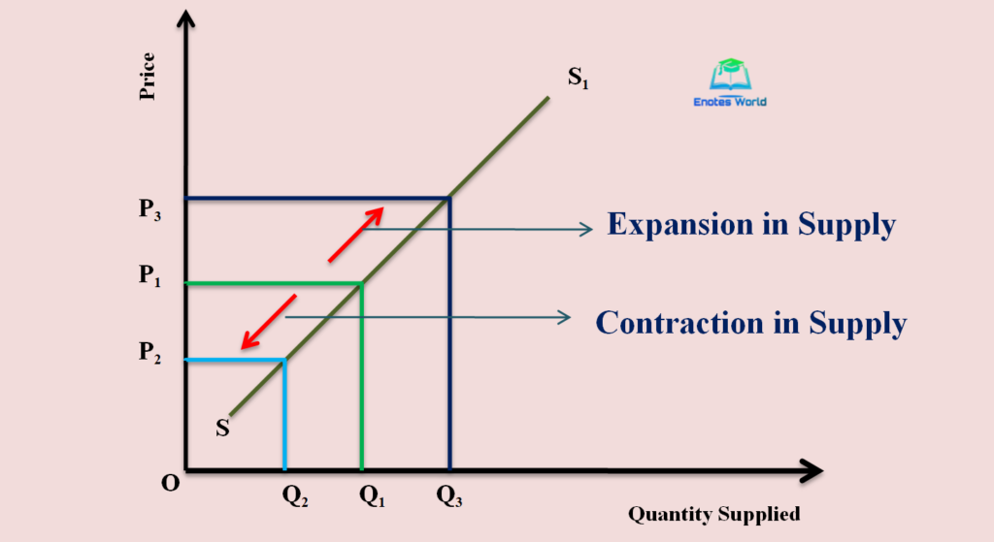
Nature of Supply Curve
Extension in supply curve
When the supply of goods increase as a result of an increase in its price and no change in determinants.
Contraction in supply curve
When supply of goods decrease as a result of decrease in its price and no change in determinants

Slide 4
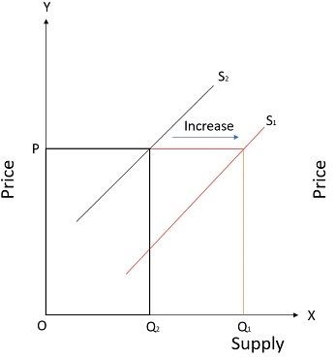
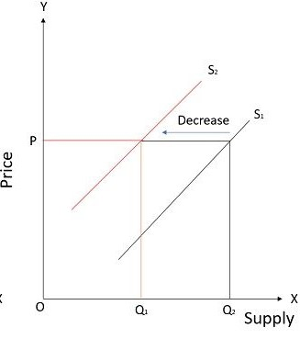
Shifting of curve
Nature of Supply Curve

Slide 5
Reference
Nature of Supply Curve
Dwivedi D N, Managerial Economics, Vikas Publishing House Pvt. Ltd, 2006

