Slide 1
PAIN
Aakanksha Bajpai
Assistant Professor
School of Health Sciences

Slide 2
The term and concept of “Pain” has been defined by the International Association for the Study of Pain as “an unpleasant sensory and emotional experience associated with actual or potential tissue damage or described in terms of such damage.
Perception of pain is influenced by a variety of factors such as cultural differences, motivation, emotional states, and past experiences with pain.

Slide 3
Rather than just being a sensation, pain is a process that involves sensory, motor, and emotional responses. Pain is formally defined as: an unpleasant sensory and emotional experience associated with actual or potential tissue damage, or described in terms of such damage. Each individual learns the application of the word through experience related to injury in early life. It is unquestionably a sensation in a part of the body but is also always an emotional experience.

Slide 4
Pain, referred to as the fifth vital sign, serves as the body’s line of self-defense.
Loss of pain sensation leaves the body, or a body area, unprotected against serious damage and, potentially, unaware that trauma has occurred.
Pain is the unpleasant sensation. Nociception (from the Latin word nocere, “to harm”) is the neural processes of encoding and processing noxious stimuli.
The important difference is that pain must be interpreted by higher brain centers as pain and nociception is the neurophysiological processes that may be interpreted as pain.

Slide 5
Pain threshold is the level (intensity) of noxious stimulus required to alert the individual to a potential threat to tissue. The pain threshold can be measured experimentally by introducing a painful stimulus such as cold water, pressure, or heat and gradually increasing the intensity until the individual reports “pain.
Pain tolerance, on the other hand, is a measure of how much pain a person can or will withstand.67 In an experimental model, pain tolerance is measured by the amount of pain or “quantity” of exposure (cold water, pressure, heat) that an individual can or will endure before physically withdrawing from the painful stimuli.

Slide 6
Therefore, a person who reports feeling excessive pain immediately after an injury may be able to endure the pain and continue to participate because of a high level of pain tolerance. An individual having a low pain tolerance may declare that an otherwise minor injury is preventing normal activity.
Pain receptors (nociceptors) activate A-delta and C fibers.

Slide 8
Nociceptors must be stimulated to initiate pain.
There are four primary mechanisms that can trigger peripheral nociceptors:
Mechanical
Thermal
Chemical, and
Polymodal stimulation

Slide 9
The pain provoked by stimulation of the A-delta fibres is distinct, sharp, well localized and usually short-lasting while the pain carried by the C fibres is dull, aching, diffuse and generally long-lasting. In clinical practice it is usually the C fibre pain that brings the patient to seek aid.
Nociceptors are the terminals of two types of primary afferent neurons: C fibers and A-delta fibers.

Slide 10
The A-delta receptors respond to strong mechanical stimulation and cause a prickling or tingling sensation when stimulated (fast pain). These impulses are carried by myelinated fibers.
Slow pain is transmitted by non-myelinated C fibers and give rise to dull aching pain when stimulated.

Slide 11
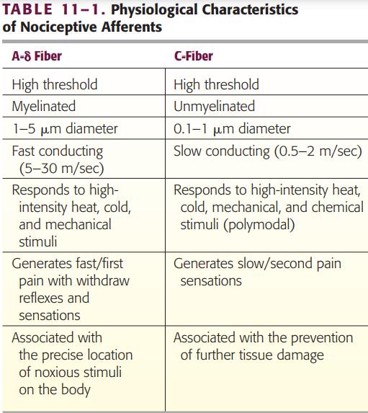

Slide 12
Influences on Pain Perception
To understand the patient’s pain and the response to pain, factors that influence the processing and interpretation of pain information are as follows:
Past Experiences
The perception of pain from an injury can be influenced by a person’s past experience with that injury and the consequences or the association it has with a location such as a hospital that increases anxiety.
Expectations
A person’s expectations can influence the perception and response to pain. These expectations can come from athletic participation and influence an individual’s response to pain.

Slide 13
Personality
Extroverts express pain more freely than introverts, but introverts are more sensitive to pain.
Age
As with most body systems, there is degeneration in neuronal circuitry that occurs with aging that lowers pain threshold.
Gender
There are well-documented differences between men and women in their pain thresholds. Men typically have higher tolerance and thresholds. These can be attributed to biological, psychological, or social influences.

Slide 14
Terms related to pain
Dyesthesia
It is a general term used to denote the experience of an abnormal noxious sensation.
Hyperaesthesia
It is an unpleasant dyesthesia characterised by exaggerated pain response to a noxious or non-noxious stimulus. The response may occur may after repeated stimuli and may have, an exclusive quality.
Allodynia
It refers to the phenomenon in which a non-noxious stimuli perceive as painful.

Slide 15
Hyperalgesia
It is defined as an increased pain response to a noxious stimulus.
Hypoalgesia/Hypalgesia
It denotes relatively diminished sensitivity to a noxious stimulus.

