Slide 1
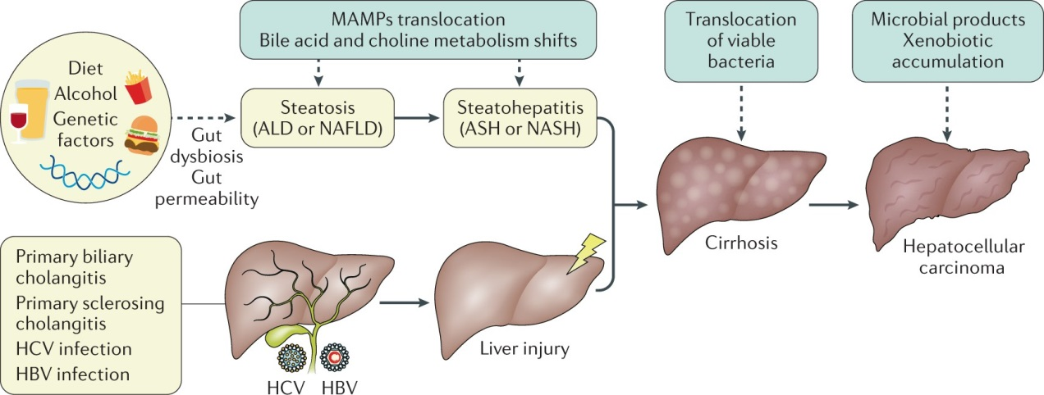
PHARMACOLOGICAL AND TOXICOLOGICAL SCREENING METHODS; MPL-103T
HEPATOPROTECTIVE SCREENING MODELS
“Preclinical Screening of New Substances for the Pharmacological Activity Using In-Vivo, In-Vitro, and Other Possible Animal Alternative Models of Different Drugs”

Slide 2
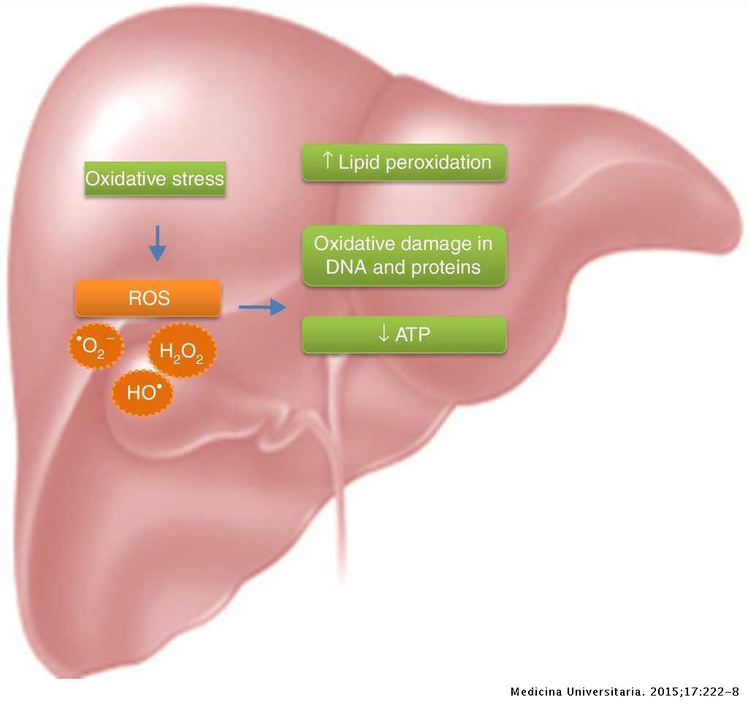
INTRODUCTION
Liver is of the largest organs that located in the right upper quadrant of the abdomen below the diaphragm and the chief site for intense metabolism and excretion
It is the only organ found in vertebrates which detoxifies various metabolites, synthesizes proteins and produces biochemicals necessary for digestion.
It has a surprising role in the maintenance, performance and regulating homeostasis of the body.
It is involved with almost all the biochemical pathways to growth, fight against disease, nutrient supply, energy provision and reproduction
© 2022 MADE BY ASHISH VERMA

Slide 3
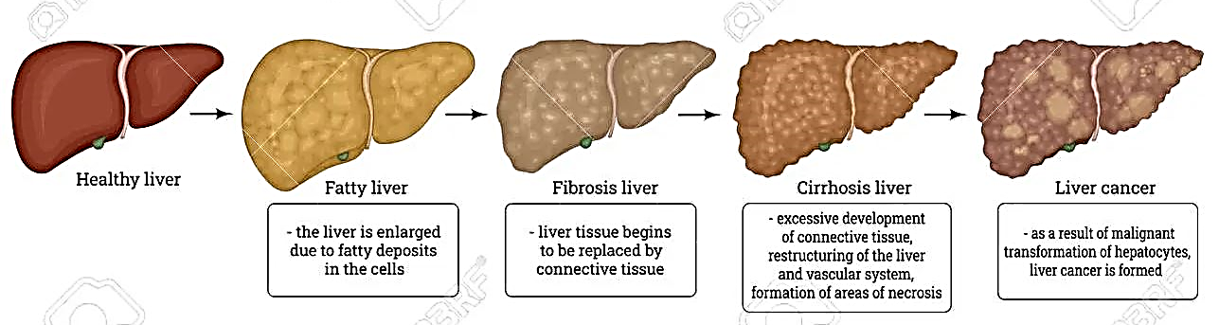
LIVER TOXICITY
In our country, the major cause of liver toxicity is Ethanol and also suspected that more than half of the cases of Hepatotoxicity is caused by Alcohol
Chemicals like Carbon Tetrachloride (CCl₄), Phosphorus, Aflatoxins, Chlorinated hydrocarbon, etc)
Drugs i.e DILI (drugs induced liver injury), Autoimmune disorders, Infections like viral hepatitis is also responsible for toxicity.
© 2022 MADE BY ASHISH VERMA

Slide 4
DRUGS INDUCDED LIVER INJURY
ANTI-TUBERCULOSIS DRUGS
(All drugs causes hepatotoxicity expect ethambutol.)
ANTI-CONVULSANT DRUGS
(Carbamazepine, Valproic Acid)
NSAIDs
(Paracetamol, Diclofenac, Indomethacin, Oxicam group)
ANTI-MICROBIALS
(Dapsone, Ketoconazole, Sulfonamides,
Anti-retrovirals)
ANAESTHEICS
(Enflurane, Isoflurane)
MISCELLANEOUS DRUGS
(Disulfram, Flutamide, Statins, Labetol, Nicotinic acid, Propylthiouracil and OC pills)
© 2022 MADE BY ASHISH VERMA

Slide 5
HEPATOPROTECTIVE SCREENING MODELS
IN-VIVO
MODELS
HEPATITIS IN LONG EVANS CINNAMON RATS
TEMPORARY HEPATIC ISCHEMIA
RIFAMPICIN + ISONIAZID INDUCED HEPATOTOXICITY IN RATS
PARACETAMOL INDUCED LIVER DAMAGE IN RATS
IN-VITRO
MODELS
PRIMARY HEPATOCYTE CELL CULTURE
STELLATE CELL CULTURE
LIVER CIRRHOSIS AND NECROSIS
KUPFFER CELL CULTURE
© 2022 MADE BY ASHISH VERMA

Slide 6
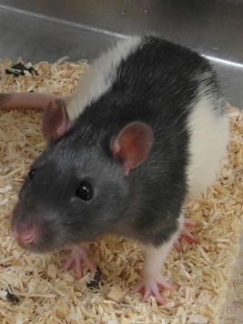
HEPATITIS IN LONG EVANS CINNAMON RAT
PURPOSE AND RATIONAL:
The long Evans cinnamon rat is useful model to study genetically transmitted hepatitis and chronic liver disease.
Due to excessive copper accumulation in the liver of ling Evans cinnamon rats, making this animal a model for Wilson’s disease in human.
Chelation therapy or feeding copper deficient diet decreases symptoms in Long Evans Cinnamon rat and Wilson’s disease.
Source: Image taken from Clinical and
Translational Perspectives on WILSON DISEASE, 2019
© 2022 MADE BY ASHISH VERMA

Slide 7
PROCEDURE :
Long evans cinnamon rats of age of 5 weeks are housed in temperature and humidity controlled room.
Group of 6-10 rats are given different diets on a 15% purified egg protein diet and supplemented with vitamins or drugs, drugs are supplied via minipumps intraperitoneally (IP) implanted under ether anesthesia.
The occurance of jaundice is easily observable as the time when the ears and tails turn yellow and the urine becomes bright ending in death of animal within about a week.
© 2022 MADE BY ASHISH VERMA

Slide 8
TEMPORARAY HEPATIC ISCHEMIA
Hepatocellular function is altered by temporary hepatic ischemia as occurring during surgical management of acute hepatic trauma and being essential during hepatic transplantation.
PURPOSE AND RATIONAL:
Total hepatic ischemia in rats is produced by placing a ligature around the hepatic artery, portal veins and the common bile duct.
PROCEDURE :
Male albino rats (300-350g) are fasted for 16 hours prior to the experiment but are allowed water and libitum
© 2022 MADE BY ASHISH VERMA

Slide 9
PROCEDURE (CONT.):
The rats are anesthetized lightly with ether and the abdominal cavity is opened through a midline incision.
Portal vein as the hepatic artery and the bile duct are occluded by placing a tourniquet around the vessels.
At the end of the 60 min ischemic period, the tourniquet around the portal vein, hepatic artery and the bile duct is removed in order to reestablish blood flow to the liver.
Blood pressure is measured via a catheter inserted into the right femoral artery. During the ischemic period, 0.7mL of saline is given IV at 20-30 min intervals for volume replacement.
The abdominal incision is then closed and the animals receive either saline (non treated) or the drug.
© 2022 MADE BY ASHISH VERMA

Slide 10
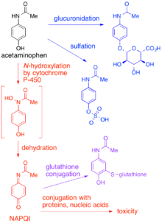
PARACETAMOL INDUCED LIVER DAMAGE IN RATS
Paracetamol is one of the most commonly and widely used analgesic, anti-pyretic drug used in higher dose lead to hepatic damage.
Its gets metabolized to an active metabolite N-acetyl p-benzoquinoneimine (NAPQI) by the cytochrome P-450 microsomal enzyme system which results is an oxidative stress producing liver glutathione and glycogen depletion.
© 2022 MADE BY ASHISH VERMA

Slide 11
PROCEDURE :
The animal are given the test drug for 6 days prior to paracetamol administration and on the seventh day along with paracetamol.
The animals are sacrificed after 24hours and the blood/serum is used for biochemical analysis and the liver for histopathological studies.
Wistar rats of either sex weight (150-200g) are used. Paracetamol 2g/kg body weight is administered orally as a single dose.
© 2022 MADE BY ASHISH VERMA

Slide 12
RIFAMPICIN+ISONIAZID INDUCED HEPATOTOXICITY IN RATS
Rifampicin (RMP) and isoniazid(INH) are used together as 1st line anti TB drug.
PROCEDURE:
RMP and INH both are given in the dose of 50mg/kg body weight of each by IP injection once daily for 15 days.
The test drug were also administered along with RMP+INH combination daily for 15 days.
Wistar/Sprague dowley rats of either sex weighing between 150-200g are used.
At the end of experiment the rats are killed by decapitation and used for further biochemical analysis and histopathology of the liver.
© 2022 MADE BY ASHISH VERMA

Slide 13
PRIMARY HEPATOCYTE CELL INJURY
Fresh hepatocyte preparations and primary cultured hepatocytes are used.
THE BASIC METHOD:
Isolation of hepatocytes by perfusion of liver with collagenase or utilization primary cultured hepatocytes.
Determination of the viability of the hepatocytes.
Incubation of the cell culture with Hepatotoxin and with or without the test drugs.
[HEPATOTOXINS: CCL4, PARACETAMOL, D-GALACTOSAMINE, TETRABUTYLHYDROPEROXIDE AND ETHANOL.]
Determination of the activity of transaminases released into the medium by the hepatocytes.
© 2022 MADE BY ASHISH VERMA

Slide 14
STELLATE CELL CULTURE
In chronic injury, there is stellate cell activation
There is secretion of matrix by activated stellate cells results in liver fibrosis and ultimately cirrhosis.
Stellate cells are isolate from rat liver by collagenase/ pronase digestion
The test drugs are incubated with the activated stellate cell culture by hepatotoxins.
PARAMETERS STUDIED:
Morphology of the cells, -SMA expression (Smooth Muscle Actin), cell count with Thymidine incorporation and inhibition in synthesis of collagen type I and type III.
© 2022 MADE BY ASHISH VERMA

Slide 15
KUPFFER CELL CULTURE
ISOLATION:- Kupffer cells are isolated from the liver by perfusion of the liver with pronase followed by differential centrifugation.
The isolated cells are maintained in culture where their phagocytic properties are retained.
On exposure of the cells phagocytic stimuli like Zymosan particles, there is increased oxygen consumption and superoxide production.
The inhibitory effects of various agents or drugs on Kupffer cells are tested in the In-Vitro Cultures.
© 2022 MADE BY ASHISH VERMA

Slide 16
LIVER CIRRHOSIS AND NECROSIS
Excessive formation of connective tissue with collagen over production reduces hepatic blood flow.
Collagen is formed as a response to chronic injury. The collagenous fibers consist of triple helical molecules. Their formation depends on the presence of hydrogen bonds.
If the number of hydrogen bonds is reduced, the resulting collagen can not form the triple helix and is degraded instead of being deposited in the extracellular matrix.
The aim of fibrosuppressive compounds is to reduce only the excessive formation of insoluble collagen.
Fibrosuppresive effects by inhibition of proline hydroxylation can be screened with in vitro methods, however the desired organ specificity has to be tested in models of liver cirrhosis and fibrosis.
© 2022 MADE BY ASHISH VERMA

Slide 17
“We cannot say what brings us success. We can only pin down what blocks or obliterates success. Eliminate the downside, the thinking errors, and the upside will take care of itself. This is all we need to know.”
© 2022 MADE BY ASHISH VERMA

