Slide 1
PHYSIOLOGY OF MOVEMENT
AAKANKSHA BAJPAI

Slide 2
There are distinct areas in the brain for planning and execution and feedback of the movements.
The basic requisite for any movement is the state of preparedness(muscle tone) in the groups of muscles where movement is to be executed.
MOTOR CONTROL has been defined as an area of study dealing with the understanding of the neural, physical and behavioral aspects of biological (e.g. humans) movements.

Slide 3
SUMMARY OF NORMAL MOTOR CONTROL
For normal movement, the movement planning areas , control circuits and descending tracts must act in contact with sensory information to provide instruction to lower motor neuron. The basal ganglia receive most of their input from the cerebral cortex.

Slide 4
In contrast, the cerebellum receives copious information from the spinal cord, vestibular system and brainstem the cerebellum influences movement via motor areas of cerebral cortex and extensive connections with upper motor neuron that arise in the brainstem only lower motor neuron deliver the signals from the CNS to the skeletal muscle that generate movement.

Slide 5
Three fundamental types of movement
Postural
Primarily Controlled by brain stem mechanisms
Ambulatory
Controlled by brainstem & spinal regions
Reaching/ grasping
Controlled by the cerebral cortex
However, all regions of the nervous system contribute to each type of movement.

Slide 6
POSTURAL CONTROL
Postural control provides orientation and balance(equilibrium).
Postural control is achieved by central commands to lower motor neuron; the central output is adjusted to the environmental contact by sensory input.
The central commands are mediated by the tectospinal, medial reticulospinal, vestibulospinal and medial corticospinal tracts.

Slide 7
To orient the world we use 3 senses:-
a) Somatosensation
b) Vision
c) Vestibular
Somatosensation provides information about weight bearing and the relative position of body parts.
Vision provides information about movement and cues for judging upright.
Vestibular input from receptors in the inner ear informs us about head position relative to gravity and about head movement.

Slide 8
AMBULATION
All region of the nervous system are required for normal human ambulation the cerebral cortex provides goal orientation, the basal ganglia govern generation of force, and the cerebellum provides timing, inter limbs coordination and error correction.

Slide 9
REACHING & GRASPING
Vision and somatosensation are essential for normal reaching and grasping.
The post parietal cortex contains neurons associated with both sensation and movement; these neurons project to pre motor cortical areas controlling reaching, grasping and eye movement.
The premotor cortical areas for each action are somewhat distinct, with the result that reaching, grasping and eye movement are controlled separately but coordinated by connection among the areas.

Slide 10
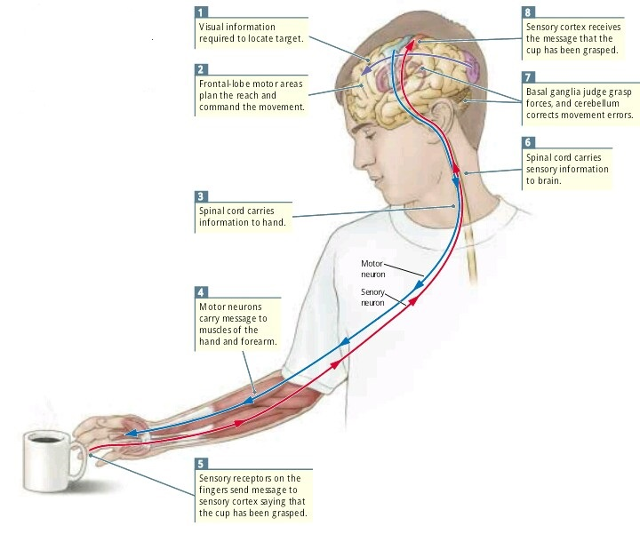
THE HIERARCHICAL CONTROL OF MOVEMENT
The brain tells the hand to reach, and the hand tells the brain that it has succeeded. Movements such as reaching for a cup require the participation of wide areas of the nervous system. The motor regions of the frontal lobe formulate the plan and command the movements required to reach for the cup. The message to the muscles is carried by pathways from the frontal lobe to the spinal cord. Motor neurons of the spinal cord carry the message to the muscles of the hand and arm. Sensory information from the visual system is required to direct the hand to the cup, and sensory information from sensory receptors in the hand is required to conﬁrm that the cup has been grasped. The basal ganglia participate in the movement by estimating the forces required to make the grasp, and the cerebellum participates by correcting errors in the movement as it is made

Slide 11
THE FOREBRAIN & MOVEMENT INITIATION
The frontal lobe of each hemisphere is responsible for planning and initiating sequences of behaviour. The frontal lobe is divided into a number of different regions from front to back, they are the prefrontal cortex, premotor cortex and primary motor cortex.

Slide 12
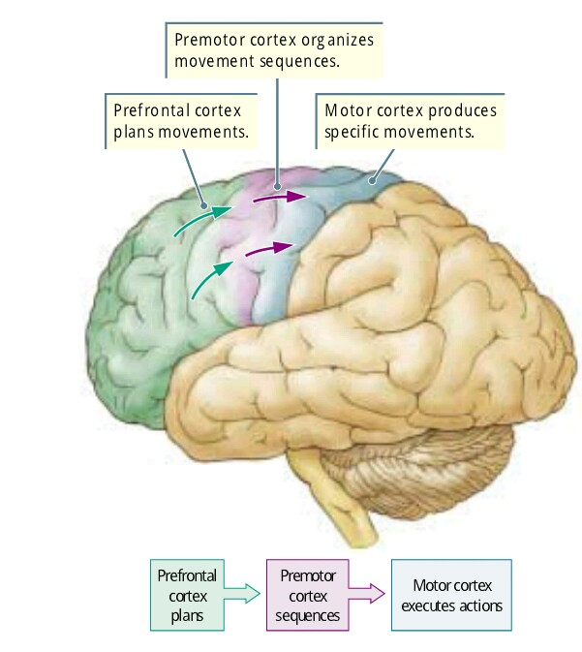
The prefrontal cortex of the frontal lobe plans movements. The premotor cortex organizes sequences of movements. The motor cortex executes speciﬁc movements. Information ﬂow is from prefrontal to premotor cortex and then to motor cortex.

Slide 13
THE BRAINSTEM – TYPICAL MOVEMENT
The brainstem is important for posture, for the ability to stand upright & to make coordinated movement of the limbs, for swimming & walking.
Grooming provides an example of a particularly complex movement pattern that is coordinated mainly by the brainstem.

Slide 14
The effect of damage to regions of the brainstem that organize sequences of movement can be seen in a person with cerebral palsy. Damage to the brainstem can also cause changes in cognitive functions such as occurs in Autism.

Slide 15
THE SPINAL CORD & MOVEMENT EXECUTION-
In view of the complex behaviors that the brain produces, the spinal cord is sometimes considered simply a pathway for conveying information between the brain & the rest of the body.

Slide 16
THE ORGANIZATION OF THE MOTOR SYSTEM-
MOTOR CORTEX-
The principle brain area involved in motor fucntion is the motor cortex, which comprises cortical (broadmann’s) area 4 and 6 located in a demarcated area of the frontal lobe called the precentral gyrus.

Slide 17
However, planning coordinated movement to accomplish a task involves many areas of the neocortex as it requires knowledge of the body’s position in space, the location of the intended target selection of an optimum movement strategy (i.e., which joints, muscle or body segments will be used) memory storage until time of execution and specific instructions to implement the movement strategy selected (where to move or what to do).

Slide 18
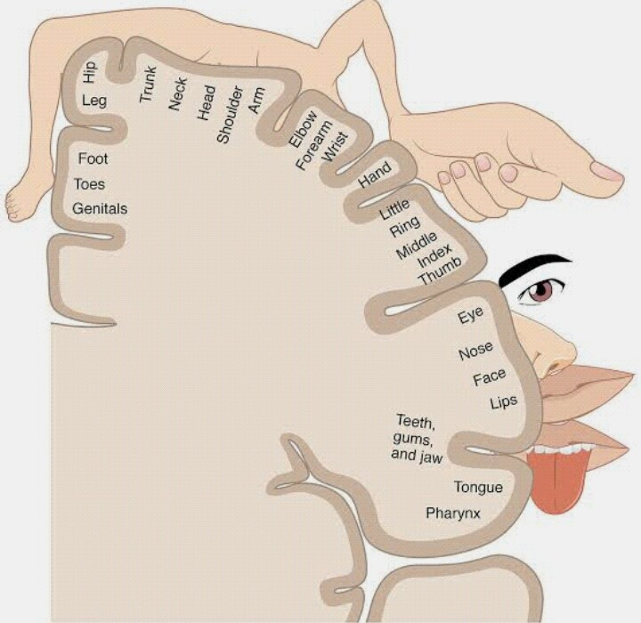
The motor homunculus indicates the somatotopic organization of the motor cortex. The relative size of body parts reflects the proportion of the motor cortex devoted to controlling that area.

Slide 19
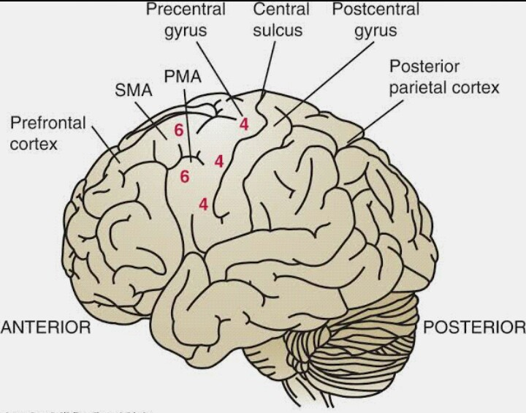
Primary areas of the cortex involved in coordinated movements.

Slide 20
Broadmann’ area 4 is designated the primary motor cortex (PMC) as it is the most specific cortical motor area containing the largest concentration of corticospinal neurons. This area is electrically excitable and stimuli of low intensity evoke a motor response. It lies anterior to the central sulcus on the precentral gyrus and controls contralateral voluntary movements.

Slide 21
Broadmann’s area 6 is also electrically excitable but requires stimuli of higher intensities to cause a motor response. It lies just anterior to area 4 and is subdivided into the the superiorly placed supplementary motor area (SMA) and the inferiorly positioned premotor area (PMA).

Slide 22
DESCENDING MOTOR PATHWAYS
The most important descending pathway of the motor system is the CORTICOSPINAL (pyramidal) tract that transmits signals from the motor cortex directly to the spinal cord. It is among the longest & largest CNS tracts.
The other major descending motor pathways that control neurons innervating muscle include the following:-

Slide 23
CORTICOBULBAR TRACT
Some fibers project directly to motor cranial nerve (CN) nuclei (e.g. trigeminal, facial, hypoglossal) & others to the reticular formation before reaching cranial nerve nuclei.

Slide 24
TECTOSPINAL TRACT
This relatively small tract projects to motor neurons in the cervical cord; fibers influence neurons innervating neck muscles as well as the spinal accessory nucleus (CN X1) ; important in guiding head movements during visual motor tasks.

Slide 25
RETICULOSPINAL TRACT (MEDIAL & LATERAL)-
Important influence on muscle tone & reflex activity via influence on muscle spindle activity (increasing or decreasing sensitivity).

Slide 26
The pontine (medial) reticulospinal tract facilitates extension of the lower extremities (excitation of extensor motor neurons) augmenting antigravity reflexes of the spinal cord; important influence on posture & gait.
The medullary (lateral) reticulospinal tract has the reverse effect (excitation of flexor motor neuron).

Slide 27
VESTIBULOSPINAL TRACTS (MEDIAL & LATERAL)
The lateral vestibulospinal tract descends to all levels of the spinal cord; important contributions to postural control & movements of the head (facilitates axial extensors; inhibits axial flexors).
The medial vestibulospinal tract projects primarily to the ipsilateral cervical spinal cord; also involved in coordinated head & eye movement.

Slide 28
RUBROSPINAL TRACT
This tract merges with the corticospinal tract in the cervical region.

Slide 29
CEREBELLUM
The primary function of the cerebellum is regulation of movement, postural control, & muscle tone.

Slide 30
BASAL GANGLIA
Basal ganglia play an important role in maintaining normal background muscle tone. The basal ganglia also are believed to influence some aspects of both perceptual & cognitive functions.

Slide 31
DORSAL COLUMN- MEDIAL LEMNISCAL PATHWAY
Regulation of movement is dependent on sensory afferent information.
The dorsal column- medial lemniscal pathway is particularly important to coordinated movement, as it is responsible for the afferent transmission of discriminative sensations.

Slide 32
Sensations transmitted by the dorsal column- medial lemniscal pathway include discriminative touch, stereognosis, tactile pressure, baragnosis, graphesthesia, recognition of texture, kinesthesia, two-point discrimination, proprioception & vibration.

Slide 33
THANK YOU

