Slide 1
Inheritance of blood group
Dr.Versha Prasad

Slide 2
Inheritance of ABO Blood Group
The Mandalian Law of inheritance is acceptable in the transfer of Antigen from the parents to the offspring and this antigen composition of all blood groups determined in the laboratory which is phenotype or Blood Group.
A person ABO blood group depend on the ABo gene which is located on chromosome no. 9 inherited from each parent . ( One from mother one from father)
A and B genes are dominant . The recessive o gene is expressed only when A and B dominant gene are absent.
A person who is group O must be of genotype oo .

Slide 3
Inheritance of ABO Blood Group
Thus a child born of an A ( AA) blood group father and mother A (AA) will represent A blood group.
A child born of an A ( AA) blood group father and mother O (oo) will also represent A blood group.
So, that means obse5rvations are-
The phenotype A could thus represent both the genotype. AA and AO.
If one gene is more powerful in expressing itself ( like the A) . It is said to be dominant.
If gene which fails to express itself in the presence of the other one ( Like o , in the presence of A and B ) is said to be recessive.
Both A and B are allelic genes and are equally dominant to o gene.
There are 6 Genotype and only 4 phenotype.

Slide 4
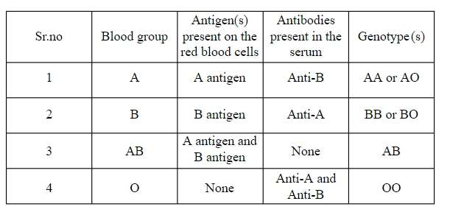
A and B Red cell Antigen -
A person Inherits A gene (AA and AO) belong to group A and expresses A antigen on their Red cells.
A person inherits B gene (BB,BO) belong to group B and express B antigen on there red cell.
A person who inherits A and B genes belongs to group AB and expresses both A and B antigens on there red cells.
A person who inherits ‘o’ gene belong to group O and does not expresses A or B antigen on there red cells.

Slide 5
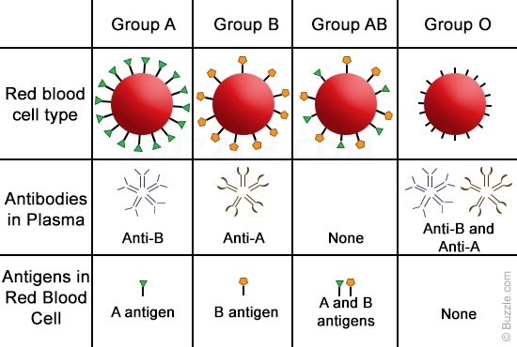

Slide 6
Heterozygous and homozygous offspring's
If the father and mother contribute two identical alleles (AA,BB,oo) the offspring are homozygous but if the allele are different like (Ao,Bo,AB) the offspring are heterozygous .
 | Father | Mother
Blood group | A | A
Genotype | AA | Ao
Possible blood group of the offspring's A

Slide 7
 | Father | Mother
Blood group | A | O
Genotype | Ao | oo
The possible blood group of offspring are A or O.
 | Father | Mother
Blood group | AB | B
Genotype | AB | Bo
Possible Blood Group of the offspring AB/A/B

Slide 8
INHERITANCE OF Rh BLOOD GROUP -
A person who is Rh +ve (phenotype) may have one of the two genotype DD or Dd.
A person who is Rh –ve lacks D gene completely. it indicate presence of d Antigen ‘dd’ genotype.( but ‘d’ is called amorphe- not found)
D is dominant of d.

Slide 9
 | Father | Mother
Rh (D) typing | +ve | - ve
Genotype | DD | dd
Possible Rh typing of offspring's is D +ve or Rh +ve
 | Father | Mother
Rh ( D) typing | +ve | +ve
Genotype | Dd | Dd
The possible Rh typing are Rh +ve DD.
Rh –ve dd

