Slide 1
School Of Pharmaceutical Science, CSJMU Kanpur
Anti-Asthmatics

Slide 2
Asthma
A chronic disease of the airways in which variable periodic symptoms occur, along with airflow obstruction and bronchial hyper-responsiveness is termed as asthma .
Antiasthmatic Agents – The agents which is used to treat asthma.
Examples- Long acting bronchodilators – Beta agonists(Salmeterol)
Anticholinergics(ipratropium)
Corticosteroid(prednisolone)

Slide 3
TYPES OF MODEL
In-Vitro tests--
Histamine receptor binding.
Effects on airways— Tests in isolated organs
Spsmolytic Activity in isolated guinea pig lung strips.
Spasmolytic activity in trachea.
Reactivity of isolated perfused trachea.
Bronchial Perfusion of isolated lung.
Vascular and airway responses in the isolated lung.
In- Vivo tests –
Bronchospasmolytic activity in anesthetized guinea pig (Konzett- Rossler method).
Effect of arachidonic acid or PAF on respiratory function.
Bronchial hyperreactivity
Body plethysmography and respiratory parameters after histamine-induced bronchoconstriction in anesthesized guinea pigs.
Pneumotachography in anesthetized guinea pigs.
Airway Microvascular leakage.
Isolated larynx in situ.
Pneumatography in guinea pig

Slide 4
TYPES OF SCREENING MODEL
In- Vivo Tests
In-Vitro Tests
Histamine receptor binding
Spasmolytic activity in isolated guinea pig lung strips
Pneumatography in guinea pig
Bronchial hyperreactivity

Slide 5
IN-VITRO TESTS—
A. Histamine receptor binding.
Purpose & Rationale - to determine the affinity of test compounds to the histamine H1 receptor by measuring their inhibitory activities on the binding of the H1 antagonist 3H-pyrilamine to a plasma membrane preparation from guinea pig rain.
Procedure :
Animal- Guinea pigs (brain)
Weight- 1g of brain in 30ml buffer.
Dose – 50 microleter
Method - Brain is homogenized in ice cold Tris solution
↓
Centrifuge For 10 minutes
↓
Discard the supernatant
↓
Freeze aliquots of 1ml at -70°c
↓

Slide 6
Resuspend pellet in buffer( 1mg/5ml)
↓
Resuspend pellet in buffer and centrifuge again
↓
Take 50micro leter test drug , 100microleter membrane suspension in shaking bath (25°C)
↓
Incubate for 30minutes in Tris HCl buffer
↓
11 concentrations of 3H Pyrilamine saturation.
EVALUATION OF RESULTS -The following parameters are calculated:
• Total binding of 3H-pyrilamine
• Non-specific binding: binding of 3H-pyrilamine in the presence of mepyramine or doxepin.
• Specific binding = total binding – non-specific binding
• % inhibition of 3H-pyrilamine binding: 100 – specific binding as percentage of control value.

Slide 7
Effects on airways— Tests in isolated organs –
Spasmolytic activity in isolated guinea pig lung strips ➢
Purpose and rationale:- to check the spasmolytic activity induced by histamine and calcium ionophores.
Procedure: ➢
Animal: albino guinea pigs
Sex: m/f
Weight: 300-450g

Slide 8
Method:
Sacrificed by ether overdose. The chest cavity is opened and the lungs are removed Cut into strips of 5cm in PSS. Mounted in organ bath. Bubbled with carbogen, temp maintained at 37°C. Tissue left to equilibrate for 30-60 mins.
↓
Prior to testing carbachol added to check their ability to contract.
↓
After 20 mins , two prevalues are obtained by adding the spasmogen & record contractile force at maximum level.
↓
20 mins eq. period- spasmogen again given. 5 mins later- test compound added in cumulative doses at 5-10 mins interval.
↓
Contractile response determined.

Slide 9
histamine dihydrochloride 10⁻⁶ g/ml for 5 min, or
Ca – ionophore 5 × 10⁻⁶g/ml for 5 min, or
Leukotriene LTC4 10^{–9}–10^{–8} g/ml for 10 min, or
to the bath and recording the contractile force at its maximal level.
↓
Following a 20 min equilibration period, the spasmogen is administered again. Five minutes thereafter, the test compound is added in cumulative doses from 10^{–8} to 10^{–4} g/ml at 5 or 10 min intervals.
↓
The contractile response is determined isometrically
Evaluation: %inhibition of spasmogen induced contraction is calculated.

Slide 10
In Vivo Model-
1.Bronchial hyperreactivity
Purpose& Rationale:-symptom of asphyctic convulsions resembling bronchial asthma can be induced by inhalation of histamine or other agents in Guinea Pig.
Agents applied as aerosols produced by an ultra sound nebulizer. First symptoms are increasing breathing frequency, forced inspiration and finally asphyctic convulsions. Occurrences of these can be delayed by antagonistic drugs. Pre-convulsion time can be measured.
Procedure :
Animal: albino guinea pigs
sex: male
Weight : 300-400g

Slide 11
Method:
Inhalation cages: 3 boxes- each ventilated with airflow of 1.5 l/min.
Animal placed in box A-test/standard is applied using ultra sound nebulizer LKBNB108-aerosol of 0.2ml solution injection by infusion pump in 1 min
Alternatively animal is treated orally or s.c. with test or standard.
Box B acts as a sluice through which animal passes into box C
Here it is exposed to aerosol of 0.1% sol of histamine HCl provided by an ultra sound nebulizer.
Time until asphyctic convulsions is measured.
Then animal is immediately withdrawn. Aerosols are removed by applying pressure.

Slide 12
Evaluation:-
Percent of increase of pre-convulsion time is calculated versus controls.
ED50 values can be found, i.e. 50% of increase of pre-convulsion time .

Slide 13
2. Pneumatography in guinea pig
Animal used – Guinea pig
Anaesthetic used- Urethane (1.5g/Kg .)
Route of administration – IP.
Aim – to measure respiratory & circulatory parameter.

Slide 14
Procedure
Trachea is cannulated ( connected to pneumatograph)
↓
Catheter placed in oesophagus (oesophageal transducer) with the tip inside thorax (register intrathoracic pressure)
↓
Cephalic vein & carotid artery cannulated
↓
Test & control reading recorded

Slide 15
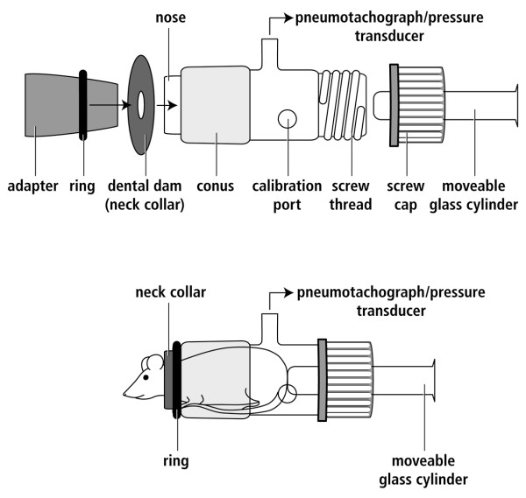

Slide 16
THANK YOU

