Slide 1
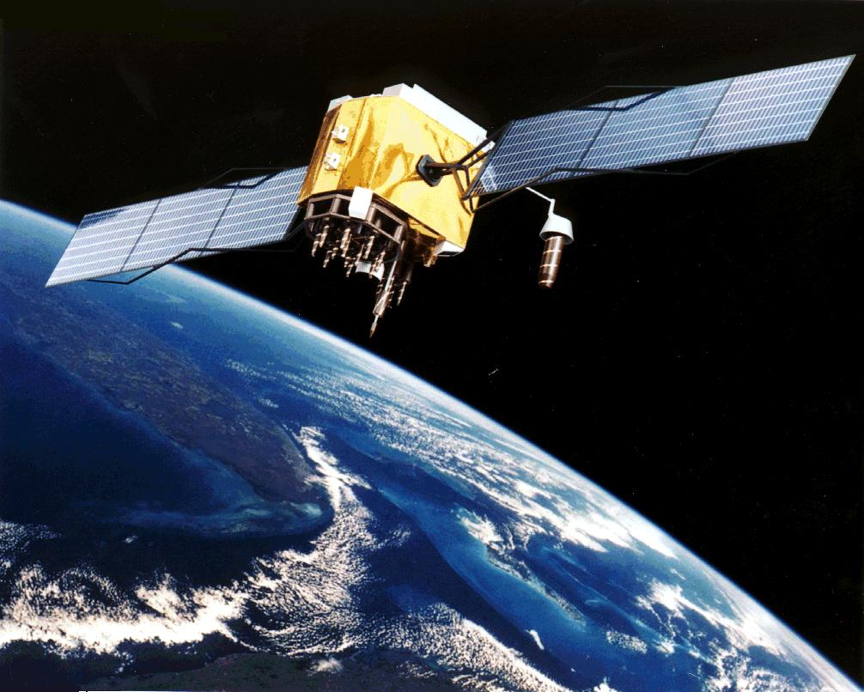
REMOTE SENSING

Slide 2
“SCIENCE & TECHNOLOGY
SAVES
LIFE, MONEY, TIME AND
ENVIRONMENT!”

Slide 3
REMOTE SENSING
Definition: Acquisition of physical data of an object from a distance without having physical contact.
Eg. formation of image on retina of human eye.
Eye collects part of EM radiation-visible light.
Info on retina processed by brain---->picture

Slide 4
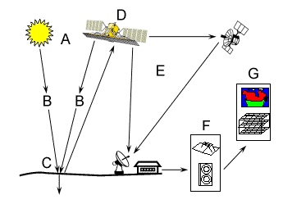
The remote sensor
Different Satellites
Processing
Units
Ground Station

Slide 5
ELECTROMAGNETIC ENERGY
Motion of atoms & molecules at temp above zero emits EM radiation
Objects reflect part of radiation received from sun or artificial source
Every object in nature has unique pattern of Reflected, Emitted and absorbed radiation
The nature & quantity of EM radiation received from a body upon detection become valuable source of data for interpreting the properties of the object.

Slide 6
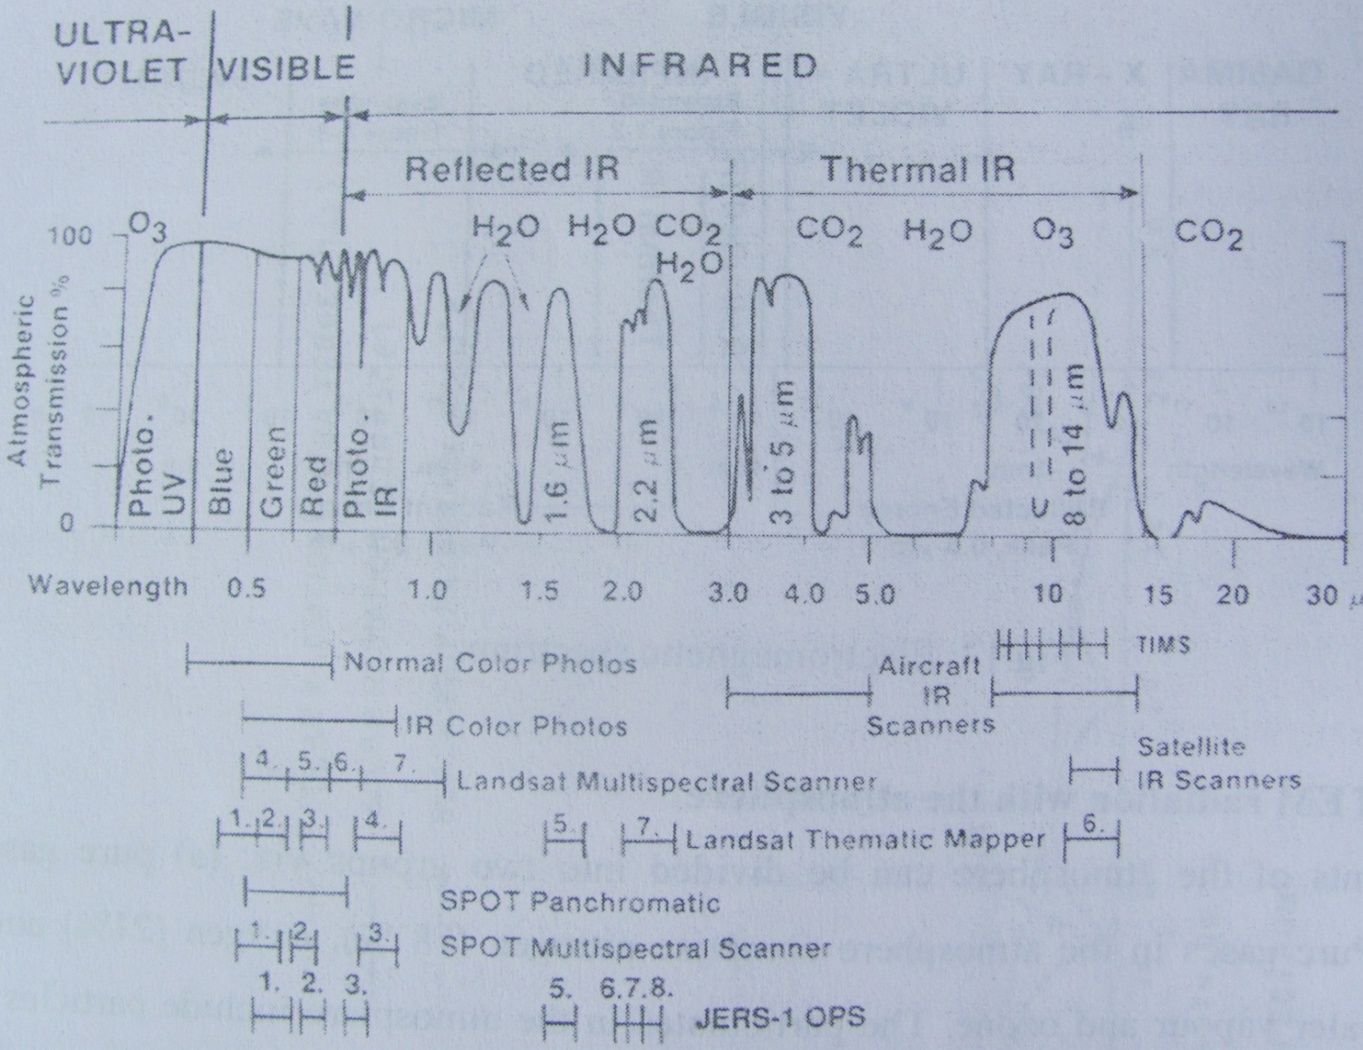
ELECROMAGNETIC SPECRTUM
0.4 to 1.3µm
3 to 5.5µm
8.5 to 14µm

Slide 7
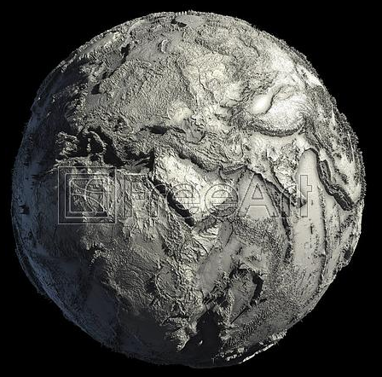
“We cannot stop disaster to happen
but
can certainly take some steps to reduce its adverse impacts on the
ENVIRONMENT”

Slide 8
The Remote Sensing Radiation System
Sun
Sun
I
n
c
i
d
e
n
t
e
n
e
r
R.S. Instrument
g
y
R.S. Instrument
Incident energy
Atmosperic absortion
Atmospheric absorption
Scattered
radiation
Scattered radiation
Atmospheric
Atmospheric
emission
Cloud
Direct
emission
Cloud
radiation
Thermal
Direct radiation
emission
Thermal emission
Scattered radiation
Scattered
Reflected
radiation
radiation
Earth
Reflection processes
Emission processes
EARTH
Reflection processes
Emission processes

Slide 9
INTERACTION PROCESSES
During the Interactions between EM radiations and mater the incident radiation may be
TRANSMITTED
ABSORBED
EMITTED
SCATTERED
REFLECTED
Emission, scattering and reflections are called surface phenomena because the interactions are determined by the surface properties such as roughness.
Transmission and absorption are called volume phenomena because they are determined by the internal characteristics such as density and conductivity.
These interactions between matter and energy are recorded on the remote sensing images, from which the characteristics of the matter is interpreted.

