Slide 1
SPINAL ORTHOSES
Aakanksha Bajpai
Assistant Professor
School of Health Sciences

Slide 2
SPINAL ORTHOSES
A spinal orthosis is a back brace used to treat spinal disorders or after Spinal Cord Injury (SCI).
All spinal orthotic devices need a physician order indicating direction for use and specifying when the patient should wear it.
Unless otherwise indicated by a doctor, patients can take off their brace when laying down flat, as well as at night when they are sleeping.
Orthoses are used to aid a weakened muscle group, correct a deformed body part, maintain the stability of a fractured spine, and protect the spine in cases of instability related to degenerative changes that result from aging.

Slide 3
Orthoses limit spinal movement, protect the spine during healing, and provide mechanical unloading.
Orthoses are used in postoperative situations, to facilitate healing of surgical constructs used to stabilize gross spinal instability.
When an orthosis is used to protect the spine during healing of a fracture or postoperatively after a surgical fusion, it generally is worn for 10 to 12 weeks.

Slide 4
OBJECTIVE OF SPINAL ORTHOSES
Orthoses are designed to limit some or all movements of the spine:
Flexion
Extension
Lateral bending
Rotation

Slide 5
SPINAL ORTHOSES INDICATION
Prescribed to:
Realign the Spine
Immobilize the Spine
Limit Mobility
Support Weakened Areas of the Spine

Slide 6
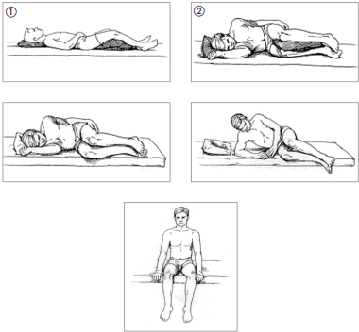
GETTING OUT OF BED WITH BRACE
(BRACE NOT SHOWN IN PICTURE)

Slide 7
TYPES OF SPINAL ORTHOSES
Numerous designs of spinal orthoses are available, providing different degrees of support to different segments of the spine.
Orthoses are named according to the body segments involved and the planes of movement restricted.

Slide 8
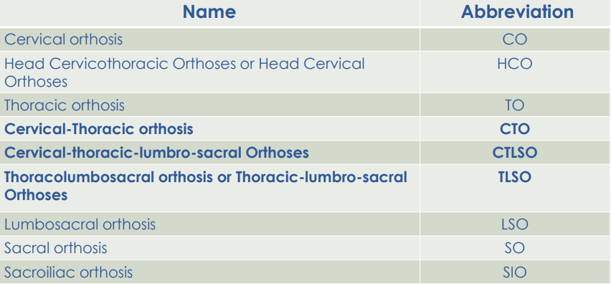
ORTHOSES NAMES

Slide 9
Head cervicothoracic orthoses (HCO)
E.g.: Semirigid Minerva orthosis
Cervical-Thoracic orthosis (CTO)
E.g.: The sternal occipital mandibular immobilizer (SOMI)
Cervical-thoracic-lumbro-sacral Orthoses (CTLSO)
E.g.: Milwaukee Orthosis
Thoracolumbosacral orthosis (TLSO)
E.g.: Jewett

Slide 10
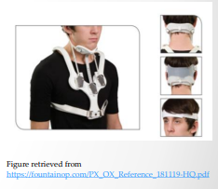
Cervical-Thoracic Orthosis (CTO)
Consist of chin and occipital pieces that are connected by two to four adjustable metal uprights to sternal and back plates.
Provide greater restriction of neck motion than collars do.
E.g.: The sternal occipital mandibular immobilizer (SOMI)

Slide 11
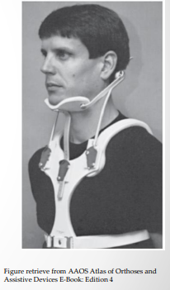
Sternal Occipital Mandibular Immobilizer (SOMI)
Parts
Sternal plate
One anterior strap to hold chin
Two rigid metal rods from anterior to posterior to occiput support.
Advantages
No posterior post - can be used while patient is supine.
Light weight for donning and doffing
Controls flexion effectively at C1–C3

Slide 12
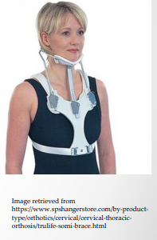
Indications
Atlantoaxial instability caused by rheumatoid arthritis
Neural arch fractures of C2, because flexion causes instability
Contraindications
The SOMI controls extension less effectively than do other orthoses.
Flexion and extension control at C3-T1: better served with a Minerva.

Slide 13
SOMI Brace Fitting Instructions
Brace Application
ALWAYS apply brace while patient is lying flat on his/her back.
Apply the chest piece over the shoulders.
Attach the chin piece to the chest piece.
Occipital piece is then attached to the chest piece (slide on sideways underneath the neck).
Snap the chin and occipital pieces together.
Sit patient up.
Shoulder straps must be criss-crossed in the back, and then attached to the hooks on the front of the brace.

Slide 15
Brace Removal
ONLY AT THE REQUEST OF THE DOCTOR –brace is usually worn at all times.
The SOMI should not be adjusted or removed without physician's consent.
To remove the brace, reverse the application instructions.
The headband or chin piece must be in place at all times.
The headband can be worn for eating instead of the chin piece.
The chin piece should be worn so that the head is looking forward, not up or down.

Slide 16
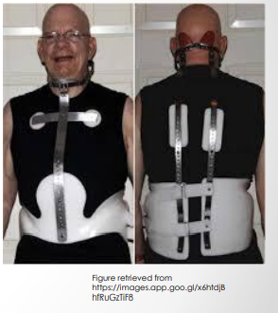
Cervical Thoracolumbosacral Orthoses (CTLSO)
Basic components:
Sternal plate
Anterior and posterior uprights
Mandibular support o Occipital support

Slide 17
Control Function:
Restricts flexion/extension of the head and cervical spine
Limits lateral flexion and rotation
Through proper adjustment (elongation) can relieve c-spine from a portion of the weight of the head
Indications for a CTLSO Brace:
Thoracic Fractures T1-T6
Motion Limited:
Restricts flexion/extension/lateral flexion & rotation

Slide 18
A CTLSO may also be known as a Milwaukee orthosis.
It is a two-piece clamshell design. It consists of a customized pelvic girdle and a metal structure that extends to the neck.
Use:
To stabilize the head and neck as well as the spine after surgery or in the event of a spinal fracture to promote healing and decrease pain, and o to treat curves high in the upper back, such as kyphosis (hunchback).

Slide 20
Thoracolumbosacral Orthoses (TLSO)
Thoracolumbosacral Orthoses Include:
The clamshell thermoplastic body jacket, and
The thoracolumbar extension orthosis or Jewett brace.
There are a number of modifications of these two basic designs.
These appliances apply three-point bending forces at the upper thorax and pelvis and at the midportion of the brace across the thoracolumbar junction

Slide 21
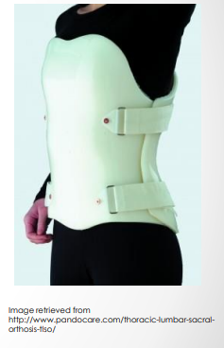
This class of orthotic is best suited for restricting thoracolumbar and lumbar gross-body motion and poorly controls low lumbar and sacral segments.
Molded appliances are particularly useful for thoracolumbar junction trauma in which the total contact feature helps to control lateral bending and rotation.

Slide 22
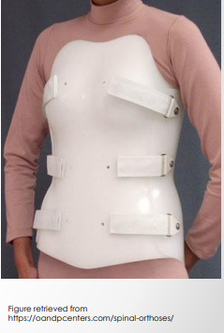
For fractures between T6 and L3. Provide support and immobilization of the thoracic and lumbar regions following various surgical procedures/traumatic injuries.
Help in treatment of post-operative thoracic/lumbar fusion, laminectomy or discectomy, compression fractures, degenerative disc disease, osteoporosis, single column spinal instability immobilization, and facet syndrome.

Slide 23
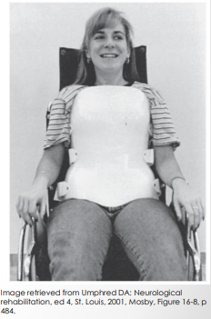
Custom TLSO is a molded plastic body orthosis.
It provides control of flexion, extension, lateral bending, and rotation, using a three-point pressure system and circumferential compression until healing can occur.

Slide 24
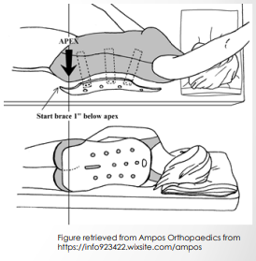
TLSO (Clam shell) Application Instructions
Ideally the orthosis should be worn on top of a T-shirt, nightshirt, or long undershirt to allow for ventilation.
Log roll the patient to their preferred side.
Put on back section of the brace first, by sliding edge of brace and Velcro straps under the patient's side. The bottom of the orthosis should be about one inch below the midpoint of the bum and the mid-line of the orthosis should be slightly more toward the side that the patient is lying on (approximately 1" beyond the spine).

Slide 25
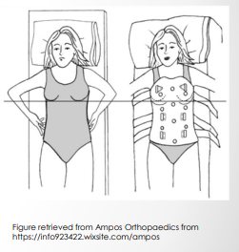
Roll patient flat onto their back, making sure that the shoulders and hips are square. At this point, the orthosis may need to be pulled so that the orthosis is lying centered on the back. Feel the sides to make sure that the orthosis comes up equally on either side of the body. Never lift the hips AT ANY TIME.

Slide 26
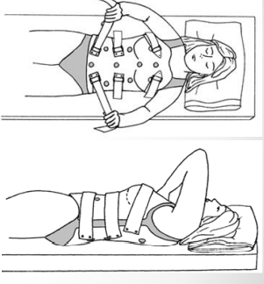
Next place the front section of the orthosis on the patient. This section should be placed low enough so that the belly is covered as much as possible. This may mean that the chest section is lower than normal, but it will move up once the brace is tightened. The straps should be done up from the bottom up, loosely at first, and then pulled tight. The patient should be able to breathe normally, but NOT be able to take a deep breath through the belly.

Slide 27
How it should look:
When wearing the brace in sitting, it should sit on top of the thighs, and the back of the brace should be about 1" above the seat of a firm chair. In standing, the back section should end at the height of the curve in the buttocks, and the midline should be within 1" of either side of the spine. If it is not there, it should be reapplied.
There needs to be a gap between the front and the back section. If these sections touch on both sides, the brace needs to be adjusted. Please call your local orthotic supplier to arrange to have this adjustment made.

Slide 29
TLSO (Clam shell) Removal Instructions
How to remove
Lie down flat on the back. Undo Velcro straps. Remove front section first. Log roll patient to most comfortable side. Slide out back section.
When to wear brace
The brace should be worn whenever the patient is sitting up or standing. It can be off when they lie down. It should be applied and taken off in a lying position.

Slide 30
TLSO (Clam shell) Care Instructions
Shower/Bathing
The brace can be worn in the water. After a shower or bath, remove the brace, towel dry and let air dry for a short time (15- 30 minutes). We usually recommend washing at night, so the brace can dry completely.
Care & Cleaning
It is recommend to wash the brace at least once a week with soap and water, a washcloth or sponge. The soap residue must be rinsed off completely. After cleaning, towel dry the brace and let stand for a short time (15- 30 minutes).

Slide 31
Jewett Hyperextension Thoracolumbosacral Orthosis (Jewett TLSO)
It is prefabricated and consists of an anterior and a lateral frame to which pads are attached laterally and at the sternal and suprapubic areas.
The system uses a 3-point pressure system to control flexion of the spine.
It applies two posteriorly directed forces:
The anterior pads place pressure over the sternum and pubic symphysis.
The posterior pad places opposing pressure in the midthoracic region.

Slide 33
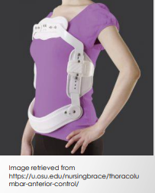
Jewett Instructions
How to apply
Ideally the orthosis should be worn on top of a T-shirt.
Lie on the bed, place the orthosis onto chest, and roll onto the right side.
Put the back pad & strap behind the back and slide the metal or plastic clasp under the right side.
Roll onto back and centre the front section into place over the stomach and chest.

Slide 34
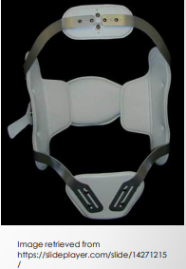
To fasten the orthosis, hold it in place with the left hand. With the right hand, use the thumb loop to pull the clasp forward tightly, and then in towards the stomach, then down. This locks the clasp into the hook. Now turn the tab so that the back strap shortens, tightening the orthosis, approximately 10 turns.
The orthosis should feel tight, and look symmetrical.
Sometimes the attaching of the clasp pushes the Jewett to one side. If this happens, try to overcorrect for this before tightening the clasp.

Slide 35
If the sternal pad can be pulled more than 1.5 cm (approximately the thickness of a finger) away from the chest while lying or standing, then the clasp should be tightened.
For a proper fit the upper pad should rest on the sternum and the lower bar should just touch the thigh when sitting. If the patient feels excessive pressure on the chest, the patient should physically straighten his or her back, keeping the shoulders back and not leaning into the orthosis for support. The orthosis should act as a reminder that the patient is bending forward and compromising his or her back.

Slide 36
How to remove
Lay down flat on your back.
Loosen the clasp by approximately 10 turns. Put the left hand on the orthosis to hold it in place, then with the right thumb, pull the thumb loop of the clasp forward tightly, then in towards the stomach, then upwards towards the head to remove clasp from the hook.
Roll onto the right side and pull plastic clasp out from under the right side.
Take off the orthosis.
When to wear orthosis
The orthosis should be worn when sitting up or standing. It can be taken off when lying flat (the patient does not have to sleep in it unless the Dr. specifies this). It should be applied and taken off in a lying position.

Slide 37
References
(American Academy of Neurology) Michael Selzer M.D., Bruce Dobkin M.D. (2008) Spinal Cord Injury: A Guide for Patients and Families, 1 edn., New York: Demos.
AMPOS Device Information Sheets (2016) Corset, Available at: https://info923422.wixsite.com/ampos/device-information-sheets (Accessed: 2nd September 2019).
AMPOS Device Information Sheets (2016) CTLSO (Cervical-thoracic-lumbo-sacral Orthosis) Information, Available at: https://info923422.wixsite.com/ampos/device-information-sheets (Accessed: 2nd September 2019).
AMPOS Device Information Sheets (2016) Hip Stabilizing Brace (Hip Spica), Available at: https://info923422.wixsite.com/ampos/deviceinformation-sheets (Accessed: 2nd September 2019).
AMPOS Device Information Sheets (2016) Jewett, Available at: https://info923422.wixsite.com/ampos/device-information-sheets (Accessed: 2nd September 2019).
AMPOS Device Information Sheets (2016) LSO (Lumbo-Sacral Orthosis) Information, Available at: https://info923422.wixsite.com/ampos/device-information-sheets (Accessed: 2nd September 2019).

Slide 38
THANK YOU

