Slide 1
INSTITUTIONAL FOOD SERVICE MANAGEMENT
STYLES OF FOOD SERVICE
Aamena Zaidi
Assistant Professor
School of Health Sciences
CSJMU

Slide 2
STYLES OF FOOD SERVICE
THE SERVING OF FOOD IS AN ART WHICH CAN MAKE OR BREAK THE REPUTATION OF CATERING ESTABLISHMENT. FOOD MAY BE SERVED IN A NUMBER OF WAYS, SOME FORMAL, INFORMAL.

Slide 3
CLASSIFIED UNDER FOUR MAIN HEADS
WAITER SERVICE
SELF-SERVICE
VENDING
CONTRACT CATERING

Slide 4
FOOD SERVICE STYLES
FORMAL (WAITER SERVICE)
SEMI -FORMAL (WAITER/SELF-SERVICE)
INFORMAL (SELF-SERVICE)
BANQUET
RESTAURANT
BUFFET
FAST FOOD RESTAURANT
CAFETERIA
BUFFET
ROOM SERVICE
HOSPITAL SERVICE
TRAVEL SERVICES
DHABA
CAFES
COFFEE SHOP
FAST FOOD OUTLETS
COUNTER SERVICE
CANTEEN SERVICE
VENDING

Slide 5
WAITER SERVICE
WAITER SERVICE IS THE FORMAL TYPE OF SERVICE IN WHICH STAFF PRESENT THE MENU TO THE CUSTOMER AND WAIT ON HIM TILL HE DECIDED WHAT HE WANTS.THE ORDER IS THEN NOTED AND PASSED ON THE KITCHEN FOR EXECUTION.

Slide 6
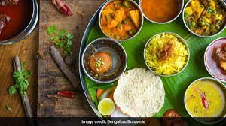
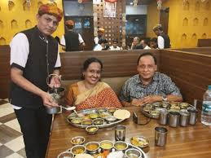
TRADITIONAL INDIAN SERVICE

Slide 7
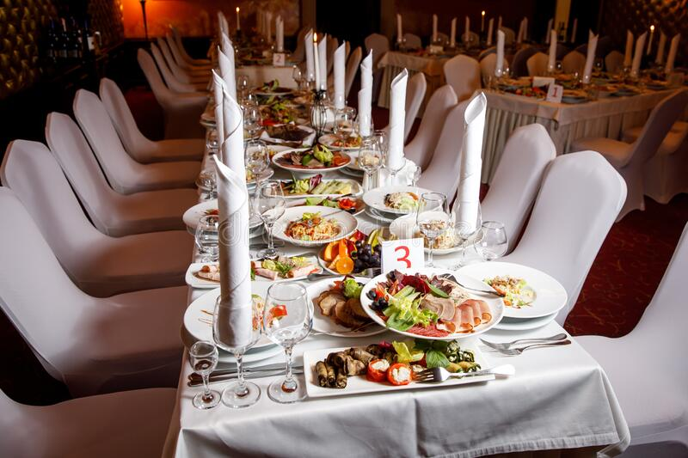
BANQUET SERVICE
THIS IS THE MOST SOPHISTICATED STYLE OF WAITER SERVICE AND IS USUALLY CARRIED OUT WHEN THE HEADS OF STATE OR GOVT. ARE BEING ENTERTAINED.SUCH SERVICES ARE SEEN AS RASHTRAPATI BHAWAN, DINNER HOSTED BY GOVERNORS OF STATE SO ON.

Slide 8
RESTAURANT SERVICE
SERVICE STYLE IS RESTAURANTS VARY SLIGHLY FROM ONE PLACE TO ANOTHER, AND ARE SLIGHLY LESS FORMAL THAN THE BANQUET SERVICE BUT FORM DIFFERENT VERSIONS OF WAITER SERVICE. THEIR OBJECTIVE IS TO PROVIDE AN ATMOSPHERE FOR LEISURE DINING TO THE CUSTOMER AND YET REMAIN PERSONALISED.

Slide 9
DIFFERENT TYPES OF FOOD STYLE
TAKE AWAY
BUFFETERIA
ESPRESSO BAR
ROOM SERVICE
ROADSIDE SERVICE
RAILWAY SERVICE
AIRLINE SERVICE
SERVICE AT SEA

Slide 10
MECHANICS OF WAITER SERVICE
STEP 1: THE PROSESS STARTS WITH THE PRESENTATION OF SERVICE BOYS, SIDEBOARDS AND TABLES FOR THE TYPE OF MENU AND TIME .
STEP 2: RECEIVING CUSTOMER
STEP 3: SERVING
STEP 4: CLEARING
STEP 5: SENDING OFF

Slide 11
INFORMAL SERVICE
SELF -SERVICE: SELF- SERVICE IS A TYPE OF ARRENGEMENT WHICH REQUIRES CUSTOMERS TO COME TO A COUNTER , BAY OR TABLE SERVE THEMSELVES.
THE ADVANTAGES OF SELF-SERVICE ARE:
THE INFORMALITY IN THE STYLE PUTS CUSTOMERS OF ALL AGES AT EASE AT WHILE EATING.
THE AMOUNT OF FOOD HANDLING IN CONSIDERABLY REDUCED
THE CUSTOMER CAN MAKE BETTER CHOICES WHEN THE DISPLAY OF FOOD
THE SERVICE IS FASTER BEACAUSE THE FOOD IS DIFFERENT

Slide 12
BUFFET SERVICE
FULL BUFFET
FINGER BUFFET
FORK BUFFET
CAFETERIA SERVICE
TRAYED SERVICE
PLATED SERVICE

Slide 13
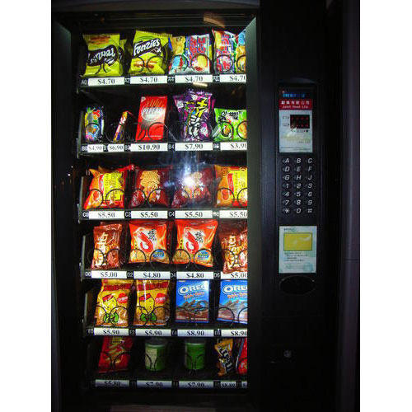
VENDING
MOBILE VENDING:
MOBILE CATERING HAS BECOME EXTREMELY POPULAR IN THE LAST DECADE, WITH CATERING CAN COMMONLY PARKED IN MARKET AREAS OUTSIDE EDUCATIONAL INSTITUTES AND ON RAODSIDE.

Slide 14
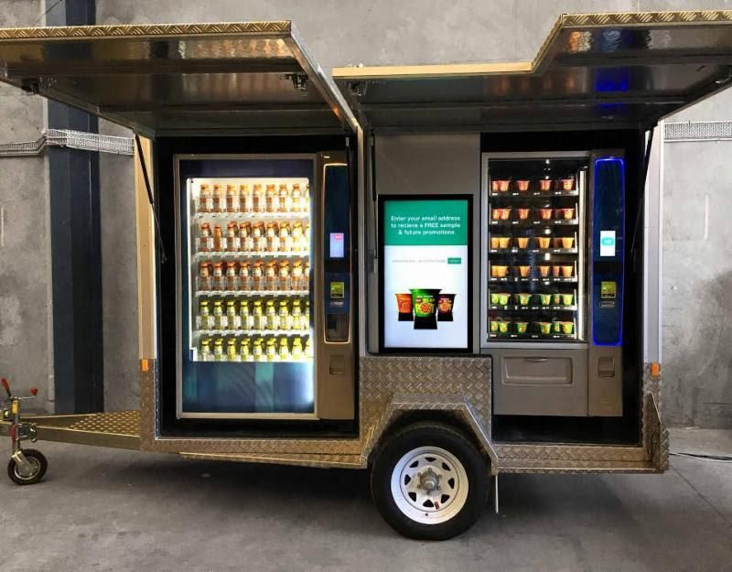
ADVANTAGES OF VENDING
THE MENU
SERVICE
SANITATION AND SAFETY

Slide 15
AUTO –VENDING
TODAY VENDING HAS MOVED FROM MOBILE VENDING TO AUTO-VENDING, A METHOD OF OFFERING CATERING SERVICES THROUGH THE USE OF AUTOMATED VENDING MACHINEDS.
AUTO – CATERING IS A USEFUL CONCEPT FOR PROVIDING A SERVICE AT ODD HOURS, AND DURING OFF-PEAS OR IN OUT OF THE WAY SPOTS IN MOTELS OR HOTELS , WHERE PEOPLE MAY CHECK IN AT ANY TIME OF DAY OR NIGHT.
ALL THE DIFFERENT TYPES OF SERVICE STYLES ACCOUNT FOR DIFFERENT RATED OF COUNTER TURNOVER.

Slide 16
CONTRACT SERVICES
CONTRACT SERVICES HAVE EVOLVED OVER THE LAST FEW DECADES AND TODAY ANY INDIVIDUAL, GROUP OR FOOD SERVICE ESTABLISHMENT CAN GIVE A CONTRACT TO A CATERER WHO SPECILIZE IN A CERTAIN CATEGORY OF CATERING, PRODUCTION OR FOOD SERVICE OPERATION.
THIS HAS HELPED FAVOURITES TO COME ON HOTEL AND RESTAURANT MENUS,, AND CHAAT PARTIED ORGANISED BY RESTAURANTS HAVE BECOME THE PICK OF THE DAY FOR KITTY PARTIES AND OTHER CELEBRATION FUNCTIONS.

Slide 17
PRESENTATION PF FOOD DISPLAY
FOOD DISPLAY
A CATERING BUSSINESS TO REACH ITS FULL POTENTIAL, IT HAS TO CREATE SALES AND PROVIDE A DEGREE OF CUSTOMER SATISFACTION WHICH IS PERCEIVED AS BEING THAN THAT OFFRED BY OTHER FOOD SERVICE OF THE SAME TYPE.
DISPLAY DESIGN
CAFETEIAS WITH DISPLAY SERVICE COUNTER ALSO RUN THE RISK OF CROSS CONTAMINATION FROM CUSTOMERS’ TABLES IF THEY ARE NOT CLEARED AWAY EFFCIENTLY.

Slide 18
INSTITUTIONAL FOOD SERVICE
EDUCATION INSTITUTIONS
SERVICE METHODS
WORK FORCE REQUIREMENTS
FOOD CHOICES
SERVICE STYLES
WELFARE CATERING
MID- DAY MEAL PROGRAMME
OLD AGE HOMES
BLIND SCHOOLS
HOME FOR OF OTHER DISABILITIES

Slide 19
THANK YOU……..

