Slide 1
Sterilisation and Disinfection- Physical Methods

Slide 2
Sterilisation
Sterilisation is defined as the process where all the living microorganisms, either in the vegetative or spore state are killed.
Sterilisation and disinfection are both decontamination process.
The process of sterilisation is used in microbiology to prevent contamination by extraneous organisms, in surgery to maintain asepsis, in food and drug manufacture to ensure safety from contaminating organisms.
Chemicals are used to destroy all forms of microbiologic life, they can be called chemical sterilants.

Slide 3
Disinfection
Disinfection is the process of elimination of most pathogenic microorganisms (excluding bacterial spores) on inanimate objects.
Different disinfectants have different target ranges, not all disinfectants can kill all microorganisms. Some methods of disinfection such as filtration do not kill bacteria, they separate them out.
Decontamination is the process of removal of contaminating pathogenic microorganisms from the articles by a process of sterilisation or disinfection. It is the use of physical or chemical means to remove, inactivate or destroy living organisms on a surface so that the organisms are no longer infectious.

Slide 4
Sanitisation is the process of chemical or mechanical cleansing, applicable in public health systems. Usually used by the food industry. It reduces microbes on eating utensils to safe, acceptable levels for public health.
Asepsis is the employment of techniques such as usage of gloves, air filters, uv rays etc to achieve microbe free environment.
Antisepsis is the use of chemicals (antiseptics) to make skin or mucus membranes devoid of pathogenic microorganisms.
Bactericidal is that chemical that can kill or inactivate bacteria. Such chemicals may be called variously depending on the spectrum of activity, such as bactericidal, virucidal, fungicidal, microbicidal, Sporicidal, tuberculocidal or germicidal.

Slide 5
Methods of Sterilisation
1.Physical
Sunlight
Heat.
Dry heat
Red heat
Flaming
Incineration
Hot air oven
Moist heat
Below 100℃ (Pasteurisation)
At 100℃ (Boiling,Tyndallisation)
Above 100℃ (Autoclave)
Drying
Filtration
Radiation
Non-ionising
Ionising

Slide 6
2.Chemical
Liquid
Alcohols
Aldehydes
Dyes
Phenols
Halogens
Surface-active agents
Metallic salts
Gaseous
Ethylene oxide
Formaldehyde

Slide 7
PHYSICAL METHODS OF STERILISATION:
Sunlight:
The microbicidal activity of sunlight is mainly due to the presence of ultra violet rays in it.
It is responsible for spontaneous sterilisation in natural conditions.
In tropical countries, the sunlight is more effective in killing germs due to ultraviolet rays and heat.

Slide 8
Heat
Heat is the most reliable method of sterilisation of materials that can withstand heat and those materials that may be damaged by heat can be sterilised at lower temperatures , for longer periods or by repeated cycles.
Mechanism of action :
The killing effect of dry heat is due to protein denaturation, oxidative damage and the toxic effect of elevated levels of electrolytes.

Slide 9
The lethal effect of moist heat is due to the denaturation and coagulation of protein.
Most heat is superior to dry heat in action.
Temperature and time are inversely proportional .As temperature increases the time taken decreases.
Thermal death time is the minimum time required to kill a suspension of organisms at a predetermined temperature in a specified environment.
Articles that are heavily contaminated require higher temperature or prolonged exposure.
Organic materials such as protein, sugars, oils, and fats increase the time required.

Slide 10
Dry Heat:
Red heat: Articles such as bacteriological loops, straight wires, tips of forceps are sterilised by holding them in Bunsen flame till they become red hot.
Flaming: This is a method of passing the article over a Bunsen flame, but not heating it to redness.
Articles such as scalpels, mouth of test tubes, flasks, glass slides and cover slips are passed through the flame a few times.

Slide 11
Incineration:
This is an excellent method for safely destroying contaminated materials such as contaminated cloth, animal carcasses and pathological materials by burning them in incinerator.
Plastics such as PVC and polythene can be dealt with similarly but polystyrene materials emit clouds of dense black smoke and hence should be autoclaved in appropriate containers.

Slide 12
Hot air oven: This method was introduced by Louis Pasteur.
Articles to be sterilised are exposed to high temperature (160℃) for duration of one hour in an electrically heated oven.Since air is poor conductor of heat even distribution of heat throughout the chamber is achieved by a fan.
The heat is transferred to the article by radiation, conduction and convection.
Articles to be sterilised must be perfectly dry before placing them inside to avoid breakage.
The material should be arranged so as to allow free circulation of air between the objects.

Slide 13
Mouths of flasks, test tubes and both ends of pipettes must be plugged with cotton wool.
Articals such as petri dishes and pipettes may be arranged inside metal canisters and then placed.
Individual glass articles must be wrapped in Kraft paper or aluminium foils.
Metallic instruments (like forceps, scalpels, scissors), glasswares(such as petri-dishes, pipettes,flasks,all glass syringes),swabs,oils, grease, petroleum jelly and some pharmaceutical products can be sterilised in hot air oven.

Slide 14
Moist Heat:At temperature below 100℃
Pasteurisation: This process originally employed by Louis Pasteur.
There are two methods of pasteurisation, the holder method(heated at 63℃ for 30 minutes) and flash method(heated at 72℃ for 15-20 seconds) followed by quickly cooling to 13℃ or lower.
This method is suitable to destroy most milk borne pathogens like Salmonella, Mycobacteria, Streptococci, Staphylococci and Brucella.
Vaccine bath:The contaminating bacteria in a vaccine preparation can be inactivated by heating in a water bath at 60℃ for one hour. Only vegetative bacteria are killed and spores survive.

Slide 15
Serum bath: The contaminating bacteria in a serum preparation can be inactivated by heating in a water bath at 56℃ for one hour on several successive days.Proteins in the serum will coagulate at higher temperature.
Inspissation:This is a technique to solidify as well as disinfect egg and serum containing media.The medium containing serum or egg are placed in the slopes of an inspissator and heated at 80-85℃ for 30 minutes on three successive days.
Temperature at 100℃:
Boiling:Boiling water( (100℃) kills most vegetative bacteria and viruses immediately, but sporing bacteria require prolonged periods of boiling.
Some bacterial spores are resistant to boiling and survive; hence this is not a substitute for sterilisation.
Certain bacterial toxins such as Staphylococcal enterotoxin are also heat resistant.
The killing activity can be enhanced by addition of 2% sodium bicarbonate.
When absolute sterility is not required, certain metal articles and glasswares can be disinfected by placing them in boiling water for 10-20 minutes.The lid of the boiler must not be opened during the period.

Slide 16
Steam at atmospheric pressure (100℃):
Instead of keeping the articles in boiling water, they are subjected to free steam at 100℃.Traditionally Arnold’s and Koch’s steamers were used.
A steamer is a metal cabinet with perforated trays to hold the articles and a conical lid.The bottom of steamer is filled with water and heated.The steam that is generated sterilises the articles when exposed for a period of 90 minutes.
Media such as TCBS, DCA and selenite broth are sterilised by steaming.Sugar and gelatin in medium may get decomposed on autoclaving,hence they are exposed to free steaming for 20 minutes for three successive days.This process is known as tyndallisation (after John Tyndall) or intermittent sterilisation.

Slide 17
At temperature above 100℃: Autoclave:-
Sterilisation can be achieved at a temperature above 100℃ using an autoclave.
Water boils at 100℃ at atmospheric pressure, but if pressure is raised, the temperature at which the water boils also increases.ln an autoclave the water is boiled in a closed chamber.As the pressure rises, the boiling point of water also raises.
At a pressure of 15 lbs inside the autoclave, the temperature is said to be 121℃. Exposure of articles to this temperature for 15 minutes sterilises them. To destroy the infective agents associated with spongiform encephalopathy (prions) 135℃ or 121℃ for at least one hour are recommended.

Slide 18
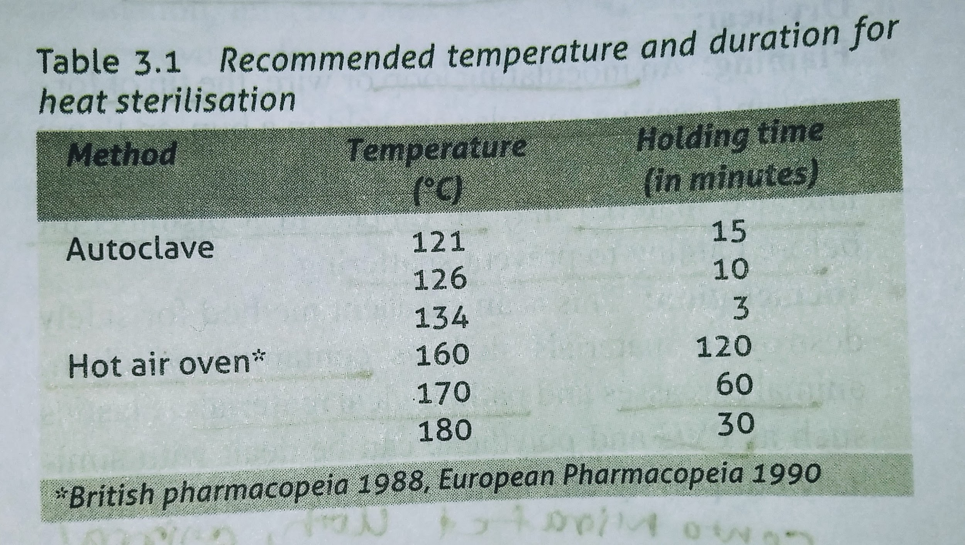
Steam has more penetrative power than dry air, it moistens the spores (moisture is essential for coagulation of proteins.
Articles sterilised: Culture media, dressings, certain equipment etc.

Slide 19
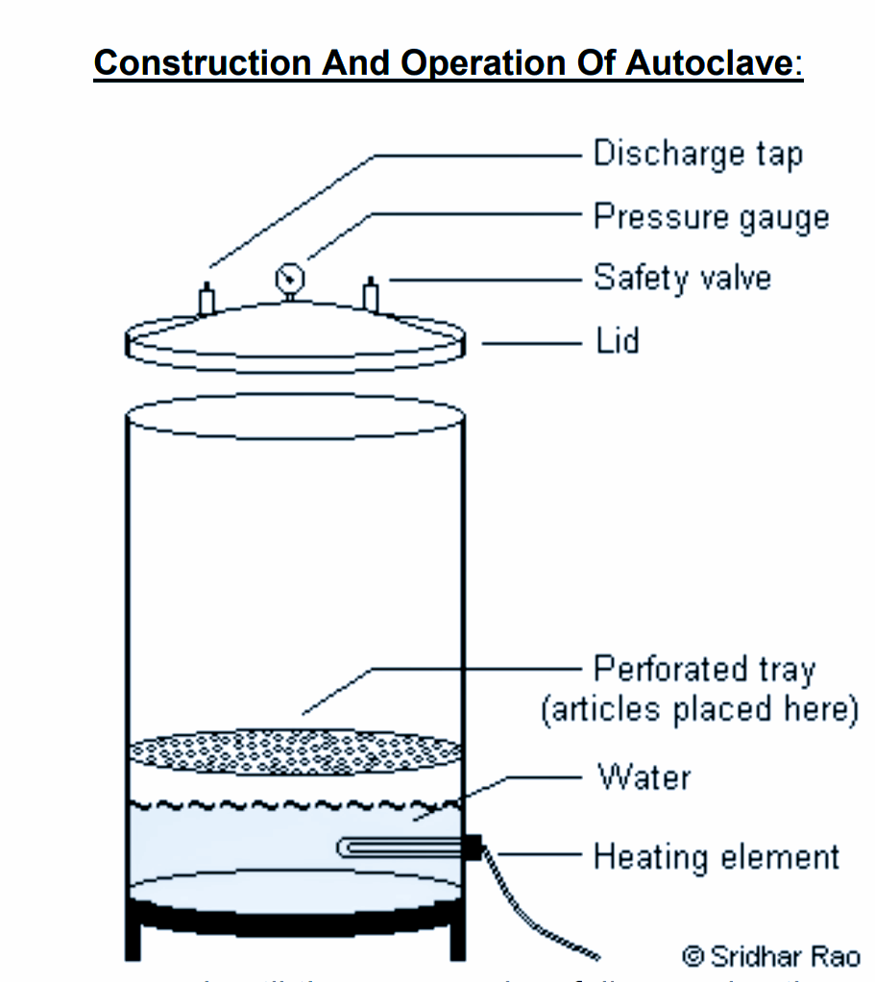

Slide 20
Drying
Moisture is essential for the growth of bacteria. Four-fifths of the weight of the bacterial cell is due to water.
Drying in air has, therefore, a deleterious effect on many bacteria. However, this method is unreliable.
Spores are unaffected by drying.

Slide 21
Filtration
Filtration does not kill microbes, it separates them out.
Membrane filters with pore sizes between 0.2-0.45 micrometer are commonly used to remove particals from solutions that cannot be autoclaved.
It is used to remove microbes from heat labile liquids such as serum, antibiotic solutions, sugar solutions, urea solutions.
The older filters made of earthenware or asbestos are called depth filters.

Slide 22
Radiation
Two types of radiation are used, ionising and non-ionising.
Non-ionising rays are low energy rays with poor penetrative power while ionising rays are high-energy rays with good penetrative power.
Since radiation does not generate heat, it is termed cold sterilisation.
Non-ionising rays: Rays of wavelength longer than the visible light are non-ionising.
Microbicidal wavelength of UV rays lie in the range of 200-280,with 260 nm being most effective.

Slide 23
UV rays are generated using a high pressure mercury vapor lamp.
Microorganisms such as bacteria, viruses,yeast etc.that are exposed to the effective UV radiation are inactivated within seconds.
Since UV rays don't kill spores,they are considered to be of use in surface disinfection.
UV rays are employed to disinfect hospital wards, operation theatres,virus laboratories, corridors etc.
Ionising radiation:X-rays, gamma rays and cosmic rays are highly lethal to DNA and other vital constituents.
They have very high penetrative power. Since there is no appreciable increase in temperature in this method, it is referred to as cold sterilisation.

Slide 24
Commercial plants use gamma radiation for sterilising items like plastics, syringes, swabs, catheters, animal feeds, cardboard, oils, fabric and metal foils.

Slide 25
References
Textbook of Medical Microbiology by Ananthnarayan, Paniker, D.R. Arora
Textbook of Medical Microbiology by C.P Baweja

