Slide 1
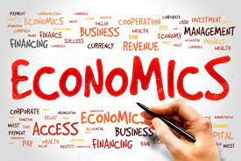
Supply- Meaning & Determinants
Dr. Pooja Singh Assistant Professor, Department of Economics, School of Arts ,Humanities And Social Sciences, Chhatrapati Shahu Ji Maharaj University, Kanpur

Slide 2
Supply- Meaning
Supply- Meaning & Determinants
Supply refers to amount of goods and services that the procedure are wiling to be sold in market at various price under certain market conditions during a period of time.
Two points are applicable to supply-
Supply refer to what firm offer for sale not necessarily to what they succeed in selling.
Supply is a flow process.

Slide 3
Determinants to supply-
Supply- Meaning & Determinants
Price of commodity
Price of related goods
Price of the factor of production

Slide 4
Estate of technology
Government policy
Other factors

Slide 5
Reference
Supply- Meaning & Determinants
Dwivedi D N, Managerial Economics, Vikas Publishing House Pvt. Ltd, 2006

