Slide 1
TABLET (UNIT -2)
PART -III
Mrs Kalpana
(Assistant Professor)
U.I.O.P, CSJMU
Kanpur-208019

Slide 2
TABLETTING: COMPRESSION
Tableting procedure
Filling
Compression
Ejection
Tablet compression machines
Hopper for holding and feeding granulation to be compressed
Dies decides the size and shape of the tablet
Punches to compress the granules within the dies
Cam tracks for guides the movement of the punches
Feeding mechanisms to move granules from the hopper into the dies

Slide 3
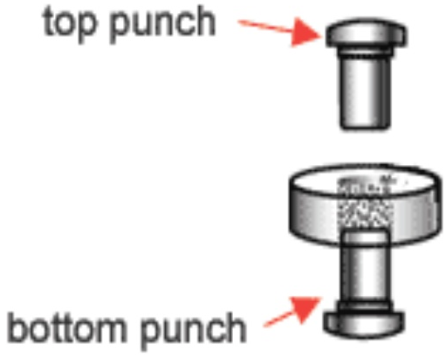
Types of Punching Machine
Single punch machine
The compression is applied by the upper punch
Stamping press

Slide 4
Multi-station rotary presses
The head of the tablet machine that holds the upper punches, dies and lower punches in place rotates•
As the head rotates, the punches are guided up and down by fixed cam tracks, which control the sequence of filling, compression and ejection.
The portions of the head that hold the upper and lower punches are called the upper and lower turrets
The portion holding the dies is called the die table
The pull down cam guides the lower punch to the bottom , allowing the dies to overfill.
the punches then pass over a weight-control cam (E) , which reduces the fill in the dies to the desired amount

Slide 5
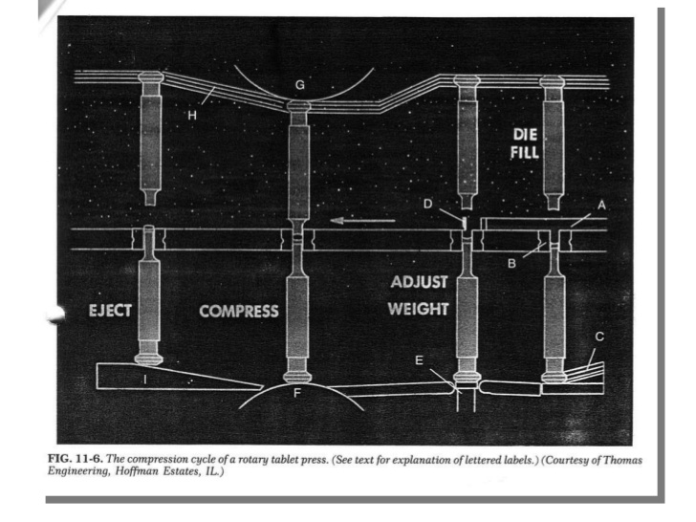
A swipe off blade (D) at the end of the feed frame removes the excess granulation and directs it around the turret and back into the front of the feed frame.

Slide 6
Tablet Compression Machine
Hopper: for holding and feeding granulation to be compressed
Dies:That decides the size and shape of the tablet
Punches: for compressing of granules within the dies
Cam tracks: for guiding the movement of the punches
Feeding mechanisms: for moving granulation from the hopper into the dies .

Slide 7
Working of compression machine
The upper punches enter a fixed distance into the dies, while the lower punches are raised to squeeze and compact the granulation within the dies
After the moment of compression, the upper punches are withdrawn as they follow the upper punch raising cam (H)
The lower punches ride up the cam (I) which brings the tablets flush with or slightly above the surface of the dies
The tablets strike a sweep off blade affixed to the front of the feed frame (A) and slide down a chute into a receptacle
At the same time, the lower punches re-enter the pull down cam (C) and the cycle is repeated

Slide 8
Recent equipments has been principle modifed from earlier equipment as a result there is an increase in production rate
Tablet Production rate is regulated by:
Number of compression stations
Number of tooling sets
Rotational speed of the press
Special adaptations of tablet machines allow for the compression of layered tablets and coated tablets
A device that chills the compression components to allow for the compression of low-melting point substances such as waxes i.e. suppositories

