Slide 1
TRANSFORMER
Aakanksha Bajpai
Assistant Professor
School of Health Sciences

Slide 2
INTRODUCTION
The transformer is a static device which is used to transfer electrical energy from one ac circuit to another ac circuit.
Input to a transformer and output from a transformer both are alternating quantities (AC).
Electrical energy is generated and transmitted at an extremely high voltages. The voltage is to be then reduced to a lower value for its domestic and industrial use.
This is done by using a transformer.

Slide 3
The power transmission system using transformers is shown in figure.
When the transformer changes the voltage level, it changes the current level also.

Slide 4
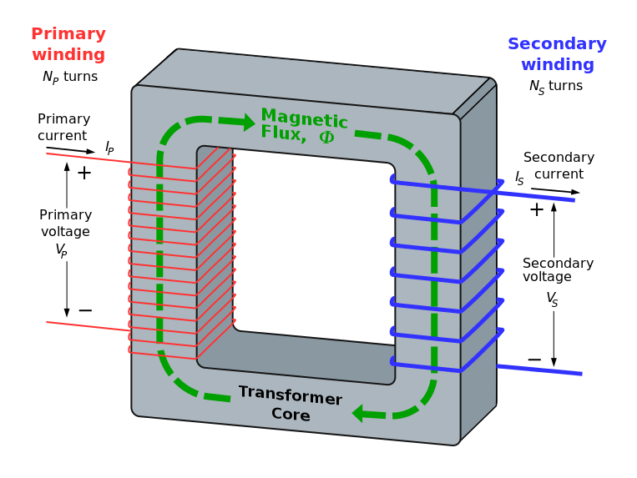
The primary winding is connected to the ac supply, an ac current starts flowing through it.

Slide 5
The ac primary current produces an alternating flux (Ф) in the core.
Most of this changing flux gets linked with the secondary winding through the core.
The varying flux will induce voltage into the secondary winding according to the faraday’s laws of electromagnetic induction.
There is no electrical contact between the two winding, an electrical energy gets transferred from primary to the secondary.

Slide 6
A simple transformer consists of two electrical conductors called the primary winding and the secondary winding.
Energy is coupled between the windings by the time varying magnetic flux that passes through( links) both primary and secondary windings.

Slide 7
The transformer action does not take place with a direct current of constant magnitude.
Because with a DC primary current, the flux produced in the core is not alternating but it is of constant value.
As there is no change in the flux linkage with the secondary winding, the induced emf in the secondary is zero.

Slide 8
If DC is applied to the primary then there is a possibility of transformer core saturation.
If core saturates the primary will draw excessively large current. Therefore application of DC should be avoided.

Slide 9
The transformer are of different types-
Static transformer
Variable transformer
Autotransformer
The magnetic core is a stack of thin silicon-steel laminations. In order to reduce the eddy current losses, these laminations are insulated from one another.

Slide 10
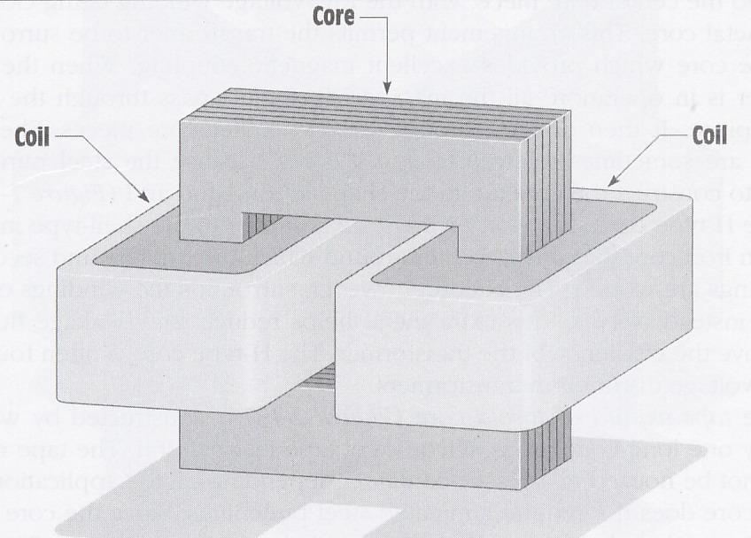
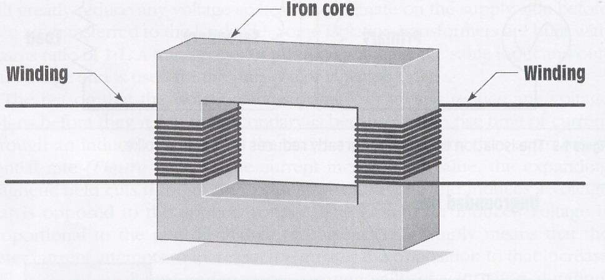

Slide 11
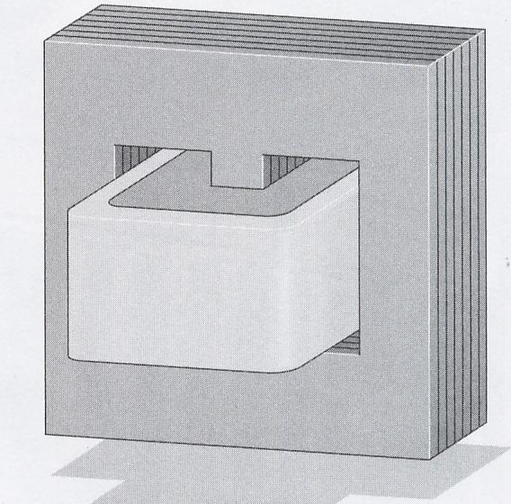
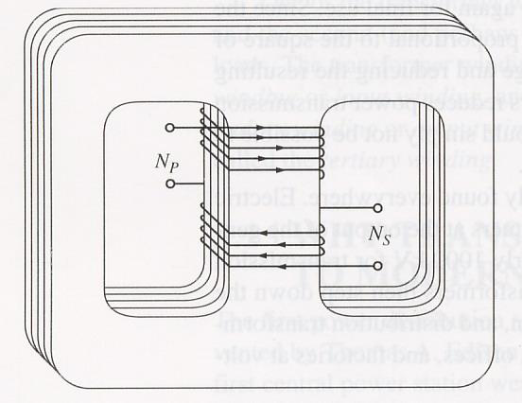

Slide 12
Principle
A transformer is based on the principle of mutual induction, i.e. whenever the amount of magnetic flux linked with the coil changes, an emf is induced in the neighbouring coil.

Slide 13
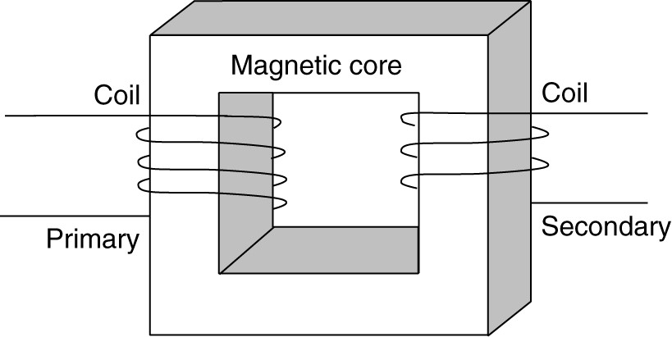
Construction
It consists of two coils of insulated wire, the primary and the secondary coils, wound on a laminated soft iron core. The coils are completely insulated from each other and one usually contains more turns of wire than the other. The frame is often rectangular in shape and the coils may be wound on opposite bars of the frame or one on top of the other on a central bar.

Slide 14
Static TRANSFORMER
The static transformer is based on the principles of electromagnetic induction and is used to alter voltage of an alternating current and to render the current earth free.

Slide 15
Working of the static transformer
An alternating current is passed through the primary coil and sets up a varying magnetic field, which cuts the secondary coil and induces an EMF in it. It is essential that the primary current varies in intensity; otherwise, there is no movement of the magnetic field relative to the conductor and no EMF is induced in the secondary coil. There is no electrical conduction between the primary and the secondary coils, the energy being transmitted from one to the other by electromagnetic induction. The core serves to concentrate the magnetic field and is made of soft iron, as this material is easily magnetized and demagnetized. It is laminated to prevent eddy currents.

Slide 16
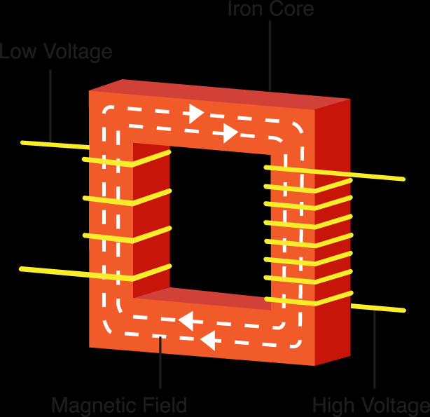
Functions of the static transformer
Alters the voltage of an alternating current: The EMF induced in the secondary coil depends upon the number of turns of wire it has, relative to the primary coil. Depending on this number of turns, the transformers can be classified as:
Step-up transformer- If the number of turns in the secondary is more than that of the primary, the voltage developed in the secondary will be increased or stepped up. Such a device is called a step-up transformer.

Slide 18
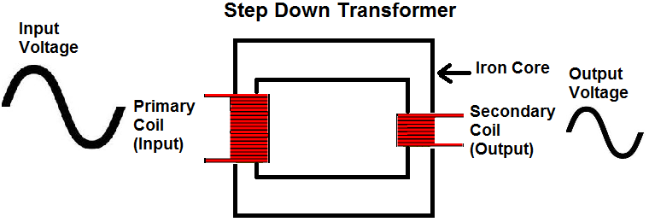
Step-down transformer- If the secondary coil has fewer turns than the primary, then the EMF, or voltage in the secondary will be less than in the primary, i.e. it is stepped down. Such an arrangement produces a step-down transformer.

Slide 19
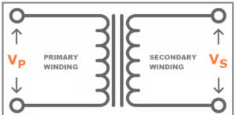
Even ratio transformer- If the number of turns in the primary and secondary coils is the same, the voltage in the primary is the same as that of the secondary. Such a device is called an even ratio transformer.

Slide 20
Renders a current earth free: If an accidental connection is made between live wire and earth, current will flow to earth as short-circuited current. If this connection were made through persons, they would then receive earth shock, as the current flows through them to earth. The static transformer reduces this danger by using electromagnetic induction, to transfer the electrical energy into the secondary coil, where earth plays no part in the circuit. The effect on the secondary coil of the magnetic field around the primary is to cause electrons to move around the secondary circuit, but not to leave it. Earth plays no part in the secondary circuit, because, even if an earth connection is made with it, electrons will not leave the circuit, but will continue to flow around it. This is an important safety factor and that all currents applied to patients are rendered earth free by using a static transformer.

Slide 21
VARIABLE TRANSFORMER
This consists of a primary and a secondary coil and is made so that one of them can be altered in length. The primary coil has a number of tappings and a movable contact can be placed on any one of these by turning a knobs. There is a step up voltage in the secondary coil. In this way, a very crude control of voltage is obtained.

Slide 23
AUTOTRANSFORMER
It consists of a single coil of wire with four contact points coming from it. It works on the principles of electromagnetic induction, but it has the disadvantage that it allows only a small step up and does not render the current earth free.

Slide 24
Uses of Transformer
A transformer is used in almost all a.c. operations, e.g.
In voltage regulators of TV, refrigerator, computer, air conditioner, etc.
In the induction furnaces
A step down transformer is used for welding purposes.
In the transmission of a.c. over long distances.

Slide 25
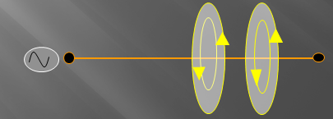
EDDY CURRENTS
Eddy currents are created through a process called electromagnetic induction.
When alternating current is applied to the conductor, such as copper wire, a magnetic field develops in and around the conductor.

Slide 26
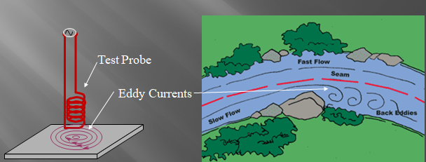
Eddy currents are induced electrical currents that flow in a circular path. They get their name from “eddies” that are formed when a liquid or gas flows in a circular path.

Slide 27
When an alternating magnetic field is applied to a magnetic material, an emf is induced in the material itself according to Faraday’s Law of Electromagnetic induction. Since the magnetic material is a conducting material, these EMFs circulate current within the body of the material.
These circulating currents are called Eddy Currents. They will occur when the conductor experiences a changing magnetic field.
As these currents are not responsible for doing any useful work, and it produces a loss in the magnetic material known as an Eddy Current Loss. Eddy current loss increases the temperature of the magnetic material.
Eddy currents are used to produce heat in the patient’s tissue, in the inductothermy method of SWD.

Slide 29
If the core is made up of solid iron of larger cross-sectional area, the magnitude of current will be very large and hence losses will be high. The magnitude of the current can be reduced by splitting the solid core into thin sheets called laminations. By laminating the core, the area of each section is reduced and hence the induced emf also reduces.

Slide 30
Thank You

